Slide 1
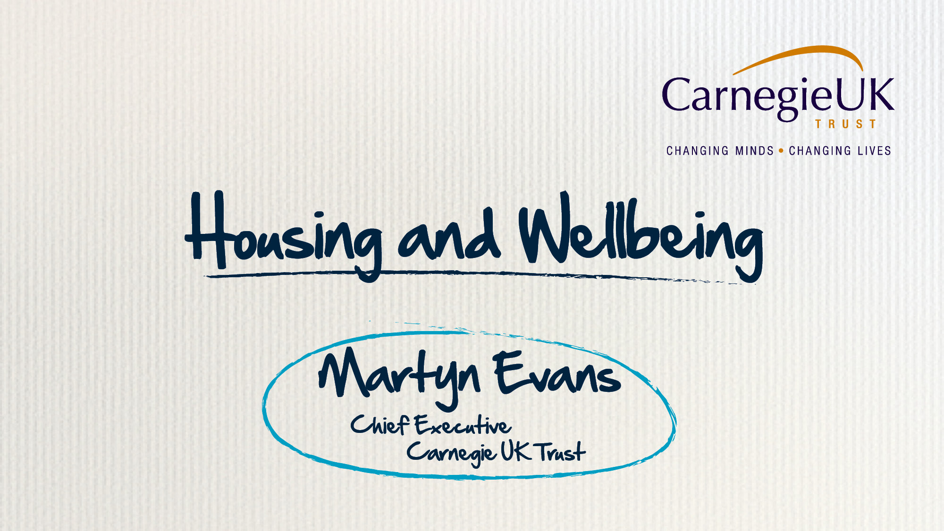

Slide 14
Notes:
Enabling State project works with SJE
3 propositions
Worked ok for most of us
Always failed the same people over and over
2000s showed us that throwing money at these problems isn’t the answer – not about more of the same
We disagree – the challenge is ours as citizens and communities, we can and will use our assets to meet that challenge.

Slide 32
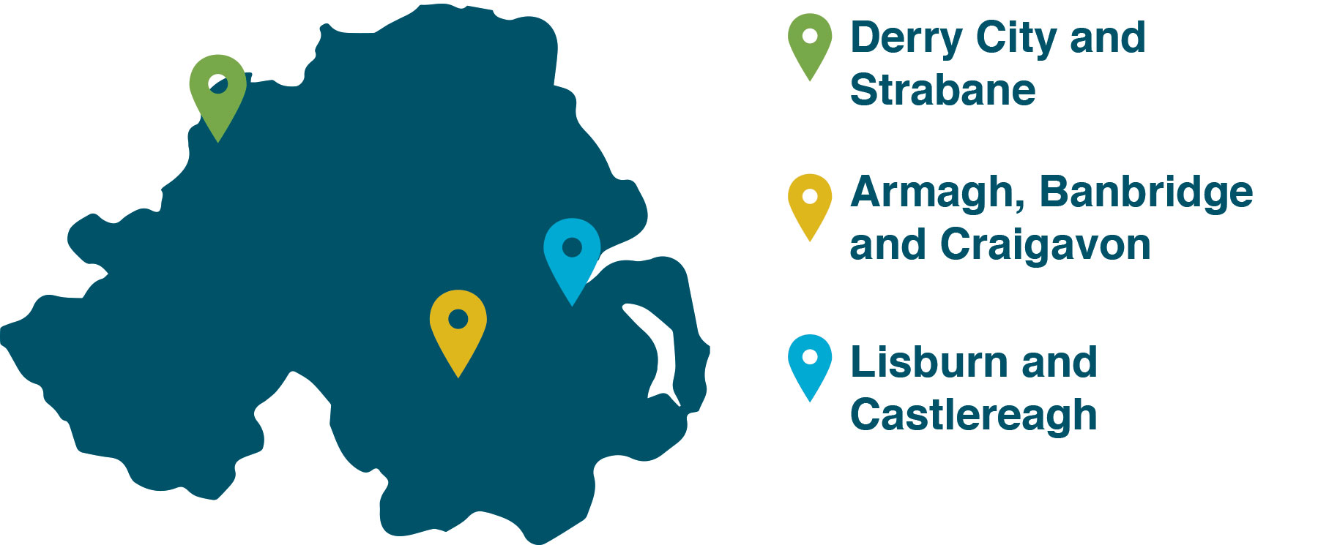
Project Participants
Embedding Wellbeing in Northern Ireland

Slide 33
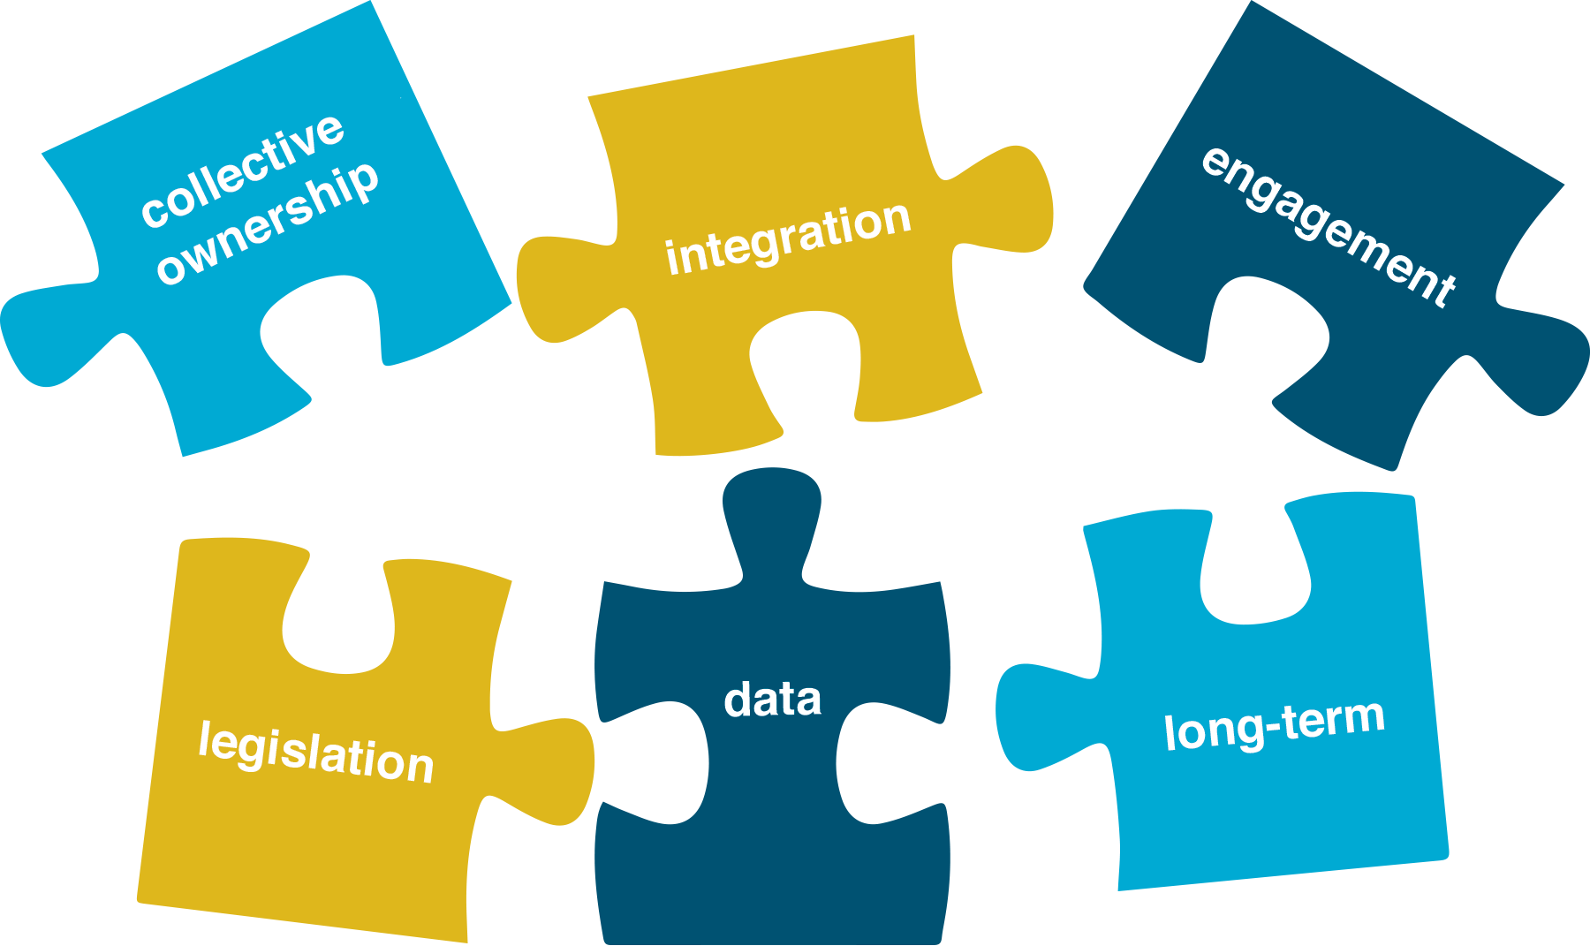
Challenges
Embedding Wellbeing in Northern Ireland
Notes:
Promoting collective ownership of the Community Plan
Integrating the cross-cutting themes
Continually engaging with local communities and delivering on expectations
Absence of a legislative and political ‘push’ behind the process
Developing a more strategic outlook with long-term resources allocated
Identifying, collecting and using data

Slide 35
Next Steps
Embedding Wellbeing in Northern Ireland

