Slide 1
‘Transforming East Ayrshire - Our Vibrant Journey to People Powered Transformation’

Slide 2
“East Ayrshire will be a place with strong, vibrant communities
where everyone has a good quality of life and access to opportunities, choices and high quality services which are sustainable, accessible and meet people’s needs.”
The vision of East Ayrshire Community Planning Partnership

Slide 3
Transforming our Relationship
Why Re-focus?
Drop in funding available to public sector
Changes in demography
Increase in demand
Listening to our communities and stakeholders
Widening inequalities gap
Welfare Reform
EAC Transformation Strategy 2014-2017 Saved £34m
Transformation 2018-2022- Save further £32m
Christie Commission

Slide 4
Our solutions are often not fit for purpose…

Slide 5
Our solutions are often not fit for purpose…

Slide 6
Changing culture, hearts and minds ... Our own, our colleagues, our communities
Changing culture ... Our own, our colleagues, our communities
Then … | Now …
Focus on Deficiencies | Focus on Assets
Problem Response | Opportunity Identification / Solution Focus
Charity/ Grants Orientation | Investment Orientation
Power skewed towards professionals | Power more equally balanced between community, individual and professionals
More Services | Fewer Services
Dependence, isolation and loneliness | Being part of communities, Companionship Increased social networks
Focus on Individuals | Focus on communities/neighbourhoods
Maintenance | Development
See People as Clients and Customers | See People as Citizens, Neighbours and Co-producers
‘Fix People’ | Develop Potential
Programmes/ Projects are the Answer | People are the Answer

Slide 7
Vibrant Communities
Unlocking Gifts
Established April 2013- Saved over £2m by 2018
Harnessing the talents, skills and experience of over 100 front facing employees, our communities and stakeholders!- extended to over 850 Housing and Communities employees
Whole system change across our organisation, our communities, our partners
Co-production; valuing local people & recognising them as assets; building social networks; promoting reciprocity and inclusion & equality.
Reduced bureaucracy and red tape
A positive and transformed relationship with our workforce and our communities
Christie and Community Empowerment in action!

Slide 9
Why Re-focus?
The Vibrant Effect- Changing Hearts and Minds- in our council, with partners and in our communities!
“
.
Major culture change across the Housing and Communities Service- Over 850 frontline staff focus on serving our communities
‘Putting people at the heart of everything we do’!
Live Crowdsourcing
Hackathons- Our Street exercise
Big idea and transformation events
A focus on coaching and leadership at every level
Good News Stories
Serving Our People- self led employee group
Drop in funding available to public sector
Changes in demography
Increase in demand
Listening to our communities and stakeholders
Widening inequalities gap
Welfare Reform
National Drivers for change

Slide 10
Focus on skills and talents not job descriptions
Kind, servant leadership at all levels
Empowered and Solution focused
Develop self managed teams
Creativity and innovation
Simplifying approaches and processes
Every decision puts ‘people at the heart of everything we do’

Slide 11
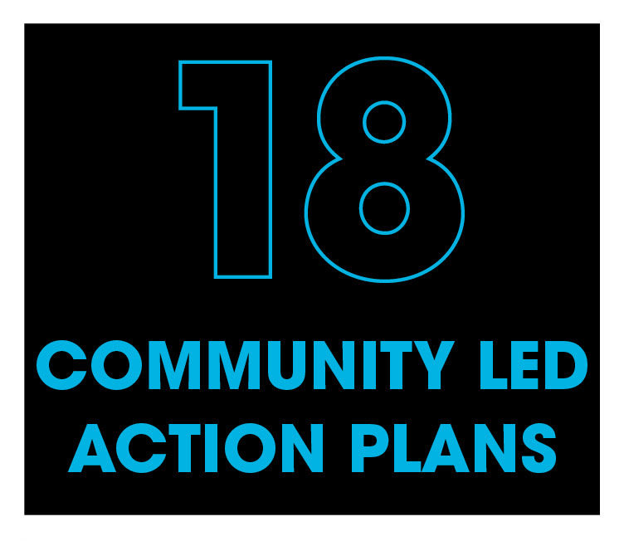
Key Achievements
50
£220,000
Notes:
The introduction of a Vibrant Communities Service is the first step towards achieving this transformation; bringing the majority of community development services into one new and refreshed team has brought about immediate improvements in relationships with individuals and communities, and will enable us to:
Improve consistency in our approach across the council to building capacity of and empowering communities ensuring services are built around people and communities;
Offer coordinated, flexible, specialist support to communities;
Use our combined strengths and being more visible within communities;
Maximise the application of valuable specialist skills and ensure concerted and sustained action to address (vulnerability and) need with individuals and communities;
Ensure employee (empowerment and) flexibility to offer more responsive action which supports community aspirations;
Provide strong, visionary and effective leadership to manage the change process and facilitate the transformation across the organisation, partnerships and within our communities;
Employ creativity, innovation and joint working across council services, departments, partnerships and within communities; and
Reduce costs but deliver best value for the people and communities we serve.

Slide 12
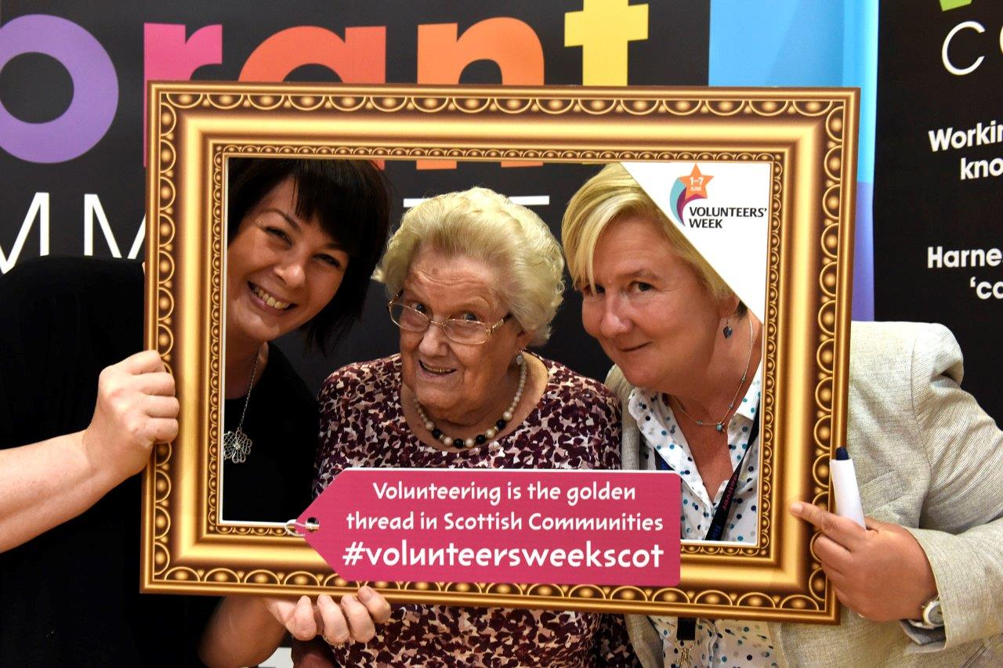
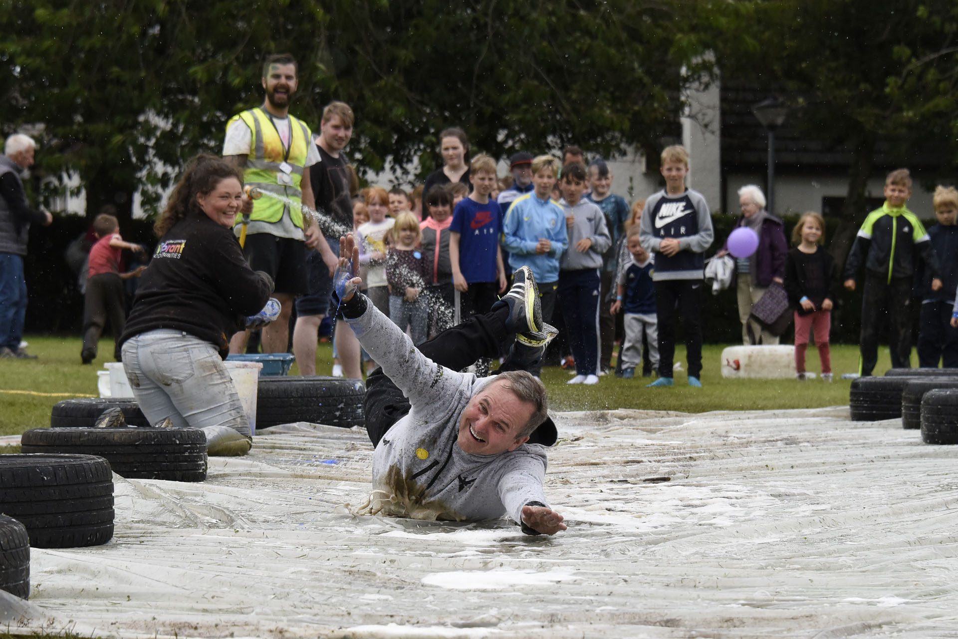
Key Achievements

Slide 13
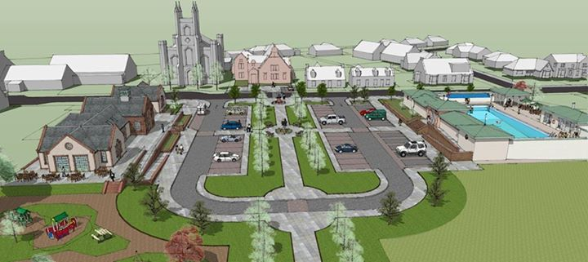
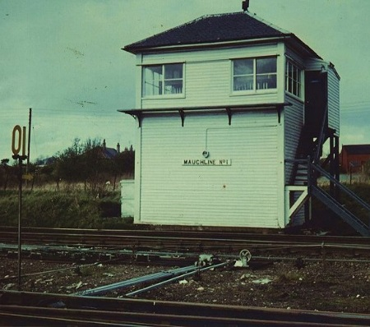
Community Led Action Plans

Slide 14
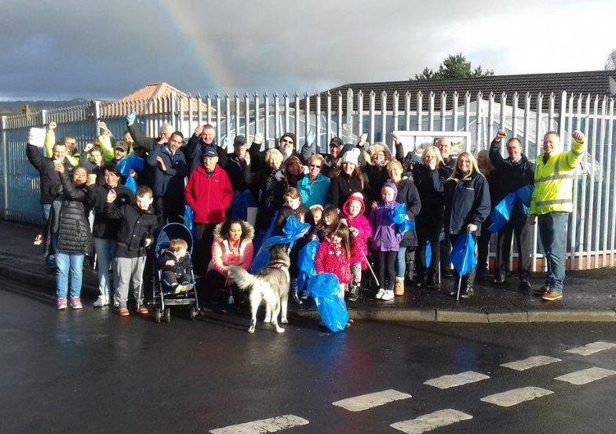
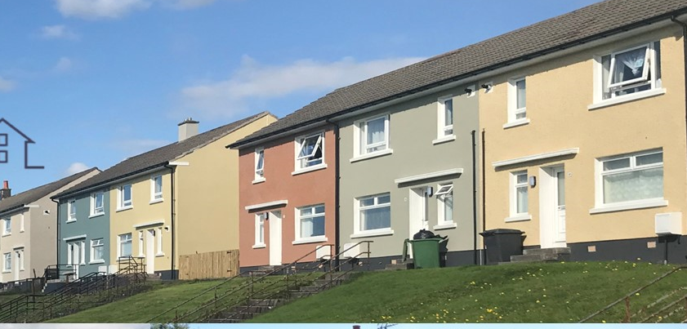
FUTURE HOMES- OUR VIBRANT, COMMUNITY LED APPROACH
A strong focus on People and Place Ensuring sustainable, affordable and good quality homes now and in the future Ensuring our homes meet the needs of the people we serve Developing and regenerating strong and vibrant communities in partnership with our people
Embedding our Clean Green and Vibrant Approach

Slide 15
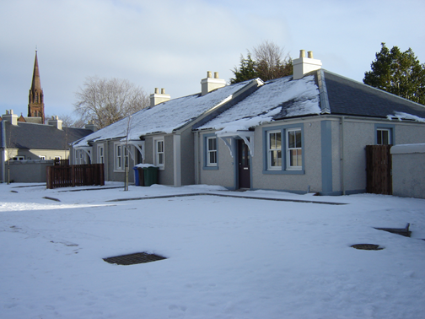
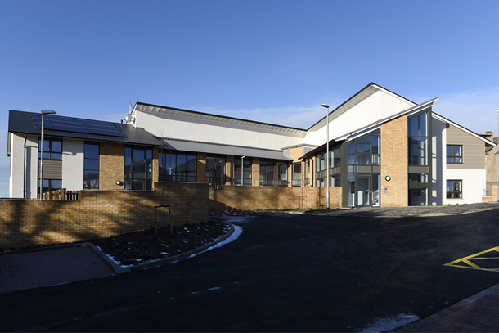
FUTURE HOMES- OUR VIBRANT, COMMUNITY LED APPROACH
£131m programme of investment over 5 years Building over 600 new houses including supported living
Working with a preferred partner using offsite construction.
Local investment of Community benefits and rebate Large scale improvement programme involving communities at every stage

Slide 16
Volunteer framework
Community Engagement Framework
Tenants and residents fed
Employee supported volunteering
Play forum
Communities Forum
Befriending
Disability Partnerships
Sports council
LGBT+ Forum
Full of life older people hubs
Young Peoples Cabinet
Building a Strong Sustainable Community Led Infrastructure

Slide 17
Harness the opportunities linked to the Community Empowerment Legislation
Further embed and share the Vibrant approach across the workforce, in our communities and with other councils
Focus on simplification and Integration
Increasing natural, inclusive supports and connections for most vulnerable people to reduce the need for formal interventions
Creating and enabling the conditions for people powered transformation!

Slide 18
Focus on the people we serve and the people we lead …..unlock skills and talents……….. connect…..collaborate……empower

Slide 19
A Time for Change
“This is not solely a matter of fiscal necessity but a once in a generation opportunity to implement radical reforms that will provide improved public services that are better focused on the needs of the people it seeks to support”
Commission on the Future Delivery of Public Services

