Slide 1
Tackling Housing Challenges Together Councils in Northern Ireland: Rising to the Challenge
Lagan Valley Island
Lisburn & Castlereagh City Council
Wednesday 19th September 2018
Notes:
Need a new picture for the “Wake”...

Slide 2
So what do councils in Northern Ireland DO anyway?
How are we different from other places?
What has changed since 2015?
What difference does that make?

Slide 3
Community Planning and Housing
Community Planning – what’s the big deal?
How is that going to work?
What difference is it going to make on housing challenges?
Are the local development plans not more important?

Slide 4
Community planning and well-being - prioritisation

Slide 5
Housing as a cross-cutting well-being issue
Social
Economic
Environmental
What are the key outcomes for Northern Ireland?
What are the key outcomes at council level?

Slide 6
Collaboration
How can (and why should) councils lead on community planning?
What does collaboration look like in council-led community planning?
How does that help address housing challenges?

Slide 7
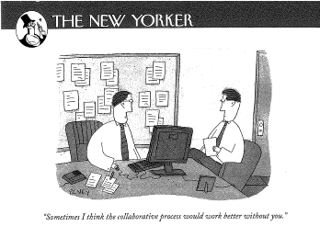

Slide 8
Effective Collaboration – are we there yet?

Slide 9
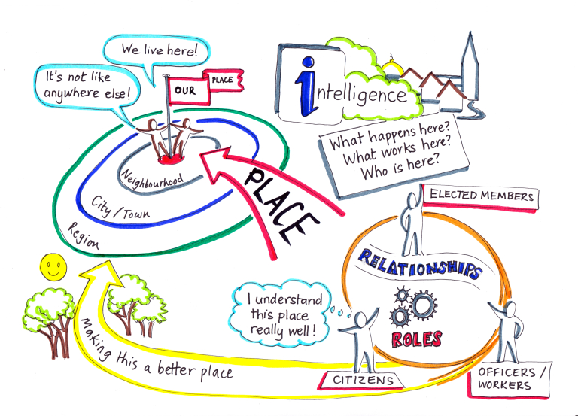

Slide 10
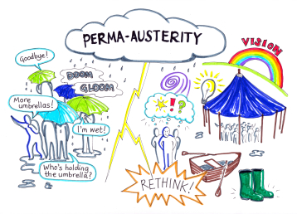

Slide 11
Thank You
Karen Smyth
Head of Policy and Governance
k.smyth@nilga.org
Notes:
Need a new picture for the “Wake”...

