Slide 1
TACKLING HOUSING TOGETHER
Elma Newberry
Assistant Director Regional Services

Slide 2
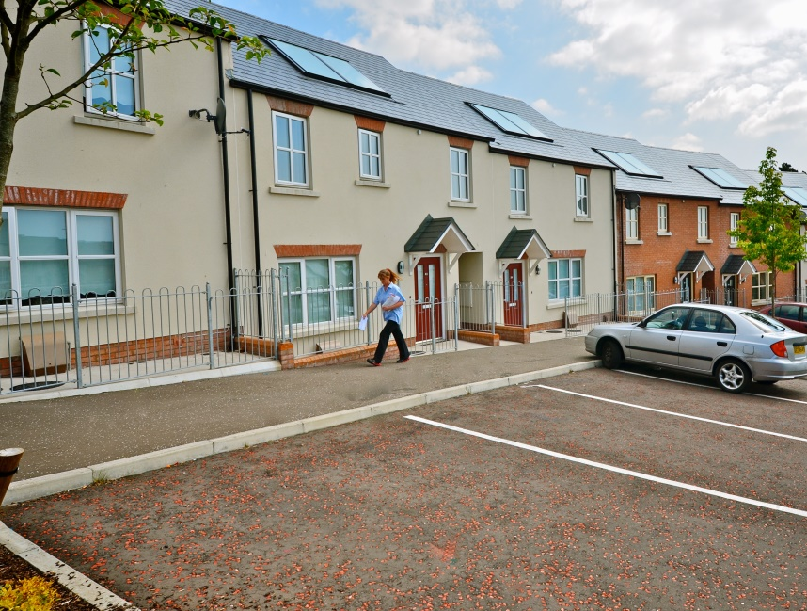
Our Mission
To ensure the provision of all forms of housing in sustainable neighbourhoods across Northern Ireland
Analysis of Housing Need
Planning Opportunities
Future Supply

Slide 3
NI Waiting List Trends 2013 to 2018

Slide 4
Social Housing Need Assessment
Strategic Guidelines
Commissioning Document
Social Housing
2018/19
1850 target
Net Stock Model total 2,000

Slide 5
Demographic
Since 2007/8, the year of the financial crash, population has risen by 5% to 1.87 million.
Total net migration has fallen dramatically (84%) since 2007 – 7714, and down to 1175 in 20171/8.
2012 based household projections indicated a much lower level of household formation. However, NISRA estimate MORE concealed families. New household projections this Autumn.
Reducing numbers of new households projected as more people are living at home with parents longer. .
Aged 65+ increased by 61k (25%) - with those aged 85+ increasing by 33% to 37k since 2007/8.
Average household size has stabilised (2.57)
Longer—term trends are now towards increasing single and two person households. .

Slide 6
Owner Occupation
Drop in the rate of construction from 14,000pa in 2006/07 to just over 7100 pa in 17/18.
Owner occupied stock numbers remain static in relation to population / household growth.
Stricter lending criteria and accessing finance, easing but still inaccessible to many.
No significant improvement in affordable housing supply. Underlying patterns of private renting as a tenure choice.
Lending criteria is easing but still inaccessible for many.

Slide 7
Private Rented
Tenure share for private renting of 18% in 2016 (HCS). Private renting has remained at this level since the pre-crash investor-driven boom.
Increasing numbers of young professionals / first-time buyers unable to afford their first home are now renting privately.
Volume of private rented transactions at Q2, in 2017 was 8627 compared to Q2, 2014 was 12,060. A decrease of 28% (Ulster University ).

Slide 8
Community Planning
NIHE as Statutory Partner in Community Planning / Local Development Plans.
Place Shaping.
Housing Market Analysis – 15 year projections.
Specific use of Strategic Planning Policies – PP S12 (Social), PPS21 (Rural), PPS8(Open Space).

Slide 9
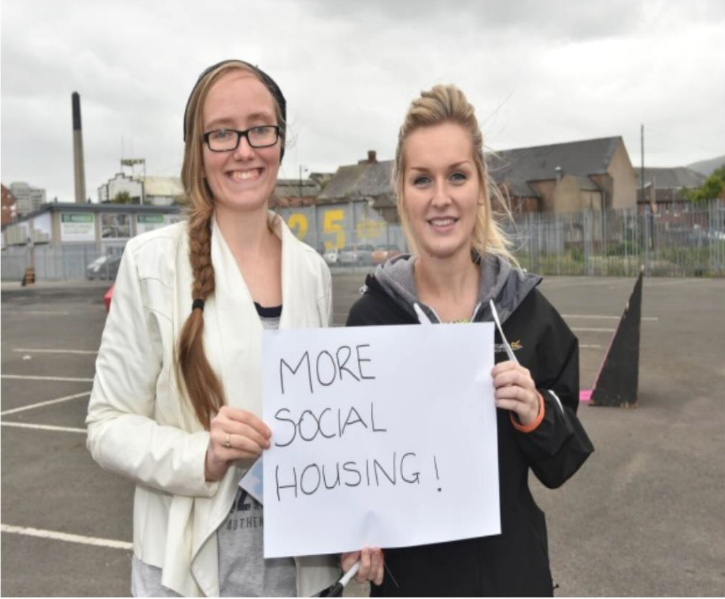
Future Supply
Public Land for Housing
NIHE land terrier
Collaboration with Local Councils
Mixed Tenure/ Mixed Use Regeneration Schemes
Posnett Street, Belfast

Slide 10
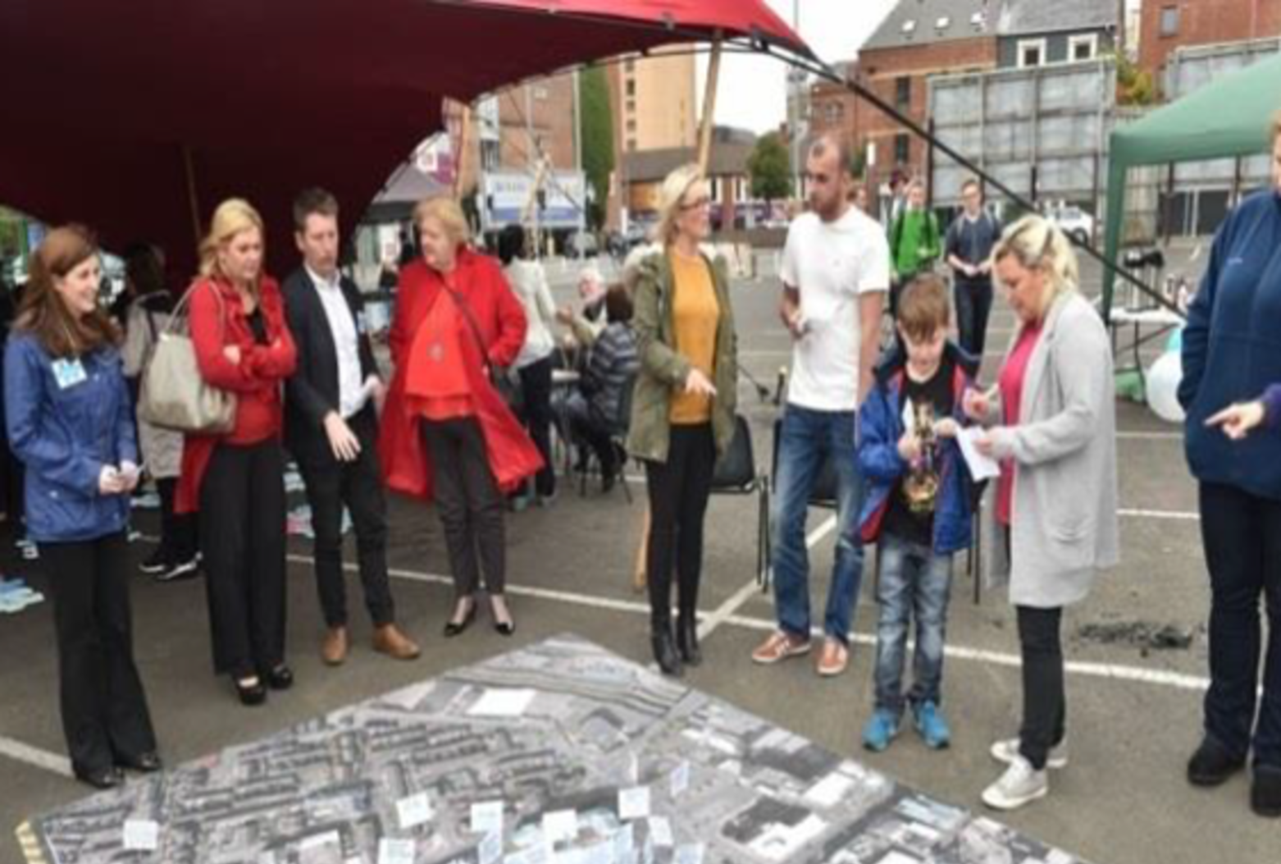
Conclusion
Growing demand
Innovative solutions
Collaborative approaches

Slide 11
Thank you!

