Slide 1
Renters’ Voice:
Cost of Living Crisis
Survey Findings
November 2022 Jenni Millar and Brigitte Anton

Slide 2
Who are Renters’ Voice?
Renters’ Voice is a project for people renting from a private landlord or letting agent who want to improve things for private tenants in Northern Ireland.

Slide 3
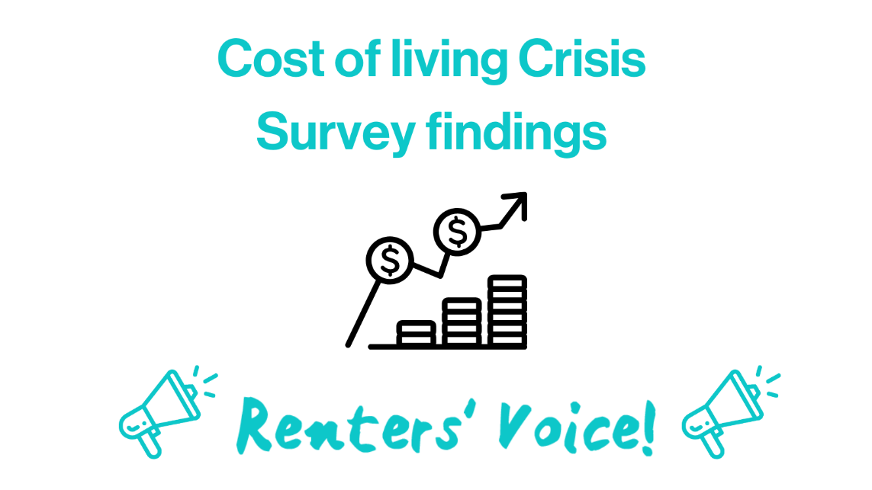
Cost-of-living Crisis
Renters’ Voice designed a survey to see how private renters in Northern Ireland have been impacted by this cost-of-living crisis so far.
The findings provide us with powerful, personal testimony.

Slide 4
People cannot afford their homes
Around half of respondents reported spending 40% or more of their income on rent.

Slide 5
“There is very little affordable housing. We are renting a property which is too expensive because there is nothing else available”

Slide 6
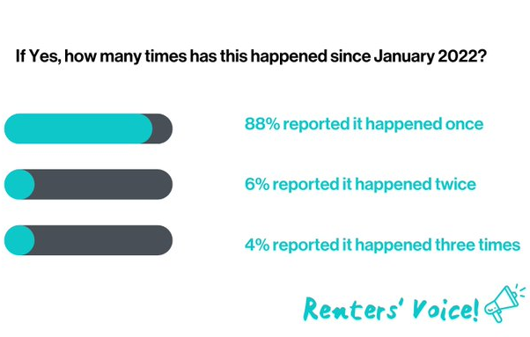
Rents are rising

Slide 7
“If my rent was to go up further, me and my family will end up homeless”
One respondent reported that their rent was £550 per month in 2021. They are now paying £750 per month for the same property. The respondent reported that the owner had carried out zero repairs or upgrades to the house during this period to warrant an extra £2400 per year.

Slide 8
Money is a constant worry
97% of respondents reported they were worried about their ability to pay their bills; 44% reporting they were extremely worried.

Slide 9
“We can’t afford much after bills and are still trying to pay off debts”

Slide 10
Health is being affected
Another 28% said they were worried their health will begin to suffer if things continue the way they are.

Slide 11
“Anxiety at all-time high”
"Constant worry of finances has impacted my mood on a-daily-basis"
"I can’t afford to visit my hometown and family and I am homesick"
"Sleepless nights worrying about paying bills”
"I am now medicating for anxiety and depression"

Slide 12
Action is needed now

Slide 13
“We need a government. A functioning Stormont”
We asked private renters what would immediately help them most during this cost-of-living crisis:
Majority of respondents wanted to see:
some form of government rent control introduced
government schemes / vouchers introduced to help with energy costs

Slide 14
“I don’t believe voucher or 1 off payments are supportive in getting people onto a better footing. We need long term support through social security and support for excess rent”

Slide 15
Thank you
For our full report email: RentersVoice@housingrights.org.uk
Please follow us on Twitter: @RentersVoice
Any questions?

