Slide 1
Promoting wellbeing & tackling housing challenges The role of Government
Louise Warde Hunter

Slide 2
Programme for Government

Slide 3
“Collaborative working across departments to achieve impact. Local government dimension to delivery through partnership working, community plans that respond to the needs of their areas. All community plans linked to the outcomes contained in the framework.”

Slide 4
PfG Outcomes & population indicators
8 - We care for others and we help those in need
Indicator 8 - Number of households in housing stress
11 - We connect people & opportunities through our infrastructure
Indicator 48 - Gap between the number of houses we need, and the number of houses we have

Slide 5
Programme for Government –Stress & Supply
Delivery of New Social & Affordable Housing
Reform of the NIHE Landlord
Housing Options Service
Homelessness Strategy
Supporting People Programme
Public Land for Housing Project
Delivery of Shared Housing & Good Relations
Improving Access to Suitable Housing
Private Rented Sector Review Implementation

Slide 6
Affordable Housing
Principal delivery partner for affordable housing has and continues to be Co-Ownership.
Delivery of over 27,000 affordable homes, with a further 3,750 homes planned for this PfG period.
Planned new affordable homes products with Housing Associations.
Two pilot schemes - Rent to Own and the Affordable Homes Loan Fund schemes.
Continue to scope out the potential to deliver more innovative affordable homes products utilising new funding schemes, such as Financial Transactions Capital loans.

Slide 7
Public Land For Housing Project
The Public Land for Housing Project recommended by DfC Housing Supply Forum
DfC Housing Division lead the project with SIB colleagues
Digitally map all registered public sector land & property to identify unused or underused land for housing
PfG target to release 10 large public sector sites for housing by 2021

Slide 8
Supporting People Programme
Annually provides support to 18,500 vulnerable people
2015 Review – 13 recommendations
Cross Departmental Steering Group

Slide 9
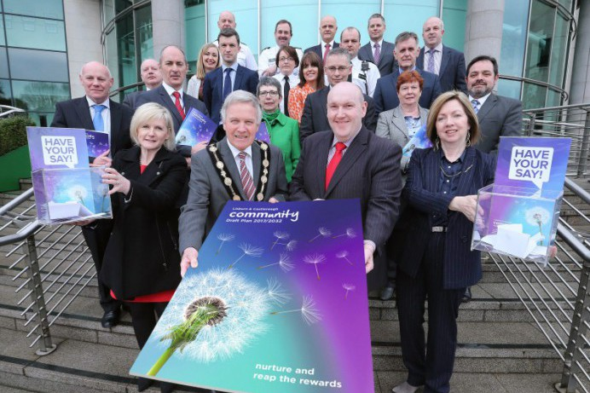
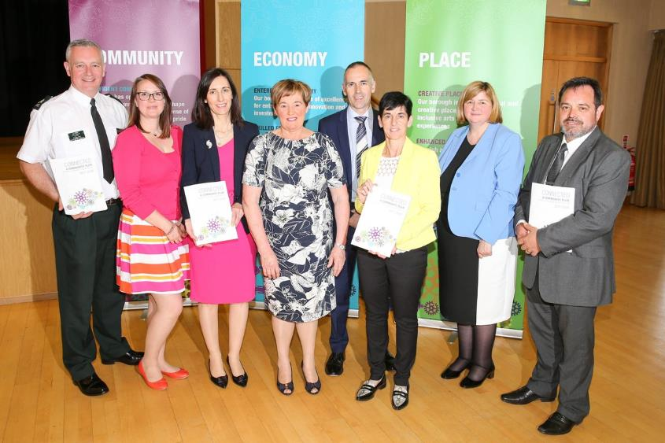

Slide 10
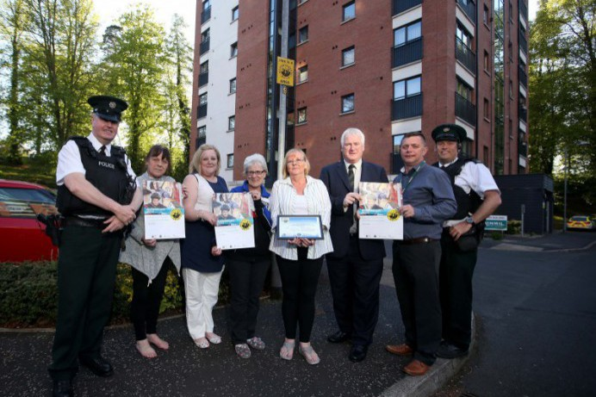
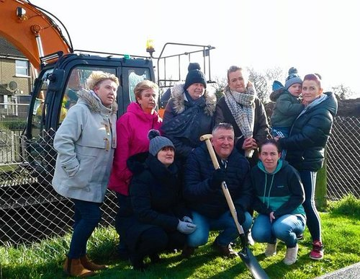

Slide 11
Partners
NI Housing Executive
Community representatives;
DfC Housing Group;
Housing associations;
LCCC;
Private sector – landlords, agents.
Identify land for housing :
Local Development Plan
Housing needs - older people; mobility & disability; prices & tenures
Building standards & LDP policy

Slide 12
Coming together is a beginning, keeping together is progress. Working together is success.
Henry Ford

Slide 13
Challenge Questions
1. How can your organisation use Community Planning to make collaborative gains?
2. How can we communicate better with partners and citizens?
3. How can we address cultural change and resource commitment?
Notes:
Community planning is still a relatively new structure in Northern Ireland and we should recognise that there are obstacles to its success. Partnership is easy in theory but harder to put into practice.
Therefore in closing, I would like to pose some questions on the challenges around Community planning which might inform our Question and Answer section.
1. How can your organisation use Community Planning to make collaborative gains?
2. How can we communicate better with partners and citizens?
3. How can we address cultural change and resource commitment?
Thank you

