Slide 1
Tackling Housing Challenges Together – Collaboration Community Planning and the Wellbeing Agenda
Re-Thinking Engagement: Lessons from home and opportunities ahead
Dr Louise O’Kane, Community Places
19 September 2018

Slide 2
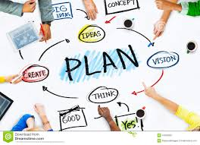
Community Places
Planning Advice to groups and individuals
Community and Stakeholder Engagement
Support Community Planning
Notes:
Funded by Department for Infrastructure which recognises the right of disadvantaged people and communities to have access to independent advice

Slide 3
BCT Civic Activism Programme
To raise awareness of the power of Community Planning
Create opportunities for people to get involved
Help to build good working relationships and networks
Notes:
Councils and partners must seek participation of and encourage ‘persons’ to express views and take them into account.
Persons : residents, service users, groups, businesses.
Local Government Act (2014)

Slide 4
What are the benefits?
Opportunity to influence and shape local services
Identify local needs and priorities
Widen participation and improve wellbeing
Improve public service design and delivery
Build effective relationships
Increases trust
More active citizens and communities

Slide 5
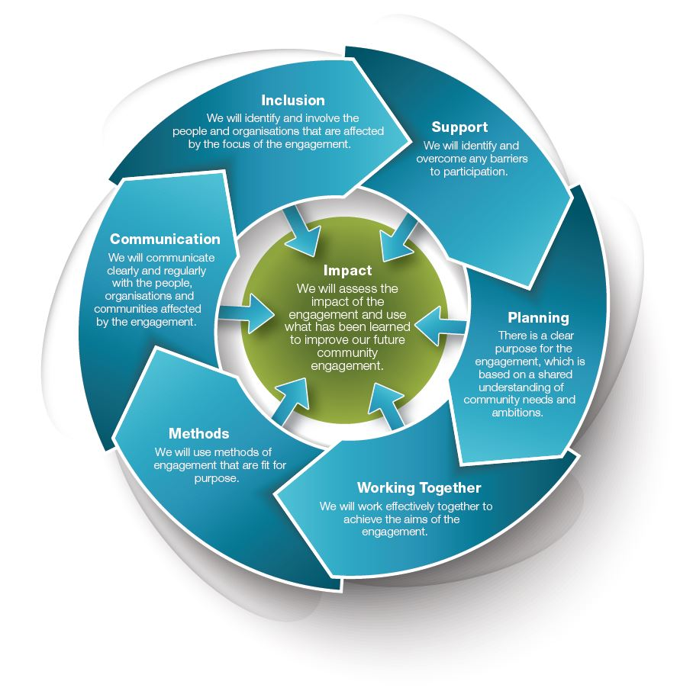
Scottish National Standards for Community Engagement SCDC

Slide 6
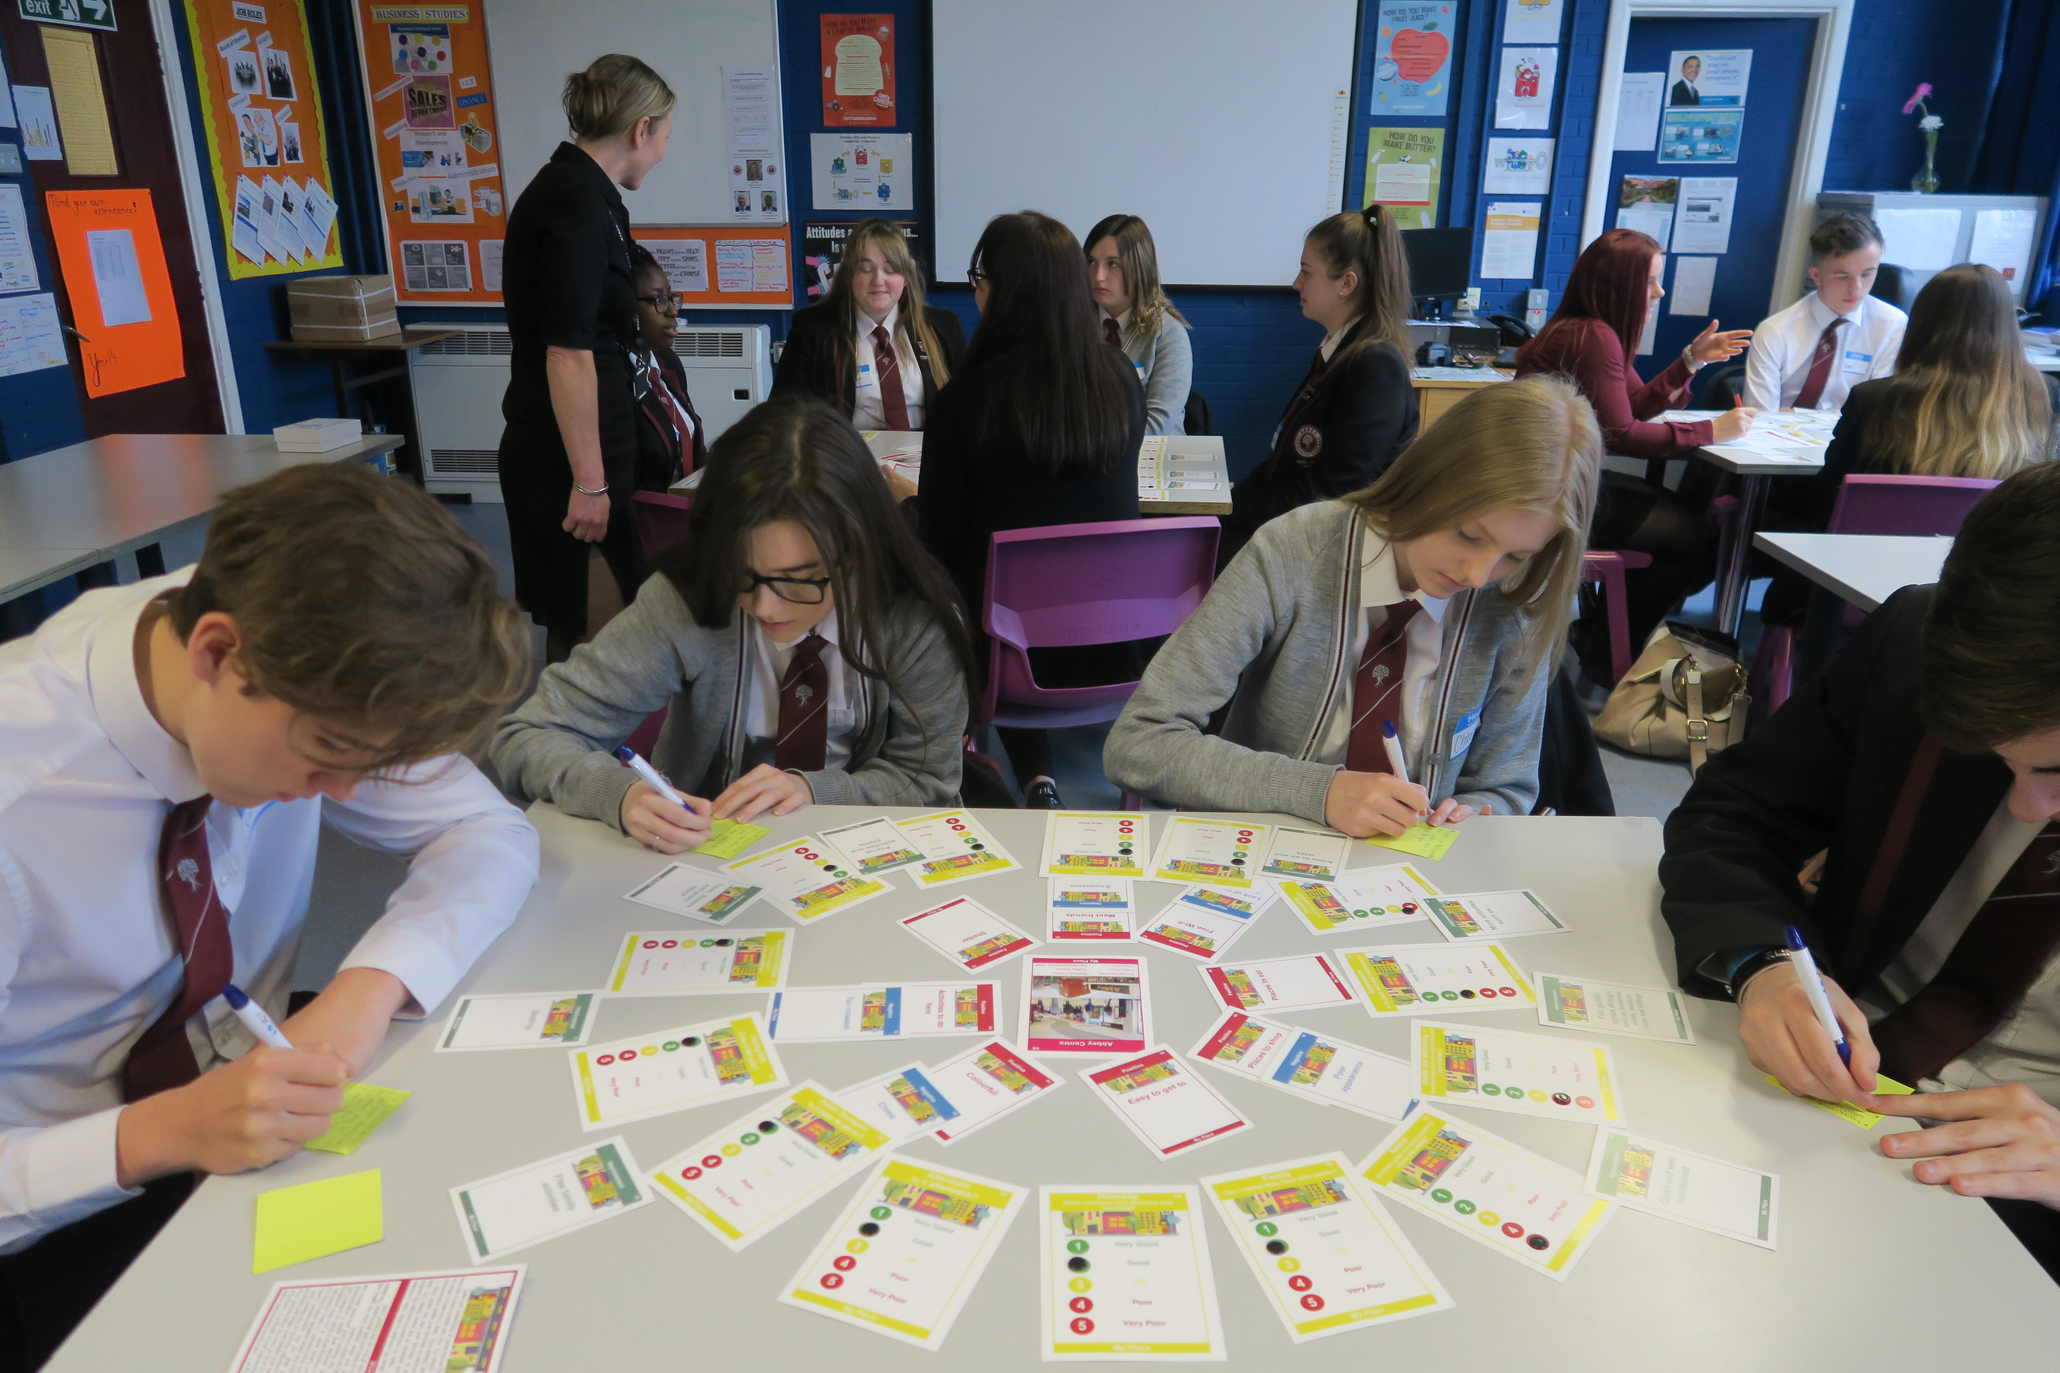
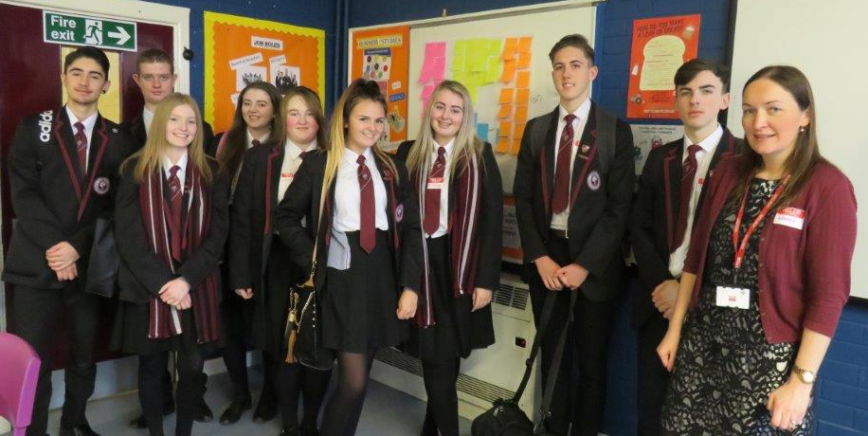
My Place – Participatory Card Game
Abbey Community College – Sixth Year Business Students

Slide 7
My Place – Participatory Card Game
Planning Workshops
Design Workshops
Generated game content
Build Ownership
Learning Resource
Peer- Peer Showcase Event

Slide 8
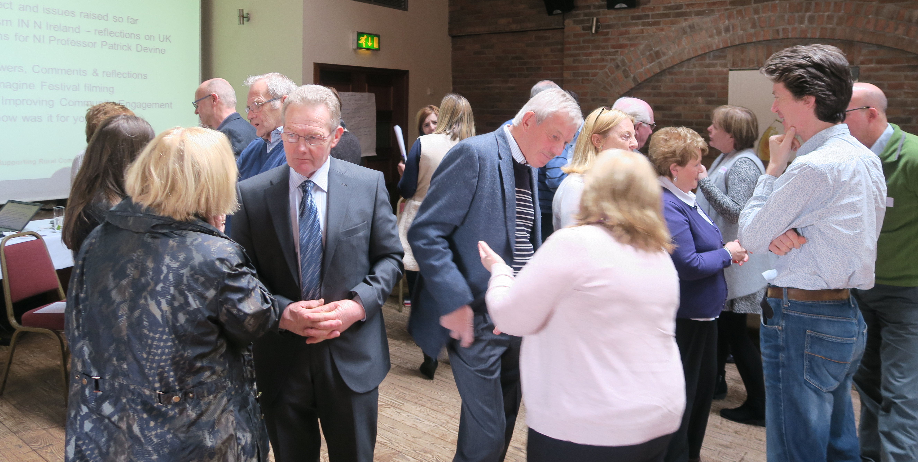
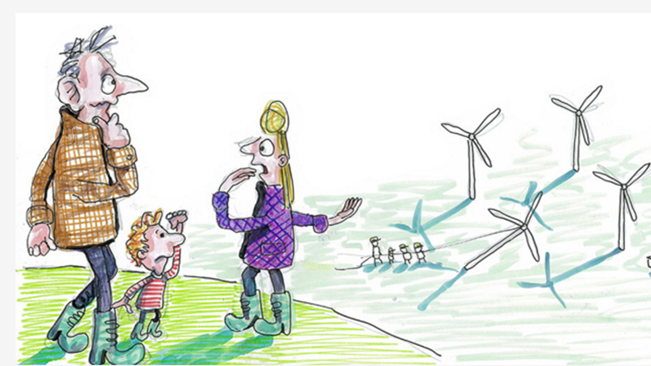
Re-Thinking NIMBYism – Siting of Renewable Energy Technology
Public Conversations Project (PCP) Dialogue
Phase 2: Sharing learning with practitioners

Slide 9
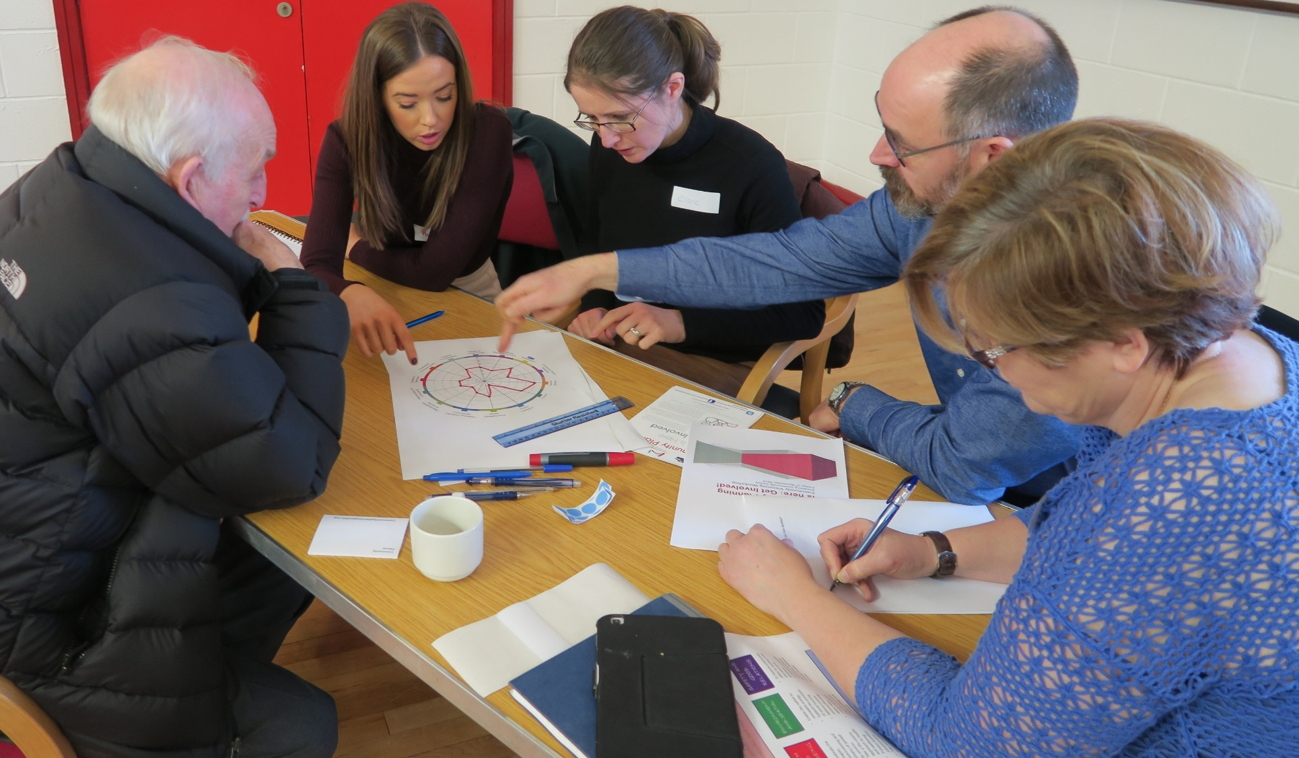
Place Standard Tool Exploring Issues and Priorities in Mournes DEA, Newry Mourne and Down
Notes:
Participants Exploring Issues – SWOT analysis and a tailored Place Standard Process

Slide 10
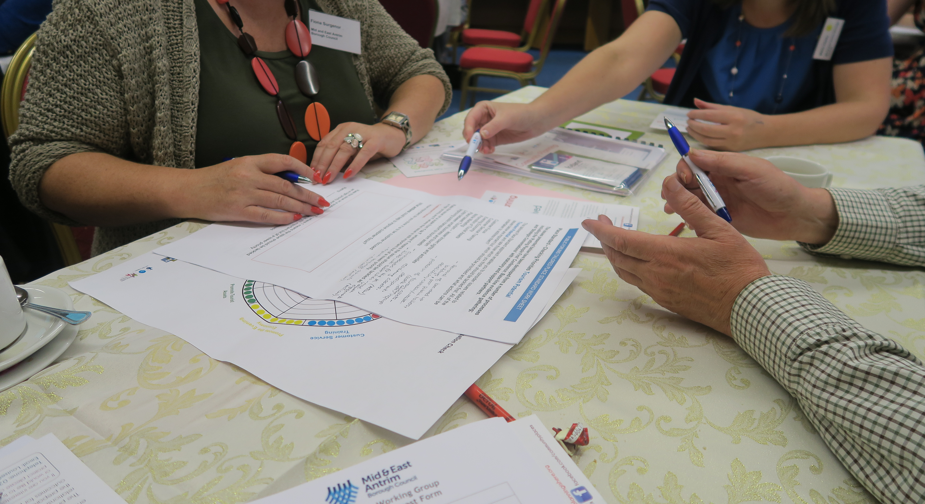
Place Standard Tool
Structured conversation – 14 Questions
Physical and Social
Tailored – Community Planning and
Place Shaping processes
Assets and areas of improvement
Target resources
Visual and engaging tool – plot results
Place Standard App

Slide 11
“Local people deciding how to allocate part of a public budget”
Participatory Budgeting – PB Works Project
Notes:
Participants Exploring Issues – SWOT analysis and a tailored Place Standard Process

Slide 12
Participatory Budgeting
Developed in Porto Alegre, Brazil in 1989
Improves the way public money is spent
Increases levels of participation and engagement and improves trust and relationships

Slide 13
Participatory Budgeting Works
Supportive and Enabling environment for PB
PB processes on the ground
Rathlin Island – ‘Grugach’s Gold’
Mournes, NMDDC and Partners ‘Communities Leading Change’
Downpatrick, Parent Action – ‘Getting our voices Heard’
Fermanagh and Omagh DC; Antrim and Newtownabbey BC; Newington Housing Association; Forward South Partnership
PB Works Network

Slide 14
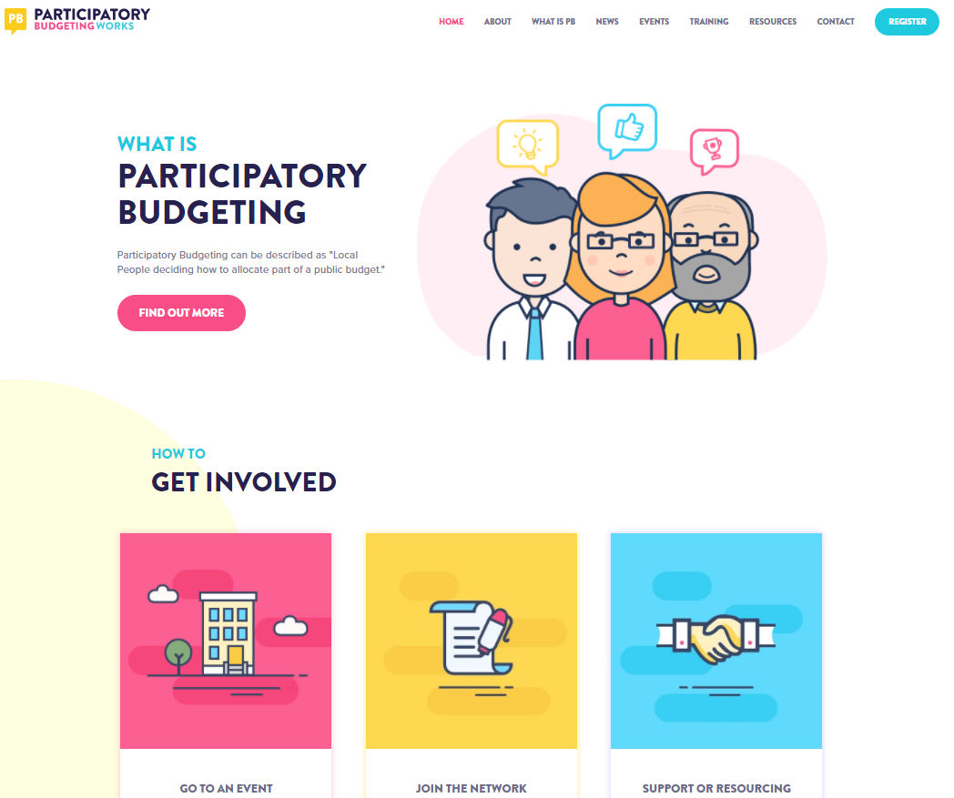
www.participatorybudgetingworks.org

Slide 15
A way forward for all?
Embedding engagement rather than ‘one-off’ or ‘tick-box’
Engagement standards – assessing quality and impact
Inclusive: Hard to reach or easy to ignore?
Engaging methods and techniques
Participatory and deliberative processes
Time and resources
Building effective relationships and trust

Slide 16
Community Places
Dr Louise O’Kane
2 Downshire Place
Belfast BT2 7JQ
Telephone: 028 9023 9444
Email: louise@communityplaces.info
Websites: www.communityplaces.info
www.communityplanningtoolkit.org
www.communityplanningishere.org
www.participatorybudgetingworks.org
Notes:
If you would like to be added to our mailing list please contact us.

