Slide 1
Mid-Market Rent in Scotland – The Wheatley Experience
Tom Barclay Group Director of Property & Development
14 October 2019

Slide 2
Our partner organisations

Slide 3
Wheatley Group – About us
Own 50,000 social rented homes
2,000+ MMR & FMR homes
£300m + Annual Turnover
Unprecedented Scale of Development (2018-2021)
Largest Developer of Social Housing in the UK
Over £1bn
Group Assets
3

Slide 4
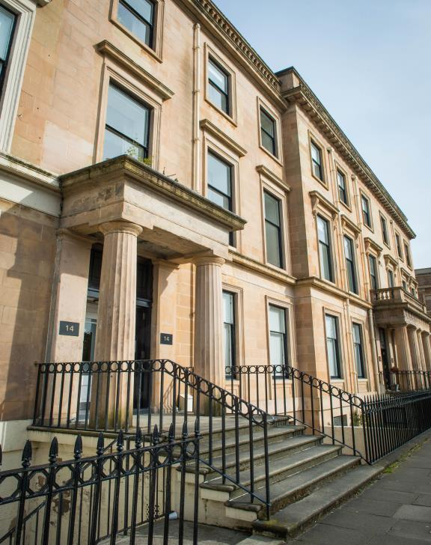
Lowther Homes
Established in 2011 in Glasgow’s Prestigious West End
Merged in 2017 with sister organisation in the East of Scotland
C.2000 MMR & FMR Homes
Over £1bn
Group Assets
4

Slide 5
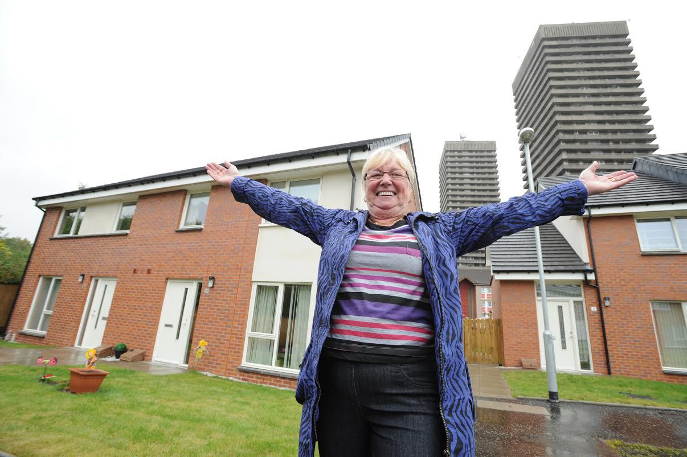
Political Context
Scottish Government’s strategy to increase the number of new homes over term of next parliament
Over £3 billion to fund the delivery of 50,000 affordable homes
Accompanied by increased subsidy levels
14,000 full-time equivalent jobs a year
£1.8 billion of economic activity a year on average
5
Notes:
5

Slide 6
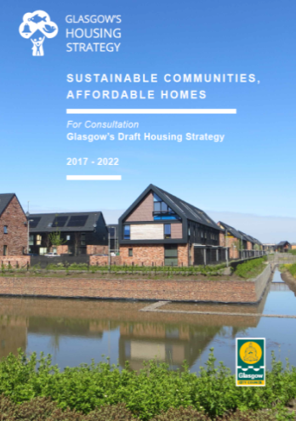
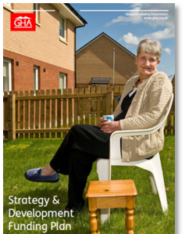
External Authorising Environment
LHS
SHIP
WHG Development Programme
LA Local Housing Strategies
- 5 Yearly
LA Strategic Housing Investment Plans
5 Yearly but reviewed Annually
RSL Strategy & Development Funding Plans
- Annually
RSL/Group
Development Strategy
- 5 Yearly

Slide 7
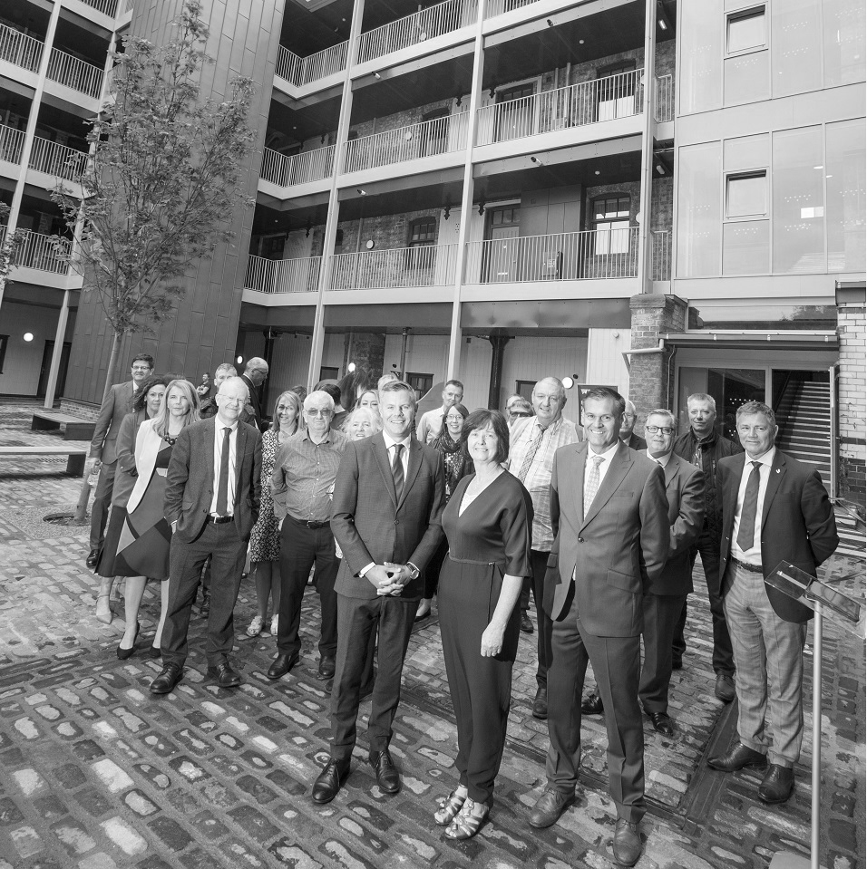
Grant Environment - Beyond 2021
Ageing Population –Government signalling potential shift of budget priorities from housing to health & education
Likely budget reduction – Further £4bn (minimum) to maintain a further 10,000 affordable homes per year post 2021
Grant per unit subsidy levels unlikely to increase
Broader range of interventions to support housing supply
Looking for innovation in order to continue to deliver new homes across all tenures

Slide 8
Funding new homes for Affordable Rent
Land & Fees
SG Grant
£72k SR
£46k MMR
Total
Project
Cost
Construction
Cost
Private Finance
Grant operates as deficit funding
Grant appraisal includes provisions for long-term financial planning
Projects are self-financing

Slide 9
Social Rent v Mid-Market Rent Development Appraisals :
Mid Market Rent Appraisal (sample)
IRR | %
NPV | £
 | 2
Development costs | -1,492,988
Grant | 519,156
Net (Private Finance) | -973,832
 | -973,832
Development costs per unit | 124,416
Grant | 43,263
Net | £81,153
Average monthly rent | £528.00
Management costs | 265
Maintenance | 450
Investment (30 years) | 19,531
Landlord Registration | 12
Marketing | 300
Social Rent Appraisal (sample)
IRR | %
NPV | £
 | 1
Development costs | -5,270,447
Grant | 3,005,136
Net (Private Finance) | -2,265,311
Development costs per unit | 128,547
Grant | 73,296
Net | £55,251
Average Rent/month | £365.03
Management | 504
Maintenance | 527
Investment (30 years) | 19,531

Slide 10
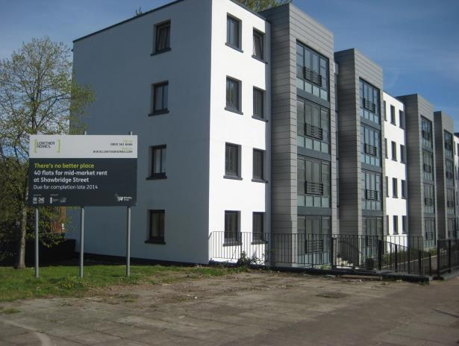
MMR - Meeting Housing Need
Increasing the supply of quality rented accommodation for moderate incomes
Private Residential Tenancies
Catalyst to improvement of the traditional PRS
Competition for PRS – Forcing better quality & value for money ?
MMR USP = high quality, energy efficient housing, professionally managed and maintained, security of tenure
10

Slide 11
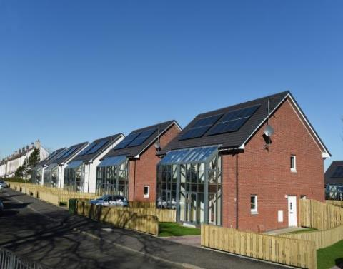
MMR – Strategic Role
Widening housing options and choice
Type and size for families if can’t access ownership or PRS
Tackling affordability in pressured markets
A role for Older people?

Slide 12
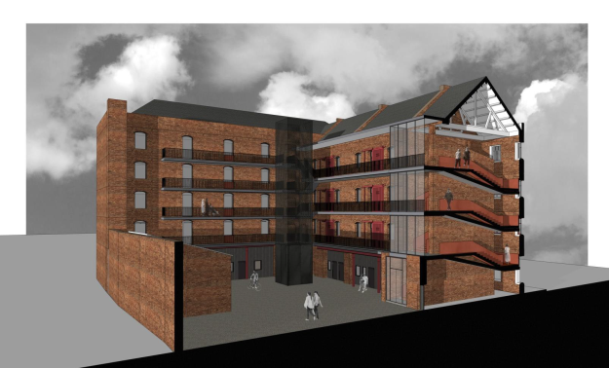
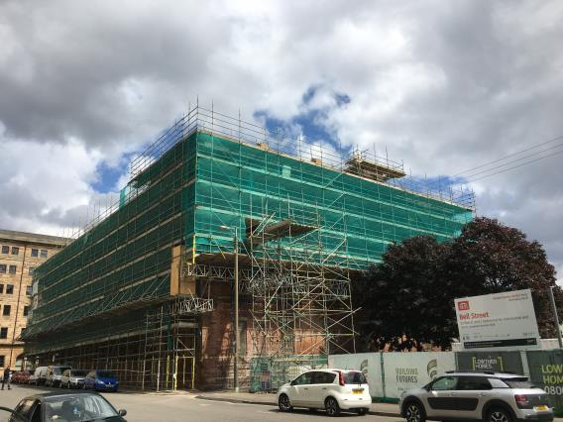
Local Housing Allowance
Move from 80% LHA towards 100% LHA or even +100%
Particularly where LHA rate is low & pressured markets where development costs are higher
Potential for more flexibility away from the LHA benchmark, towards Broad Rental Market Areas, or other pricing options
Converse would be higher grant levels
12

Slide 13
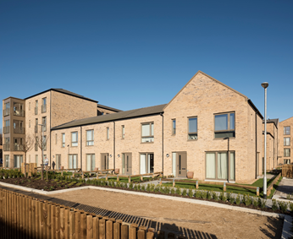
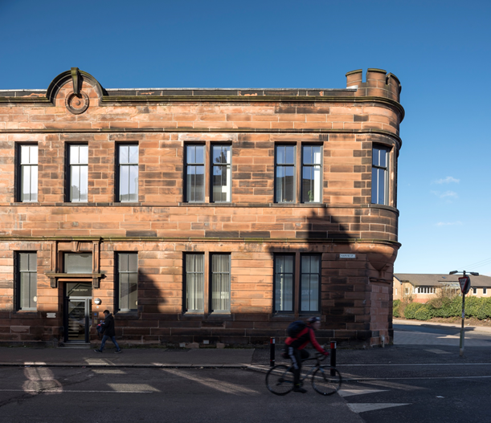
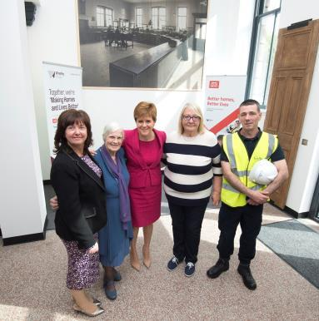
Case Study : Brand Street, Glasgow
13

Slide 14
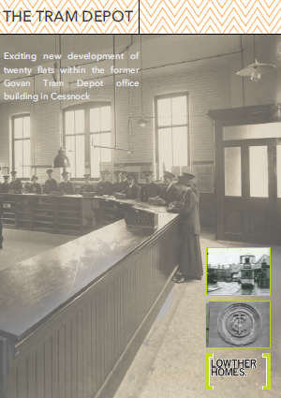
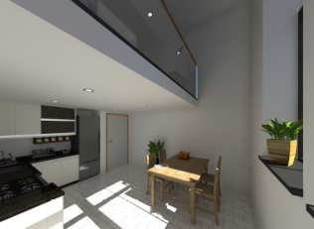
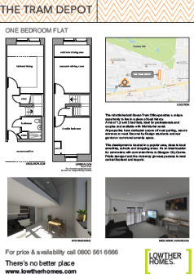
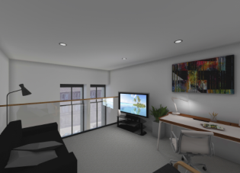
Mid Market Rent & Financial Models

Slide 15
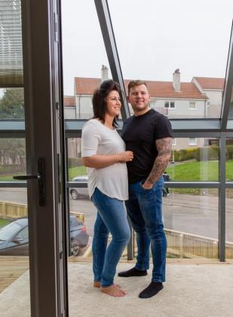
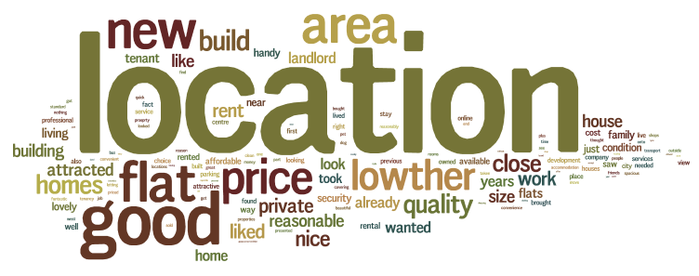
MMR – Customer Profile
Typical Income between £20k & £40k
High proportion of Customers come from PRS
Most are single or childless couples
65% plan to stay in their home for at least 3 years
Location
Quality of property
Car parking
15

Slide 16
Group Development Programme
Approximately 2,000 units on site or due on site
Five year developments programmes for each RSL
5,500 new homes by 2025

Slide 17
Future Projects (by tenure)
Social Rent
MMR

Slide 18
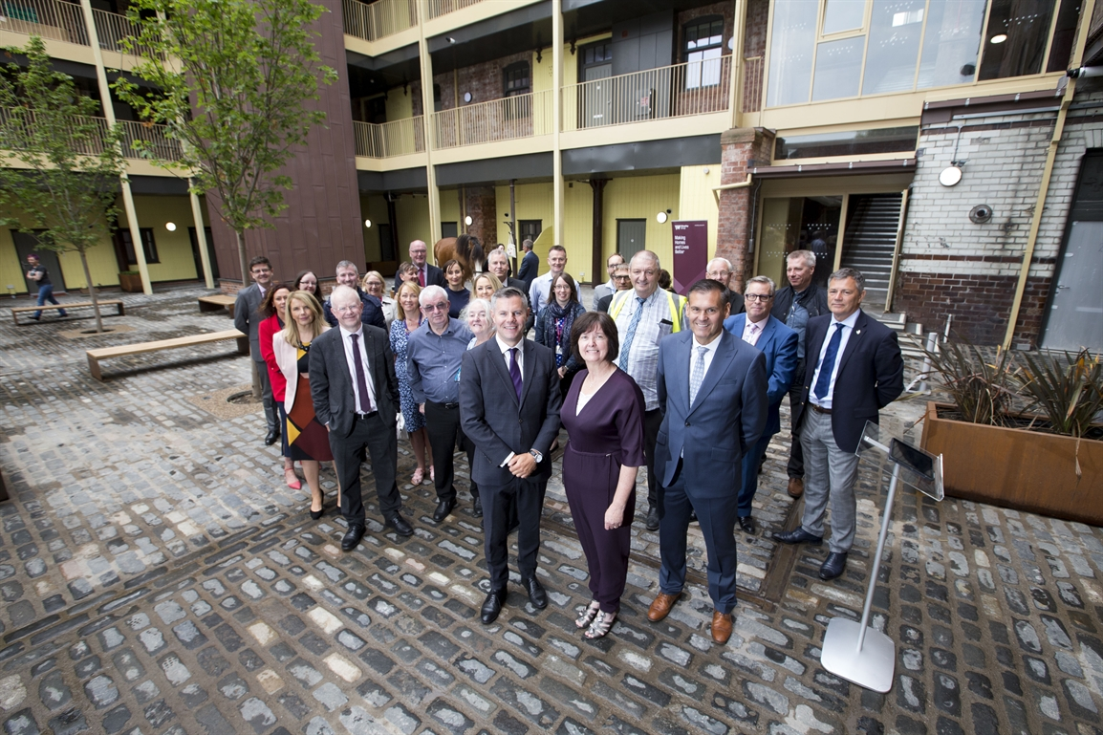
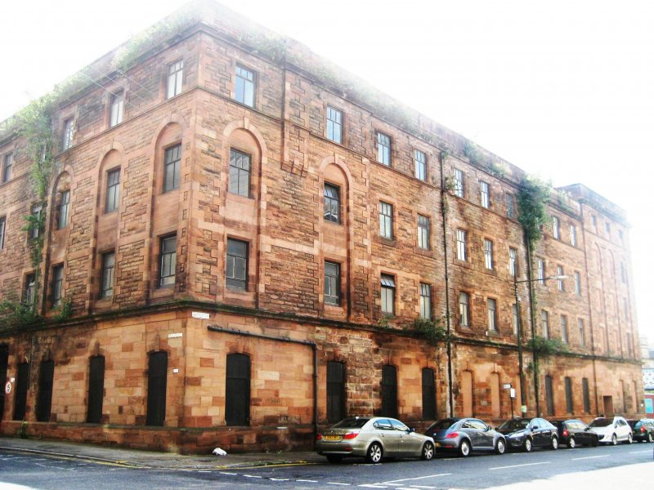
Case Study - Bell Street, Glasgow
52 x 1 & 2 bed flats
£7m Re-furb Project
B-Listed Former Police Stables
City Centre Location

Slide 19
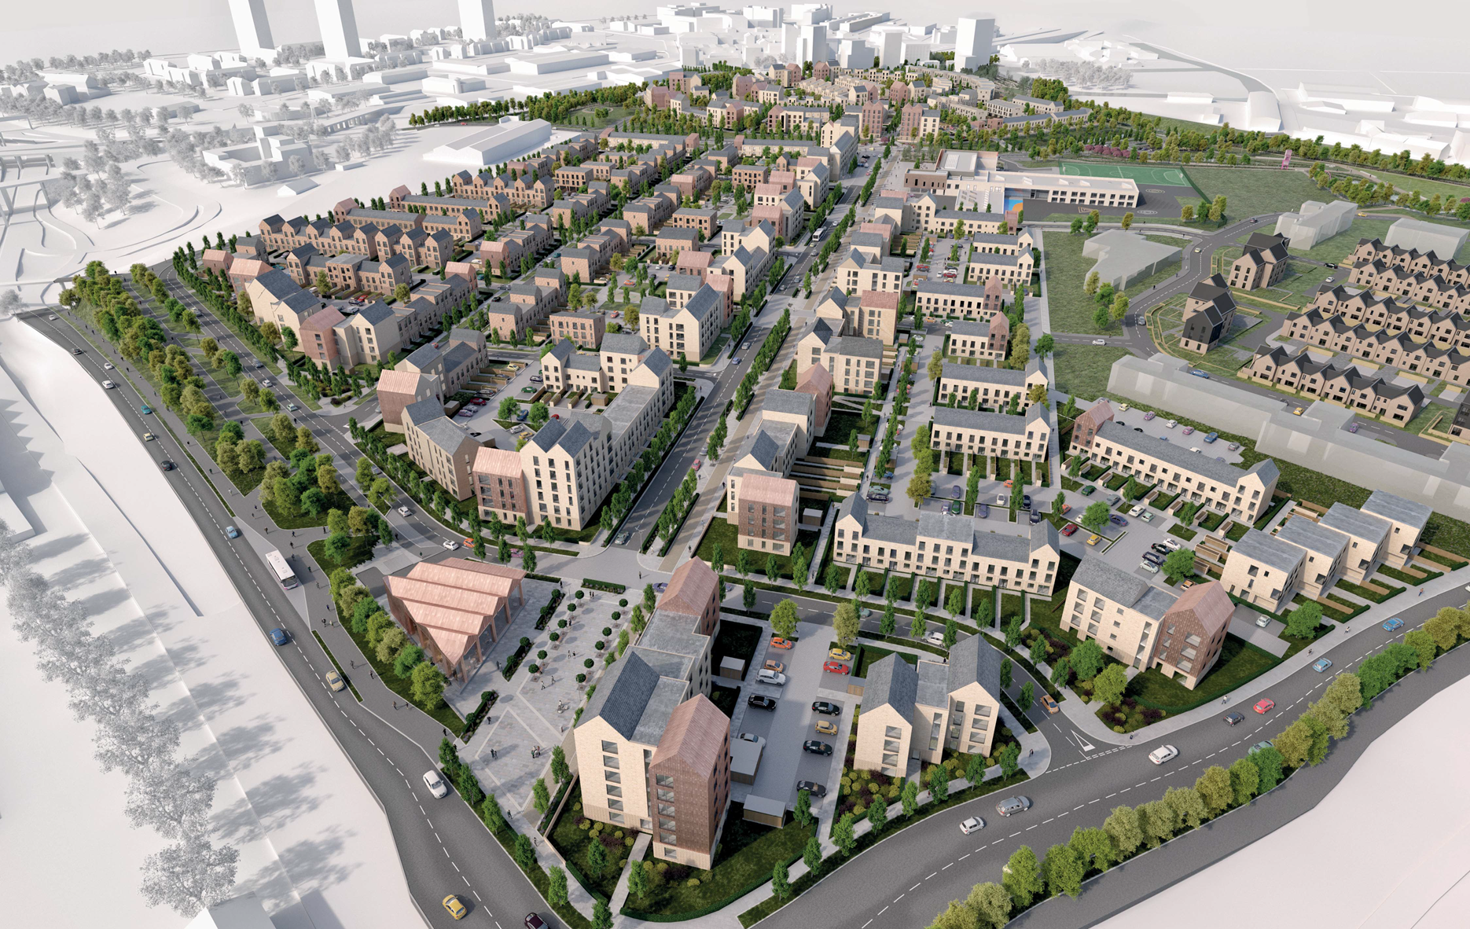
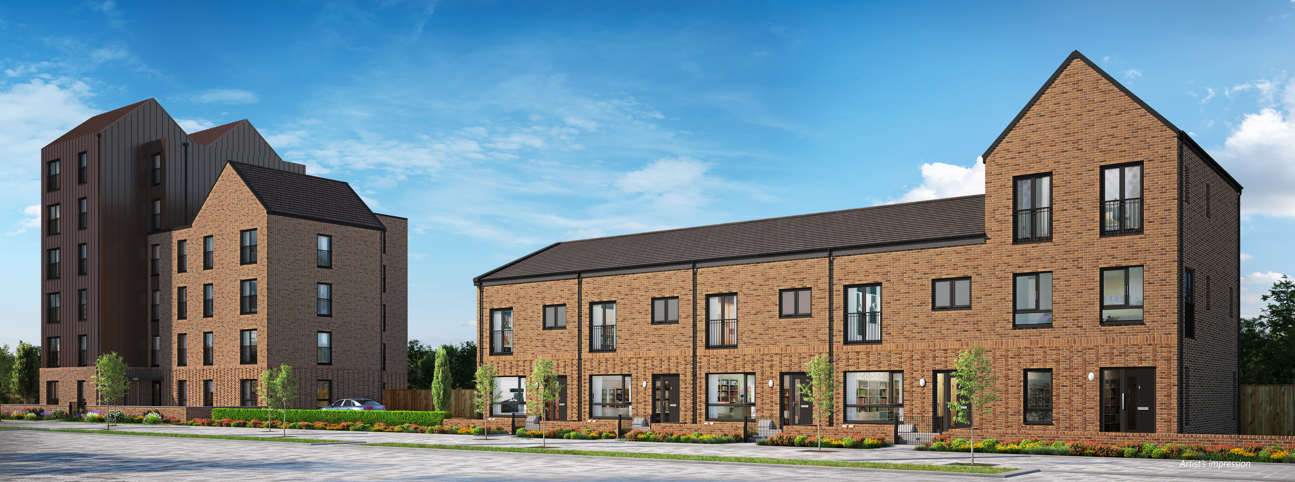
Case Study – Sighthill, Glasgow
198 new MMR homes
Mix of 1 & 2 bed flats & 2 & 3 bed houses
£25m new-build Project (part of larger £250m+ Regeneration project)

Slide 20
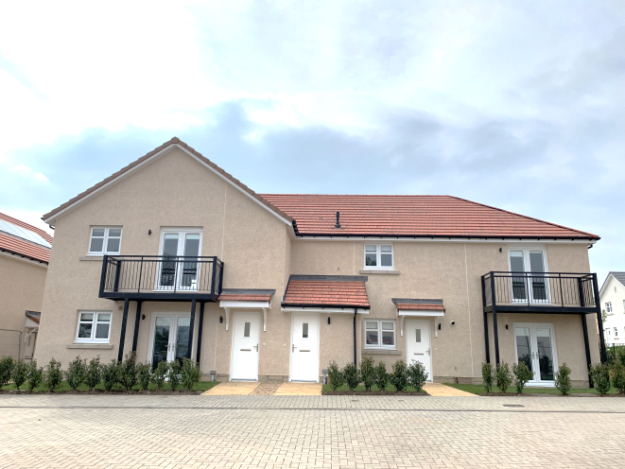
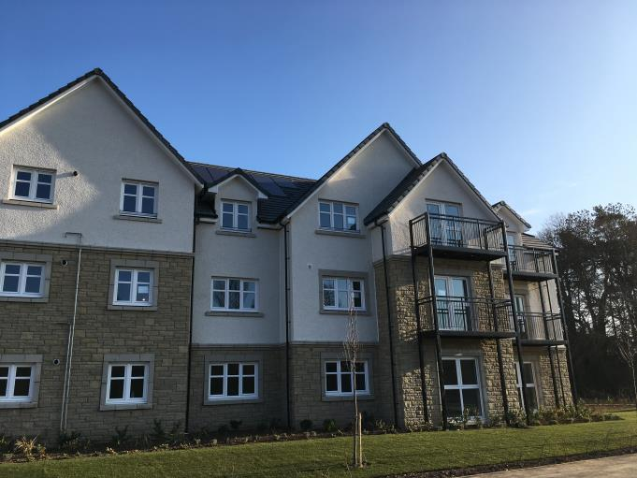
Section 75 / Partnering
Balerno, Edinburgh - strong market area
39 x MMR homes as part of s.75
Cotttage Flats and Terraced Houses

Slide 21
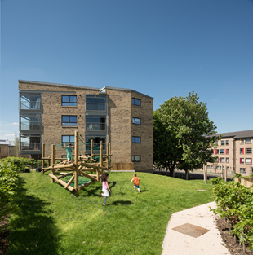
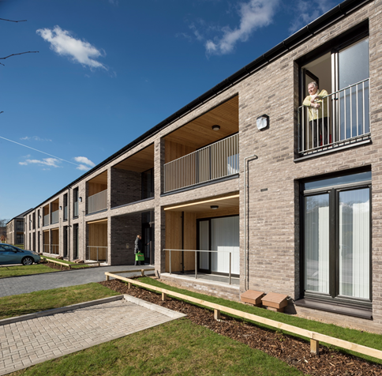
Conclusion
National & local political environments in Scotland has lead to unprecedented post war affordable housing development activity
MMR has established itself as a tenure of choice in Scotland
It helps provide tenure diversity, meeting a variety of housing needs
It forms a significant part of Wheatley Groups growth ambition
MMR is popular with our customers who value affordability, quality and security of tenure
Demand is high for the right product in the right location.
21
Notes:
21

Slide 22
Mid-Market Rent in Scotland – The Wheatley Experience
Tom Barclay Group Director of Property & Development
14 October 2019

