Slide 1
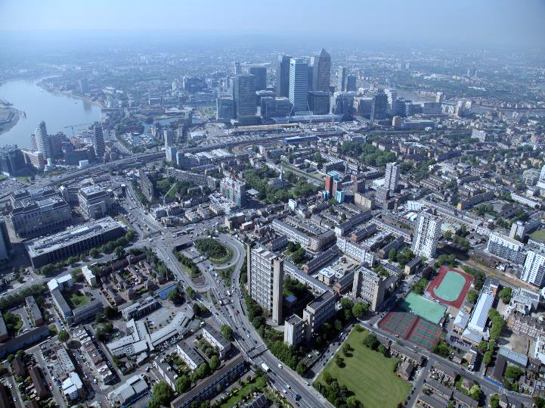
Delivering genuinely affordable homes
Rent Models
Steve Stride
CEO, Poplar HARCA

Slide 2

4 | miles²
9,000 | homes
45,000 | people
Notes:
Talk about us – bit of history and context

Slide 3
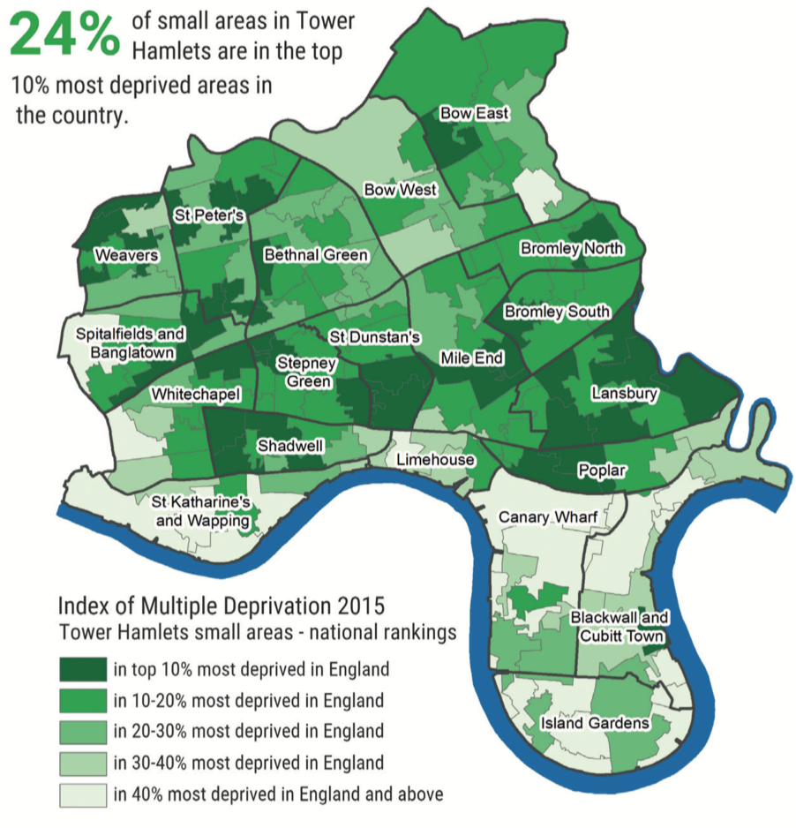
the challenge
Notes:
Despite an improvement in the borough’s deprivation rankings over time, levels of poverty remain high, particularly among pensioners and children, and the need for in-work welfare support is rising
highest rate of pensioner poverty in England: 50% aged 60+ living below poverty line compared with national average of 16%
highest rate of child poverty in Great Britain: 31% children live in families below poverty line compared with national average of 17%

Slide 4
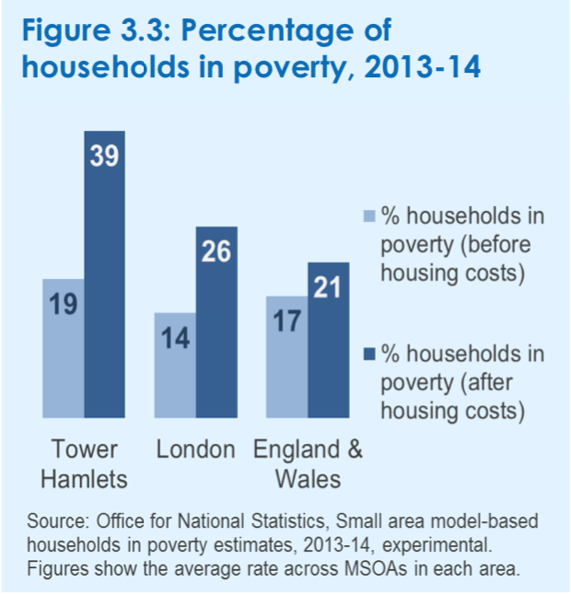
% of households in poverty

Slide 5
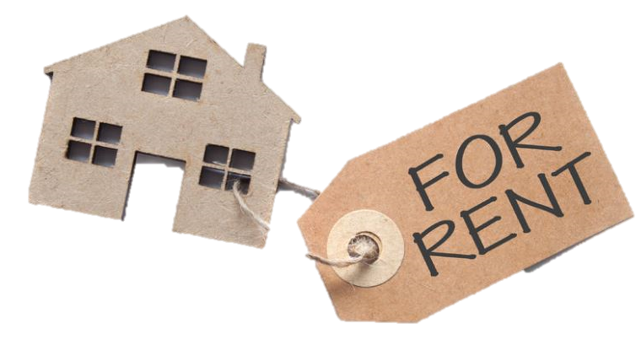
generally considered to be no more than 30% of income spent on housing
affordability

Slide 6
our rent model gets complicated…
 | regulated | means tested | rent formula | aimed at | avg. weekly rent
 |  |  |  |  | 1-bed | 2-bed | 3-bed | 4+ bed
Social Rent | ✓ | ✓ | national rent regime | statutory homeless priority housing need | £107 | £120 | £134 | £147
Affordable Rent | ✓ | ✓ | 48%-75% of market rent (large property = lower %) | can’t afford market rent don’t quality for social | £194 | £202 | £224 | £259
Intermediate Rent | ✓ | ✓ | 80% of market rent | can’t afford market rent don’t quality for social | £184 | £220 | £284 | £324
Local Housing Allowance | ✓ | ✓ | 30th percentile market rent | market rent tenants | £276 | £320 | £376 | £442
Market Rent | ✗ | ✗ | market demand / supply | anyone | £335 | £420 | £530 | -
Notes:
Aspiration is still for ownership, but increasingly out of reach
Housing need now hugely more diverse than in previous generations
PRS can be tenure of choice – as elsewhere in Europe – well managed, security of tenure, allows for mobility
Talk about MITS (LHA in table) aimed at statutory homeless

Slide 7
89% of our rented stock is ‘social’ rent
Notes:
Increasing proportion of home owners (leasehold and shared owners)
But concentration of social rent = residualisation - occurring since 1970s, accelerated in 1980s and 1990s
De-residualisation is attempt to increase social diversity and so social/affordable housing is less a tenure of last resort
2000s government tried to combat with policy aspiration to create more mixed communities

Slide 8

so what business are we really in?
community enabler
placeshaper
landlord
house builder
developer
Notes:
Important question as will define strategy i.e. what social/financial ‘return on investment’ do we want/need
Will influence rent strategy – important to engage stakeholders, explain strategy to residents (current and future)

Slide 9
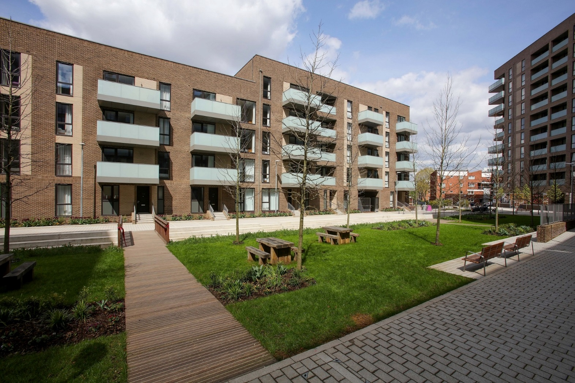

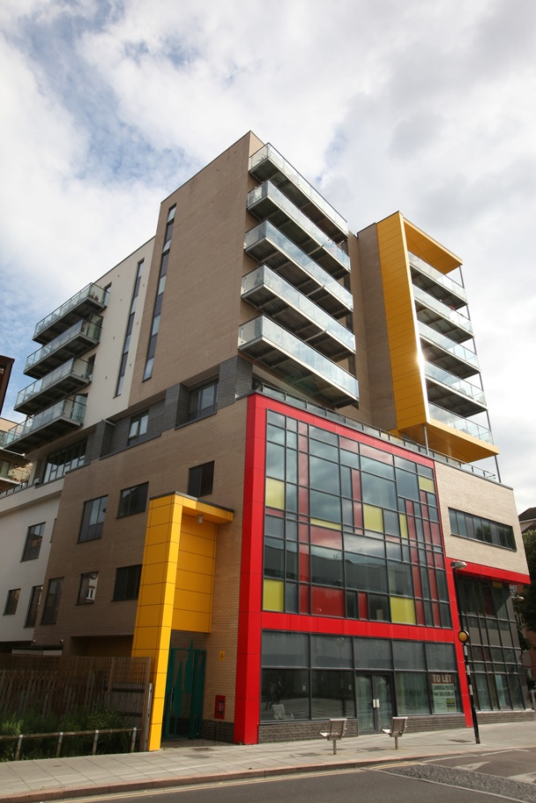
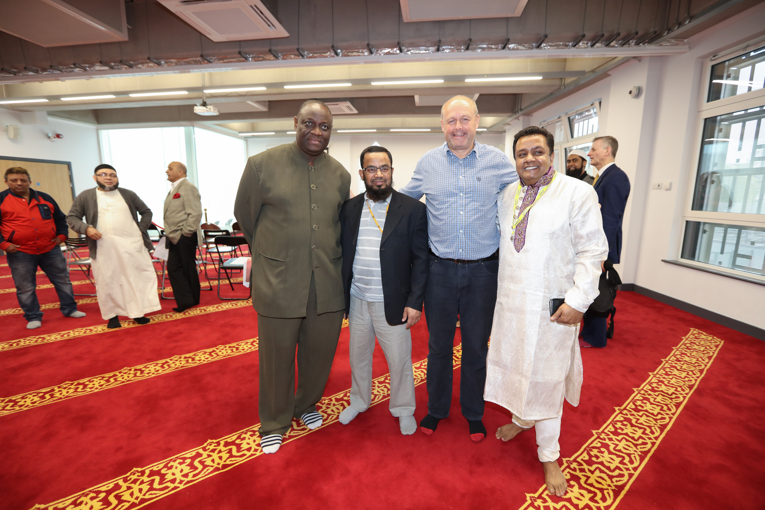
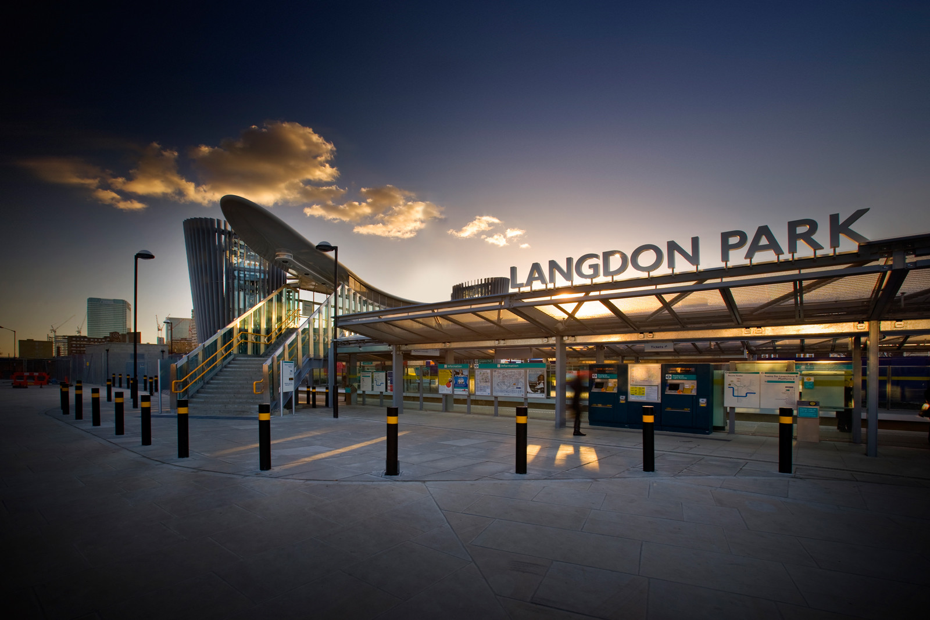

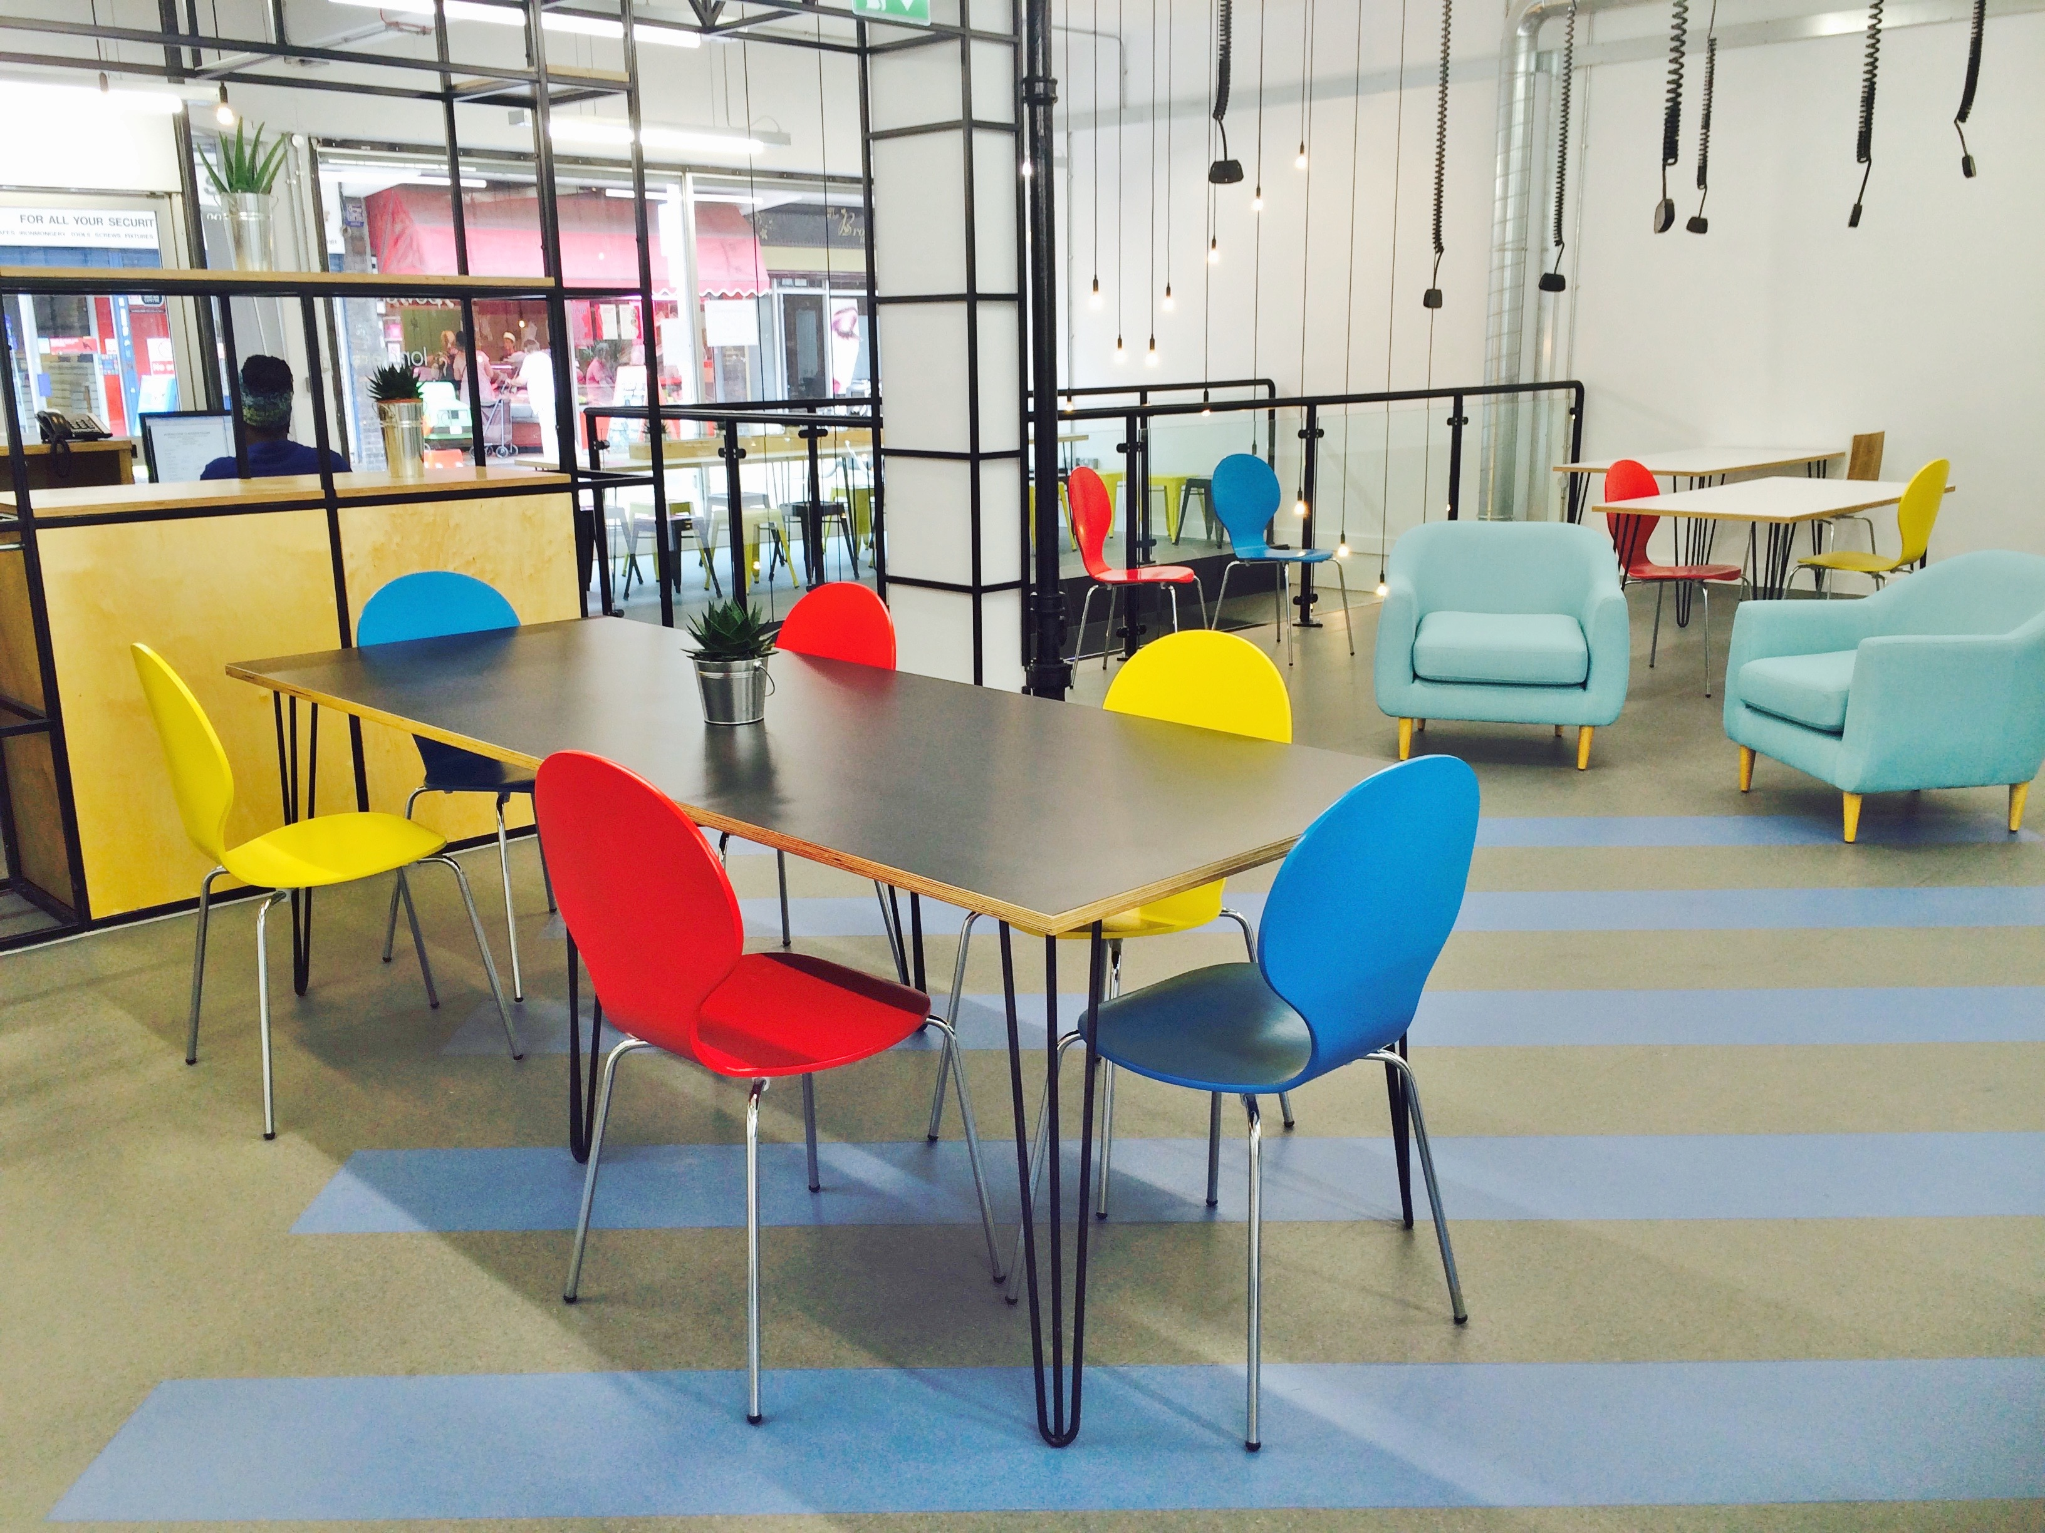

faith buildings
homes
education
healthcare
leveraging £2.5billion investment into 4 miles²
connectivity
business
workspace
community space

Slide 10

Creating Opportunities for Mixed Communities
tackling poverty and inequality
building community cohesion and promoting shared values
improving quality and number of affordable homes, and increasing overall supply of new homes
Notes:
Poplar HARCA’s vision is about Regen – people and place
Mixed communities has influenced our rent model – particularly the variety of tenures now on offer

Slide 11


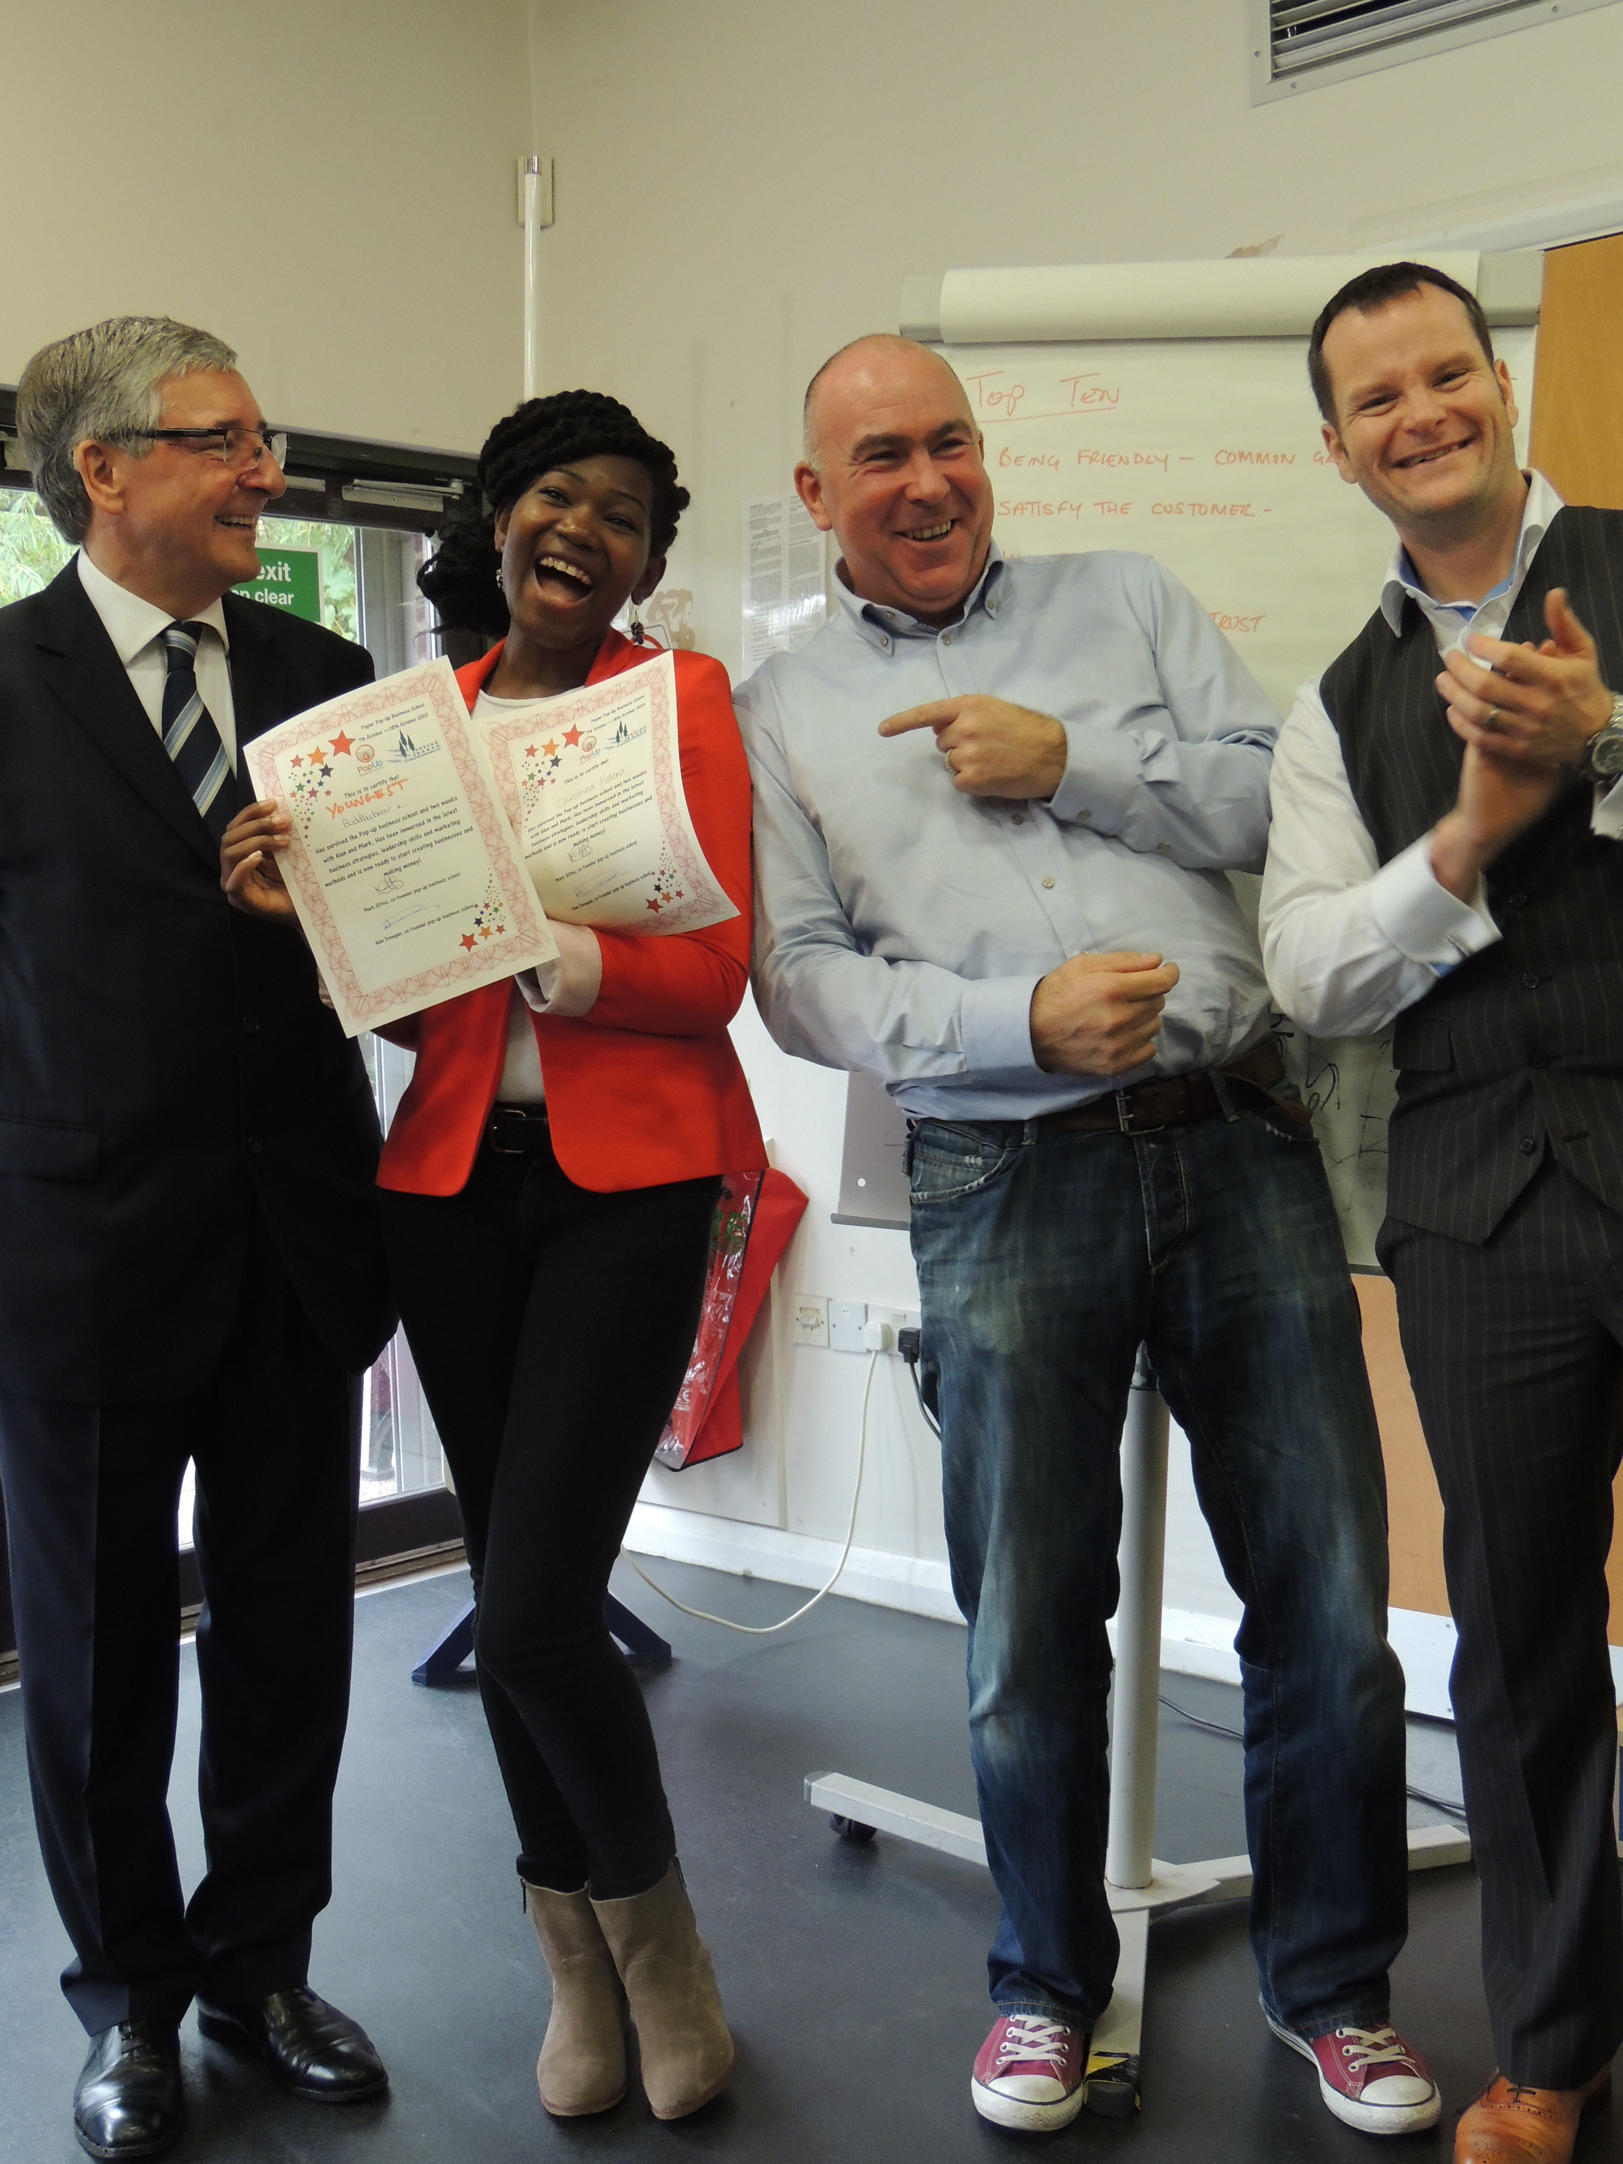
Creating Opportunity
5,000+ local people into jobs
5,000+ local people gain accreditation/ qualifications
300+ volunteers = £17m social impact annually
Notes:
Increased financial return from mixed tenure = increased investment in people
Community Links awards: Leadership of the Year, Business Development Award & Commitment to Excellence Award
Plus Best Corporate Volunteering Opportunities Award from East End Community Foundation

Slide 12

‘ordinary & successful places to live’
mixed communities are judged to be successful not characterised by problems linked with exclusively low-income areas tenure & income ‘non-issues’ for residents – neighbours ‘ordinary’ inner-city mixed communities attract younger families planning rules only one part of the picture developers willing to engage in building mixed communities
Notes:
The reason why mixed communities is important to us
JRF research from 2006 found that ‘mixed communities’ work for all households

Slide 13
what do we mean by mixed communities?
‘mixed communities are part of an integrated and fair society in which people of all classes and incomes share the same space, services and facilities, creating conditions in which mutual understanding and shared values can develop’
Notes:
Good governance - this is Board-led
Resourcing The Vision includes Mixed Income Tenure Strategy
Conscious attempt to increase income diversity and lower benefit dependency to create virtuous cycle

Slide 14
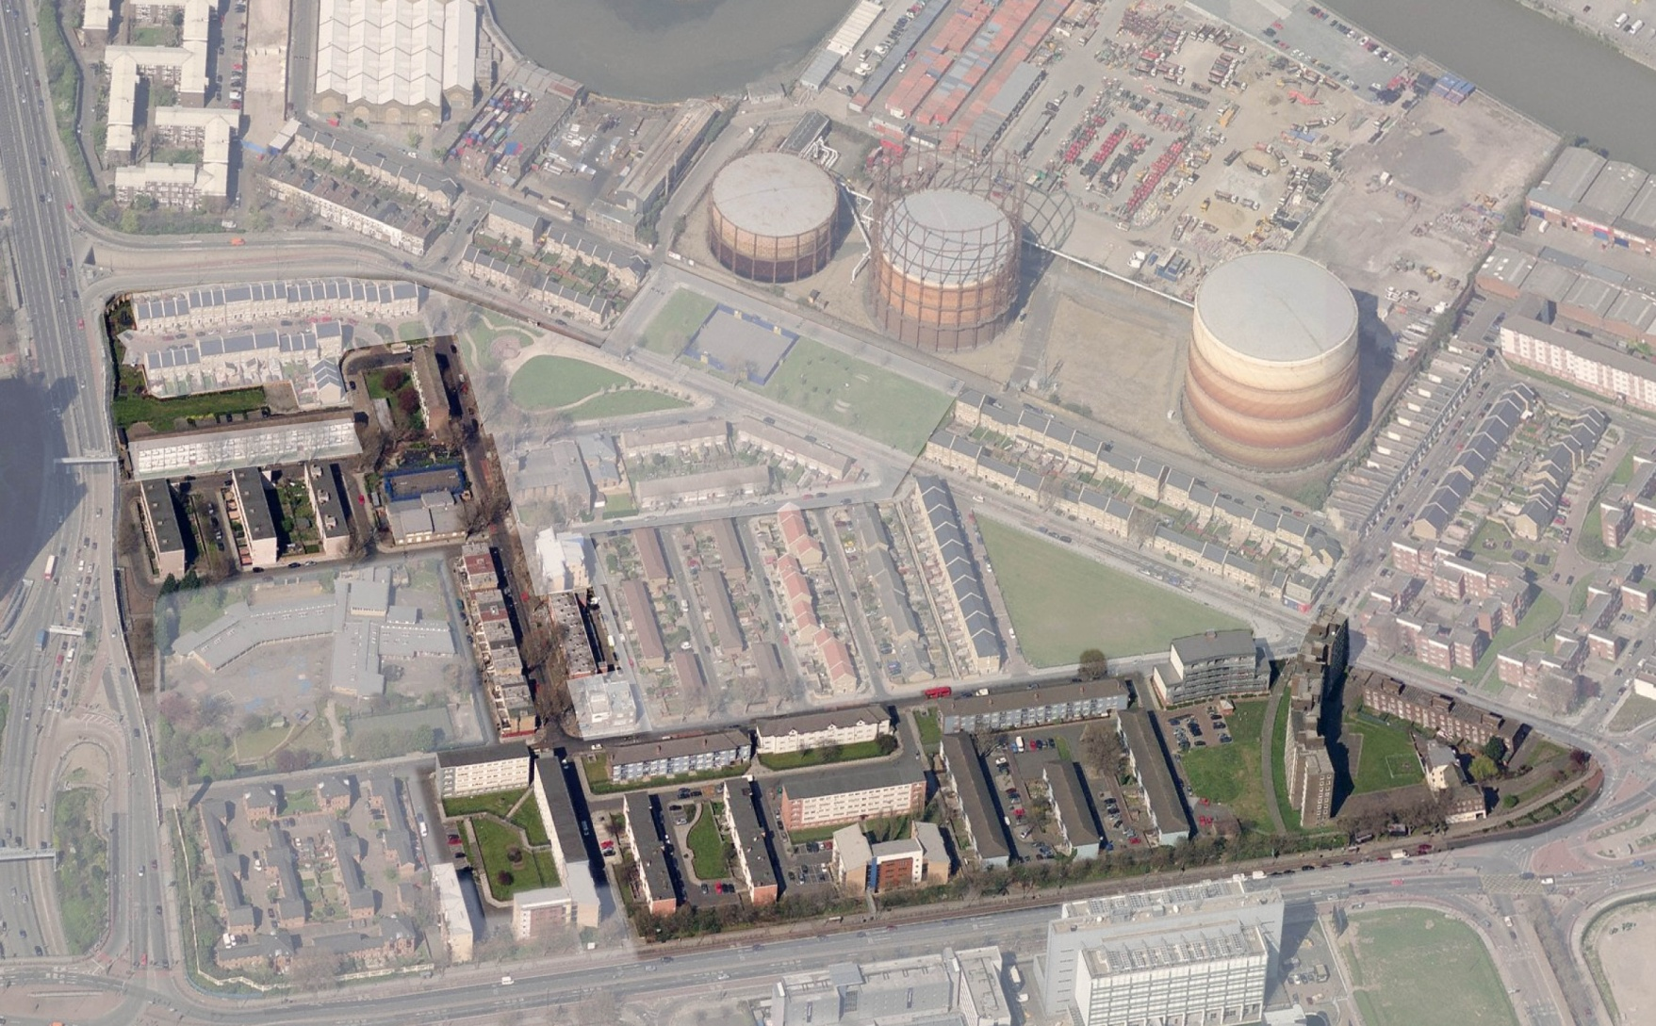
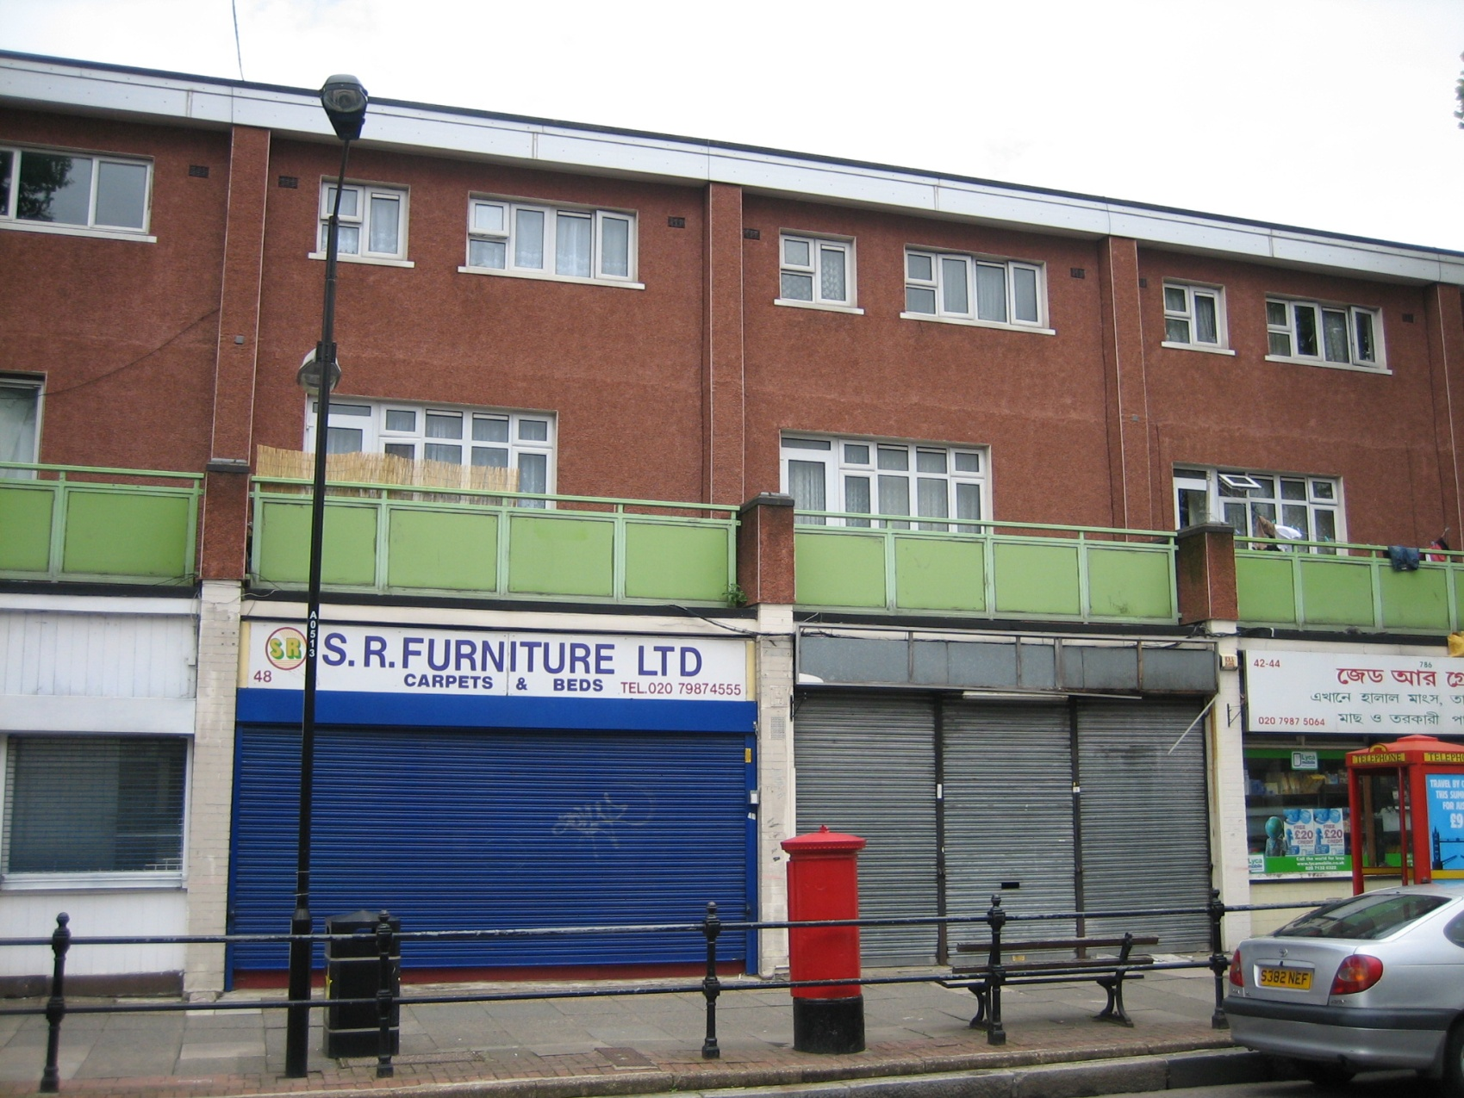
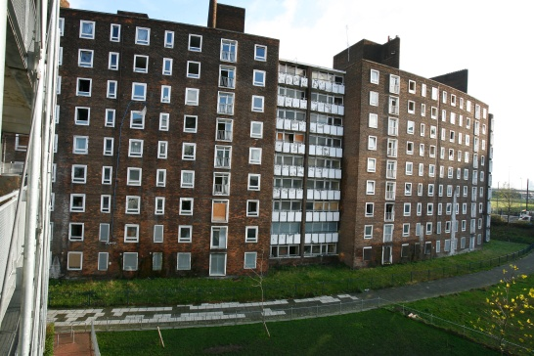
Second most deprived ward in London Circa 420 ex-local authority homes Run down commercial centre Poor quality green space
Aberfeldy – ten years ago
Notes:
Blah Blah – you know this one

Slide 15
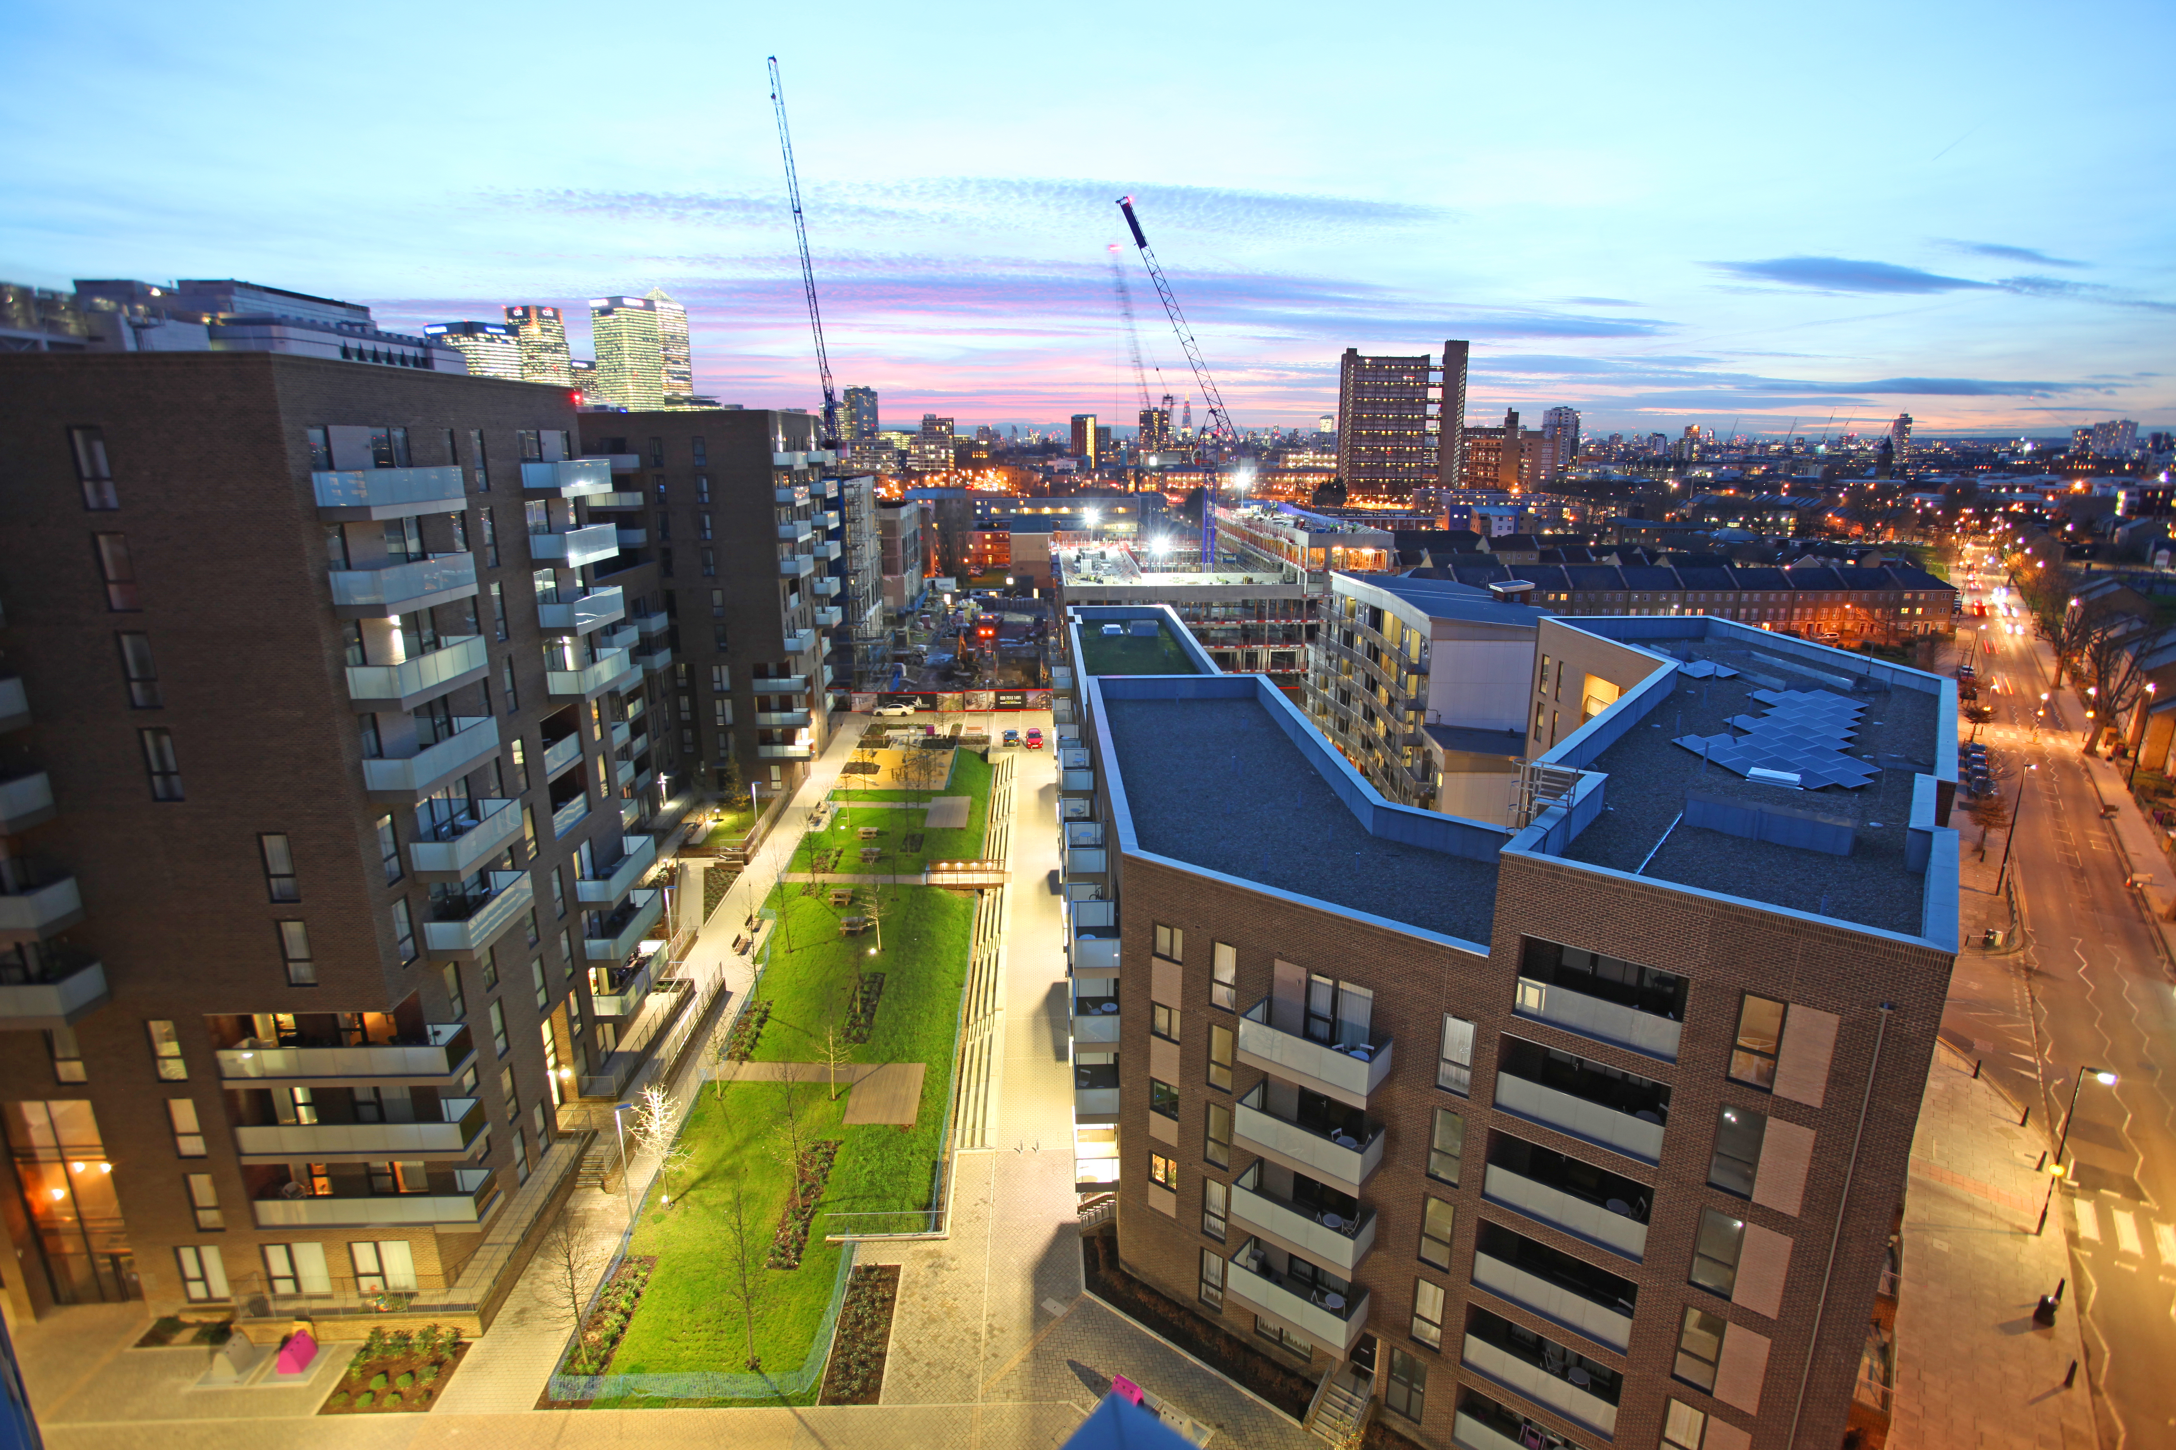
Aberfeldy New Village
50/50 partnership with private sector creating vibrant mixed community 828 homes for private sale 190 social and affordable (replacement +5%) 158 private rent Plus Health Centre / Café / Retail

Slide 16


changed demographic & local spending power created immediate regeneration impact enabled faster delivery of future phases (including social/affordable) as not restricted by speed of sales or bank funding leveraged- in alternative funding mix satisfied local need/demand
transformational
PRS

Slide 17
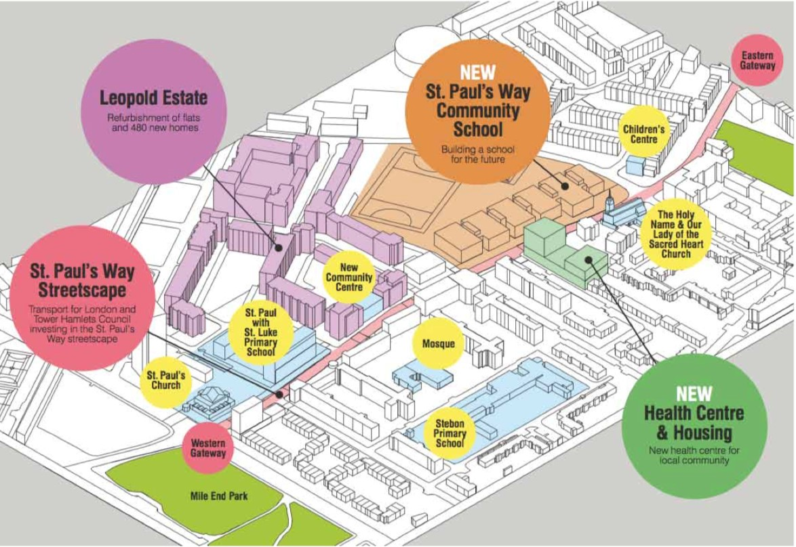
St Paul’s Way
transformation

Slide 18
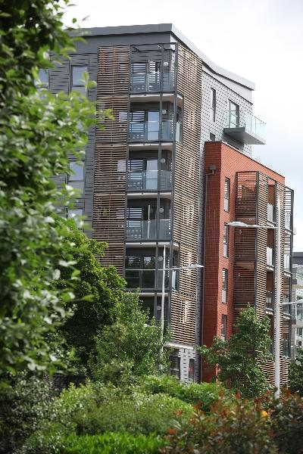
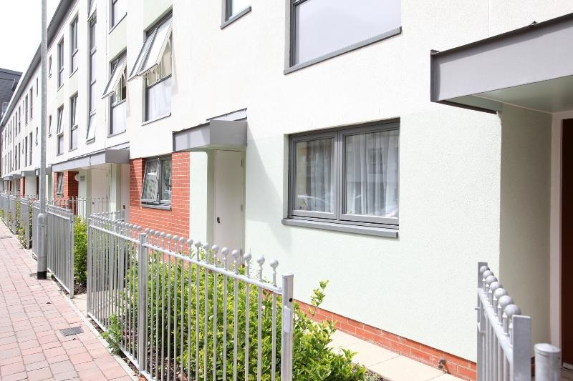
486 new homes
35% affordable
new community space
overage funds 60 additional affordable homes
Leopold

Slide 19

community space
‘high street familiar’
attractive & welcoming
quality food offer
replace receptions with conversations
Bow Brew
&
St Paul’s Way Centre

Slide 20
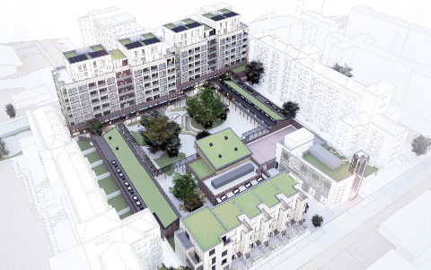
St Pauls Way Trust Primary School

Slide 21
health space
William Cotton Place
10,000 ft² health
10,000 ft² science & education
10,000 ft² training & enterprise

Slide 22

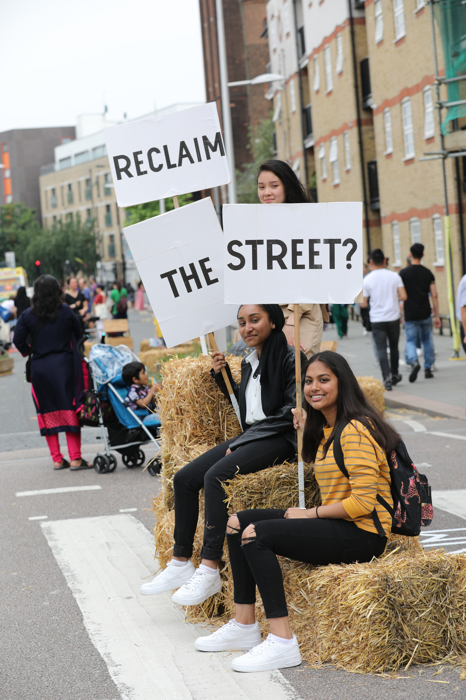
superb public realm
pedestrians priority
traffic calming
street lighting

