Slide 1
Sean Cullen
@belfast_h_lab
belfasthousinglab@gmail.com
Belfast Housing Lab
A collaboration between The Holding Project & EastSide Partnership
Funded by the Nationwide Community Foundation

Slide 2


+
We aim to design, develop and trial new strategies for improving housing affordability and accessibility in Belfast.
We use small scale experimentation, led by a design approach in collaboration with residents, housing organisations, community stakeholders, councils and policymakers to bring new housing ideas to life.
Belfast Housing Lab
A collaboration between The Holding Project & EastSide Partnership
Funded by the Nationwide Community Foundation

Slide 3
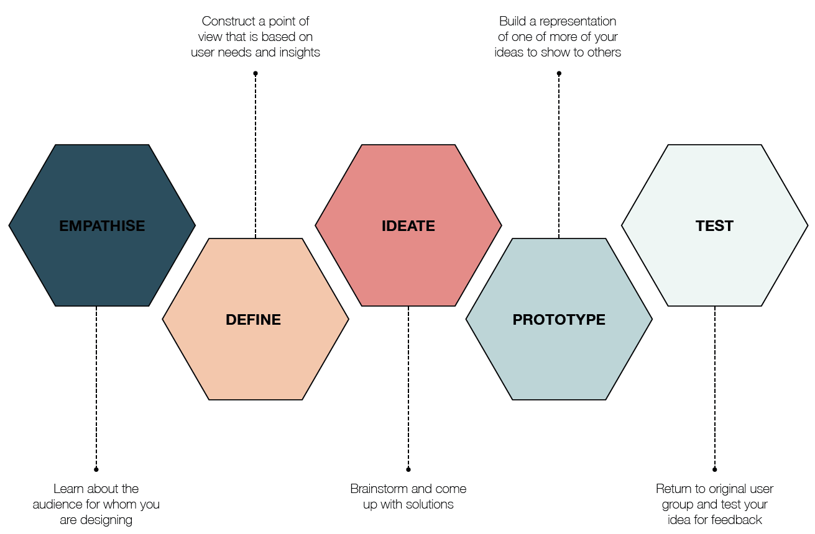
Belfast Housing Lab
A collaboration between The Holding Project & EastSide Partnership
Funded by the Nationwide Community Foundation

Slide 4

Parvin Gordian Knot
Source: Alistair Parvin
Belfast Housing Lab
A collaboration between The Holding Project & EastSide Partnership
Funded by the Nationwide Community Foundation

Slide 5
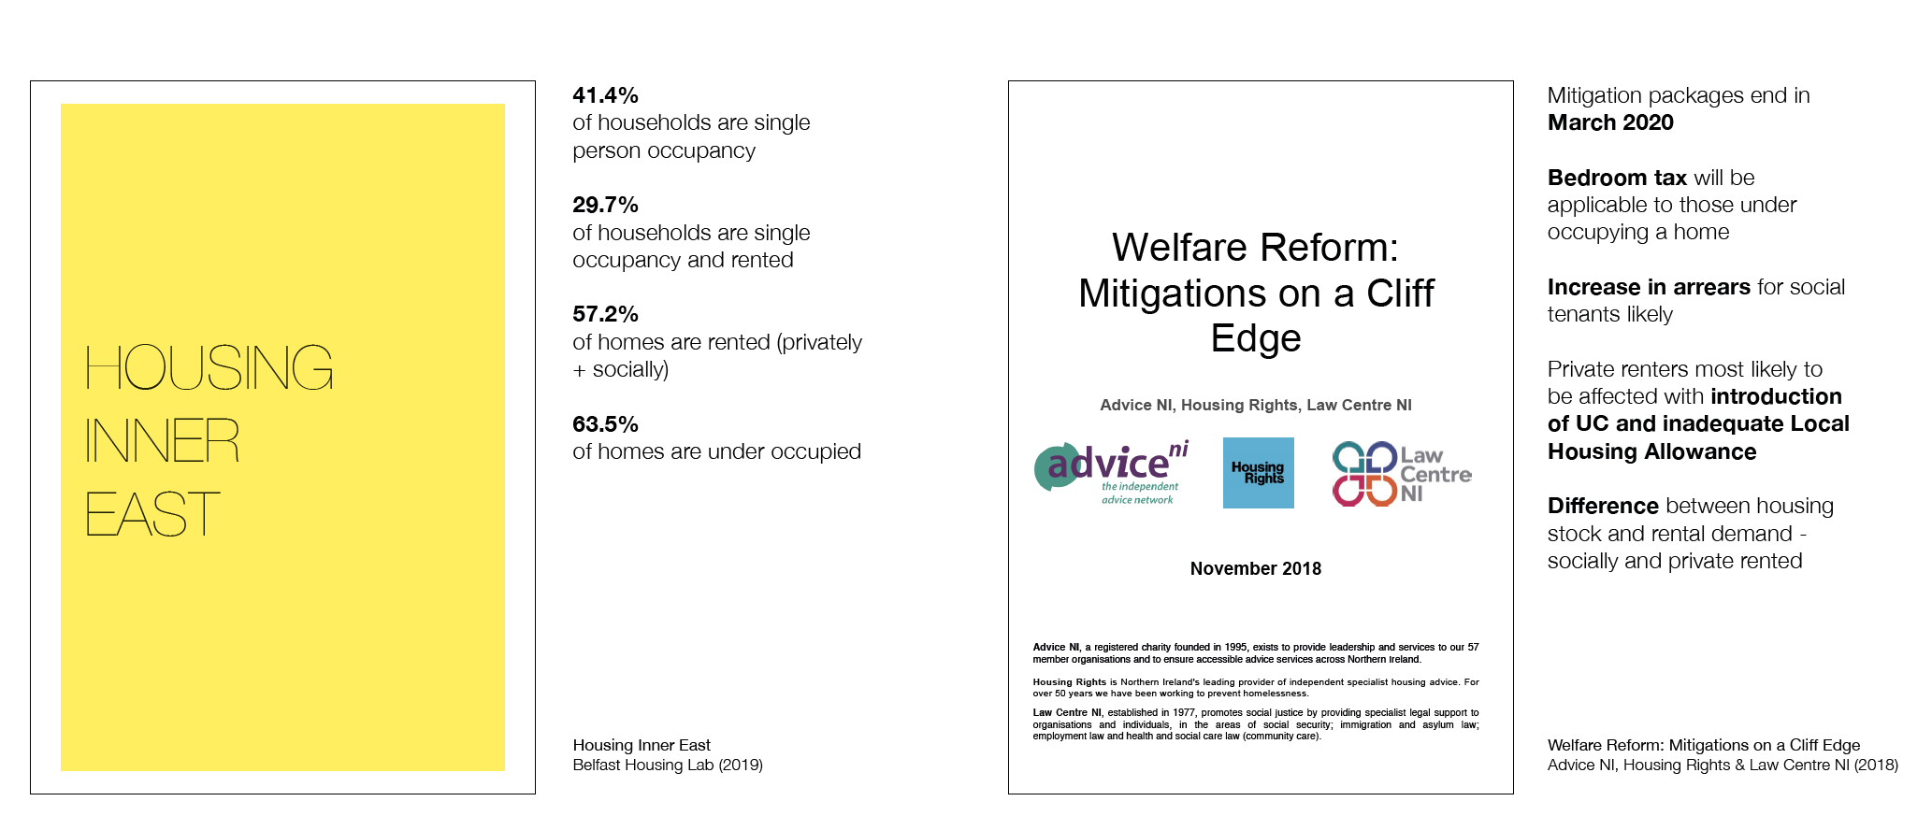
Belfast Housing Lab
A collaboration between The Holding Project & EastSide Partnership
Funded by the Nationwide Community Foundation

Slide 6
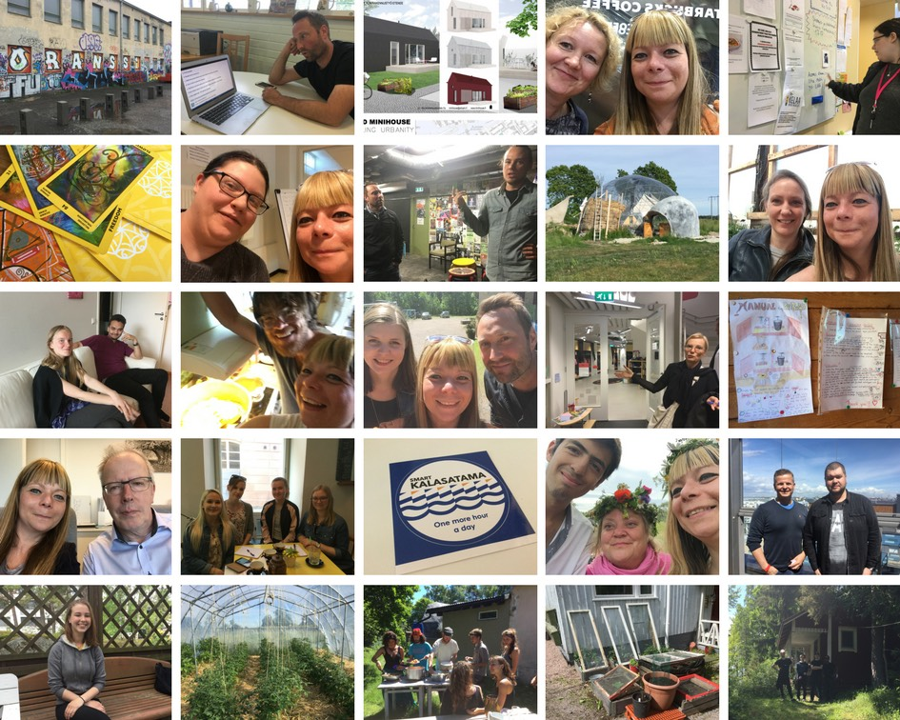

Dearbhaile Heaney
Affordable and sustainable housing models for Northern Ireland (2017)
Belfast Housing Lab
A collaboration between The Holding Project & EastSide Partnership
Funded by the Nationwide Community Foundation

Slide 7



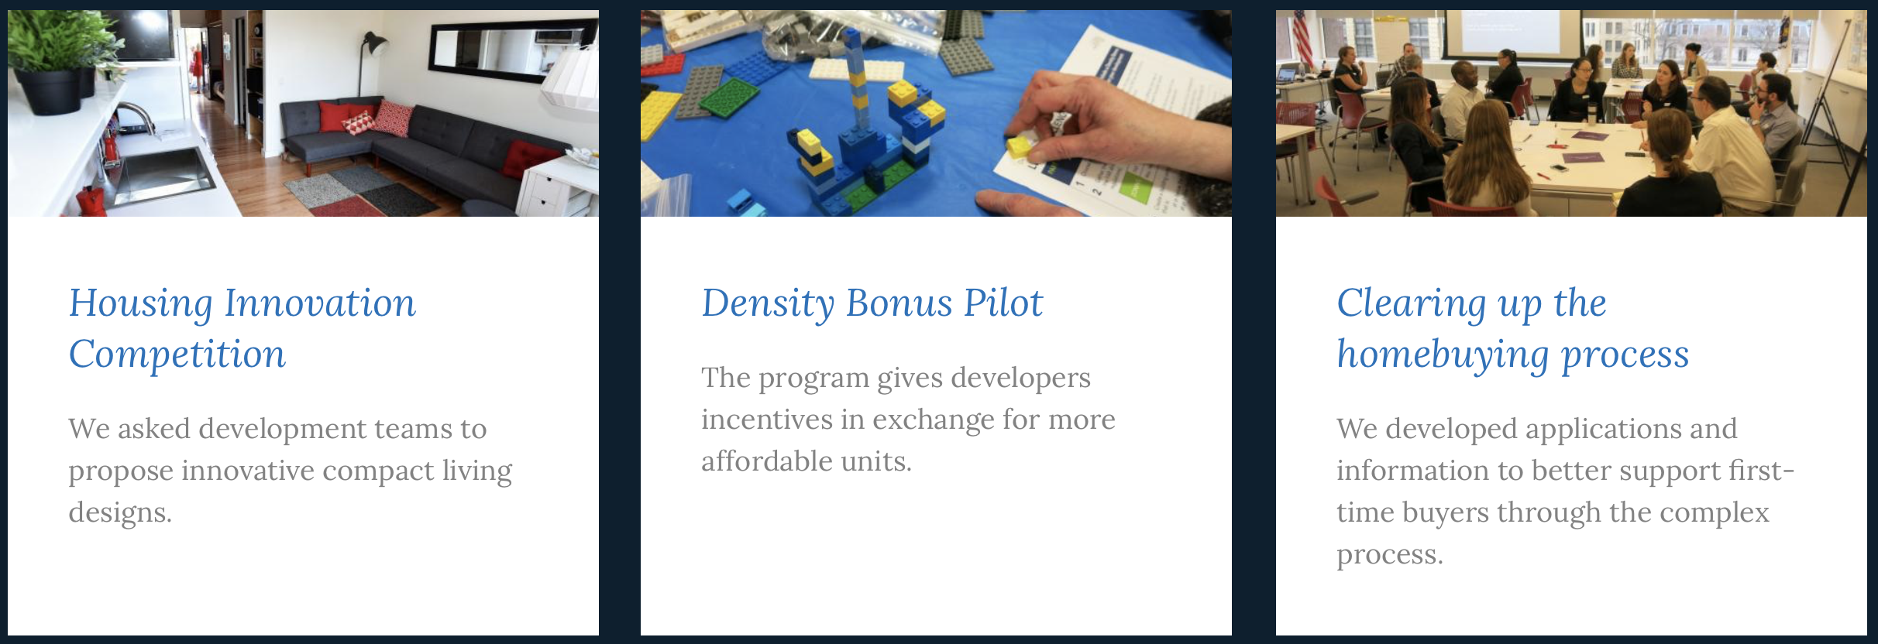
Belfast Housing Lab
A collaboration between The Holding Project & EastSide Partnership
Funded by the Nationwide Community Foundation

Slide 8
Belfast Housing Lab
A collaboration between The Holding Project & EastSide Partnership
Funded by the Nationwide Community Foundation

Slide 9
Good Neighbour Pilot
A Home That Fits | Helsinki, June 2017

Slide 10
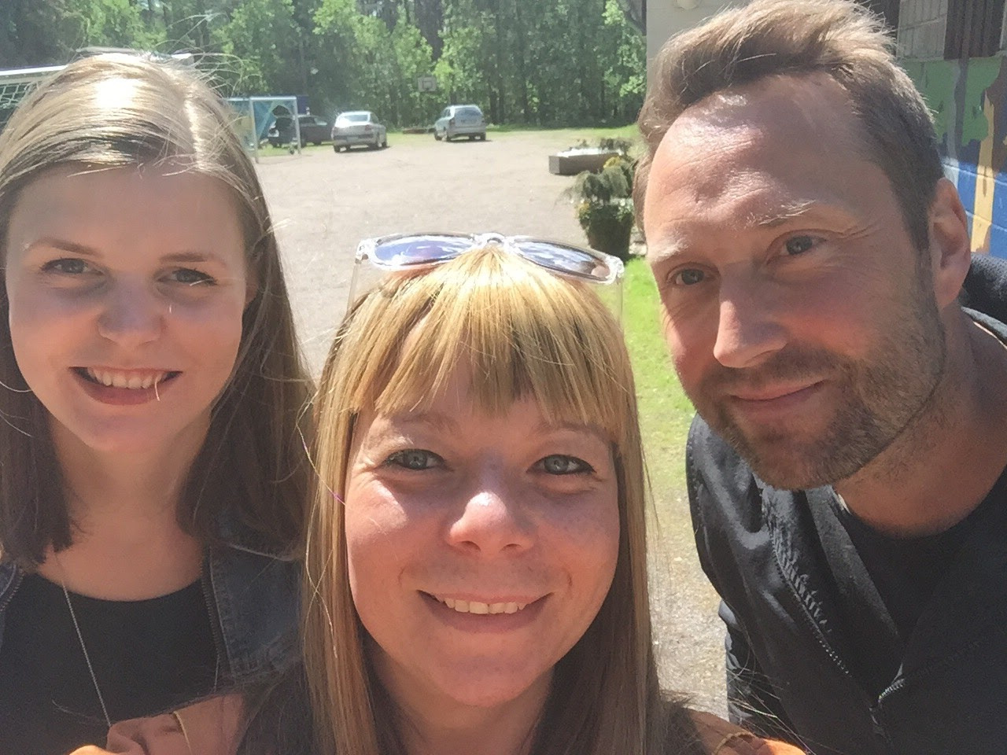
Notes:
In Helsinki I spent a lot of time with a brilliant organisation called A Home That Fits, which is a legacy project born out of the World City of Design award that they received in 2012. Helsinki is really a city that embeds good design within its public services and allows for experimentation and user focused development, just like any cutting edge design studio would. I worked alongside Miki Mielonen, an ex-youth worker and his intern Ella who was studying systems and policy. They have a number of brilliant projects which focus on the renting sector and their work has been reported on worldwide due to its groundbreaking nature. As you’ll see though, their housing pilots are somewhat surprisingly simple and use common sense. Their strength lies in the allowance that has been made by the city to explore these concepts and the way in which they are solving the financial impact of renting by using human-led behaviours and research.

Slide 11
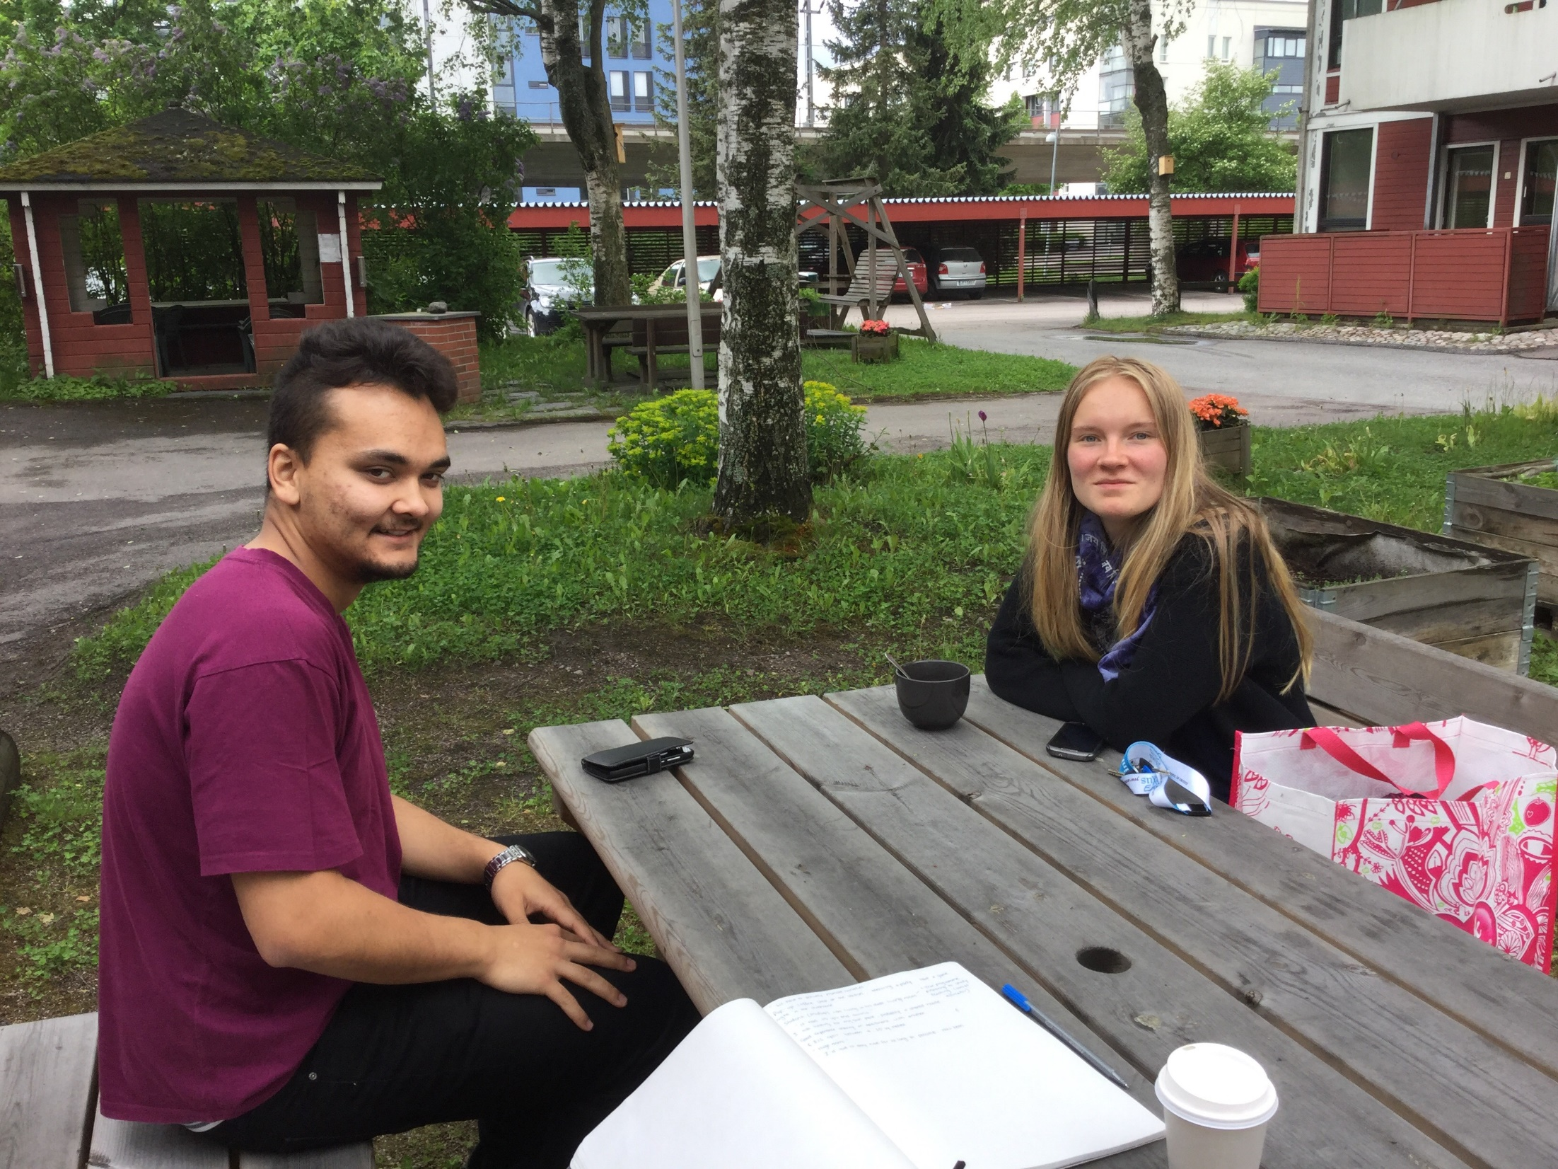
Notes:
All their projects are small short term pilots which have been taking place over the last four years and the first of which that I’d like to talk about is The Good Neighbour Project. This is Laura and Mafua, they are young renters in Helsinki who were originally sofa surfing with friends and family while trying to make their way in work and city life. They were successful applicants in securing a home in the project which covers around 75% of their rent costs, which are 400 euro per person in a shared flat for two. In return, Laura and Mafua were asked to agree to dedicate 20 hours of their time per month towards ‘being a good neighbour’. The project was constructed in such a way that they had to decide on how that service was provided.

Slide 12
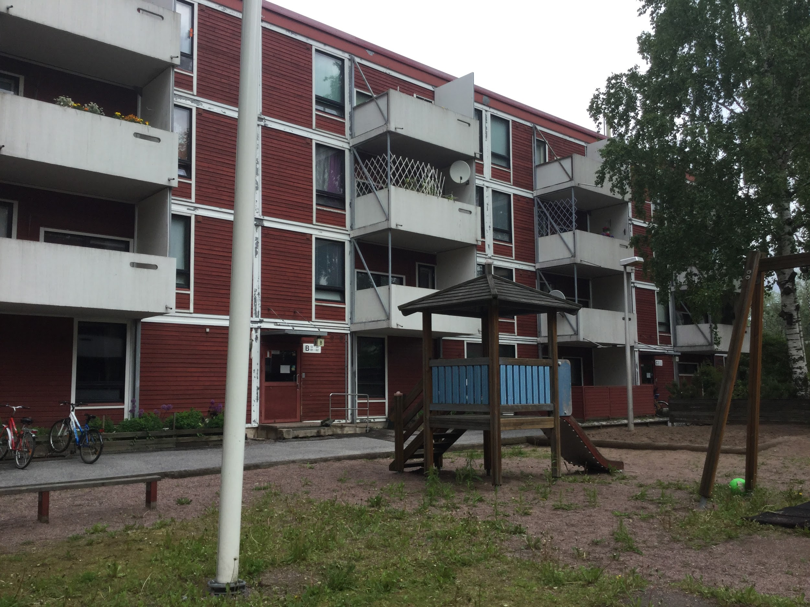
Notes:
Cleverly, they shared a mobile phone and gave the number to surrounding residents and suggested that these people call them if they were in need of home repairs, babysitting services and errands done such as groceries. The uptake was slow at the beginning, but when I visited they were one year in and had regular bookings. They were also offering time at a local residential home where they had begun to host a board games night for residents and the public.

Slide 13
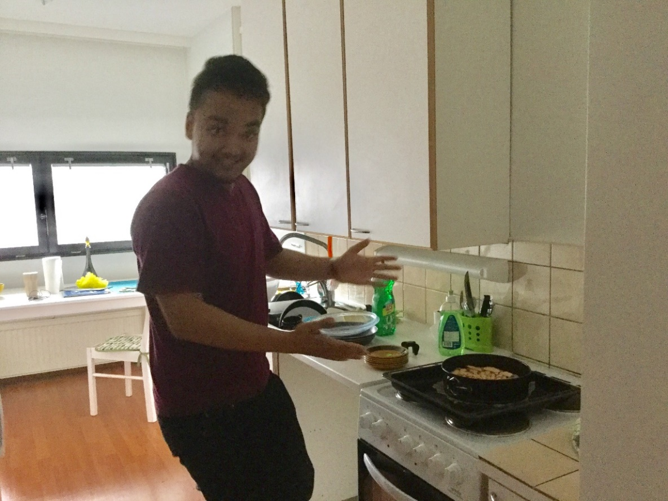
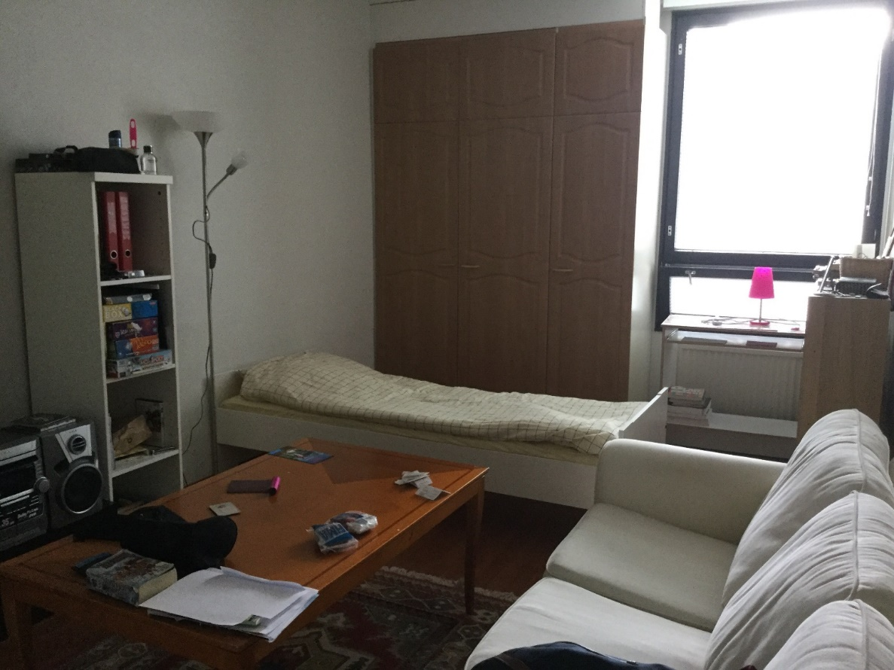
Notes:
I thought that this project was truly remarkable, especially when both of these young people described how their neighbourhood work has impacted their personal lives and how they felt about themselves in the city. Mafua said, “I never want to leave here, I feel like I belong. I have learned a lot about how to work with people.” Laura added, “I feel really at home here, very settled in my community.”

Slide 14
The Repair Project
Oranssi | Helsinki, June 2017

Slide 15
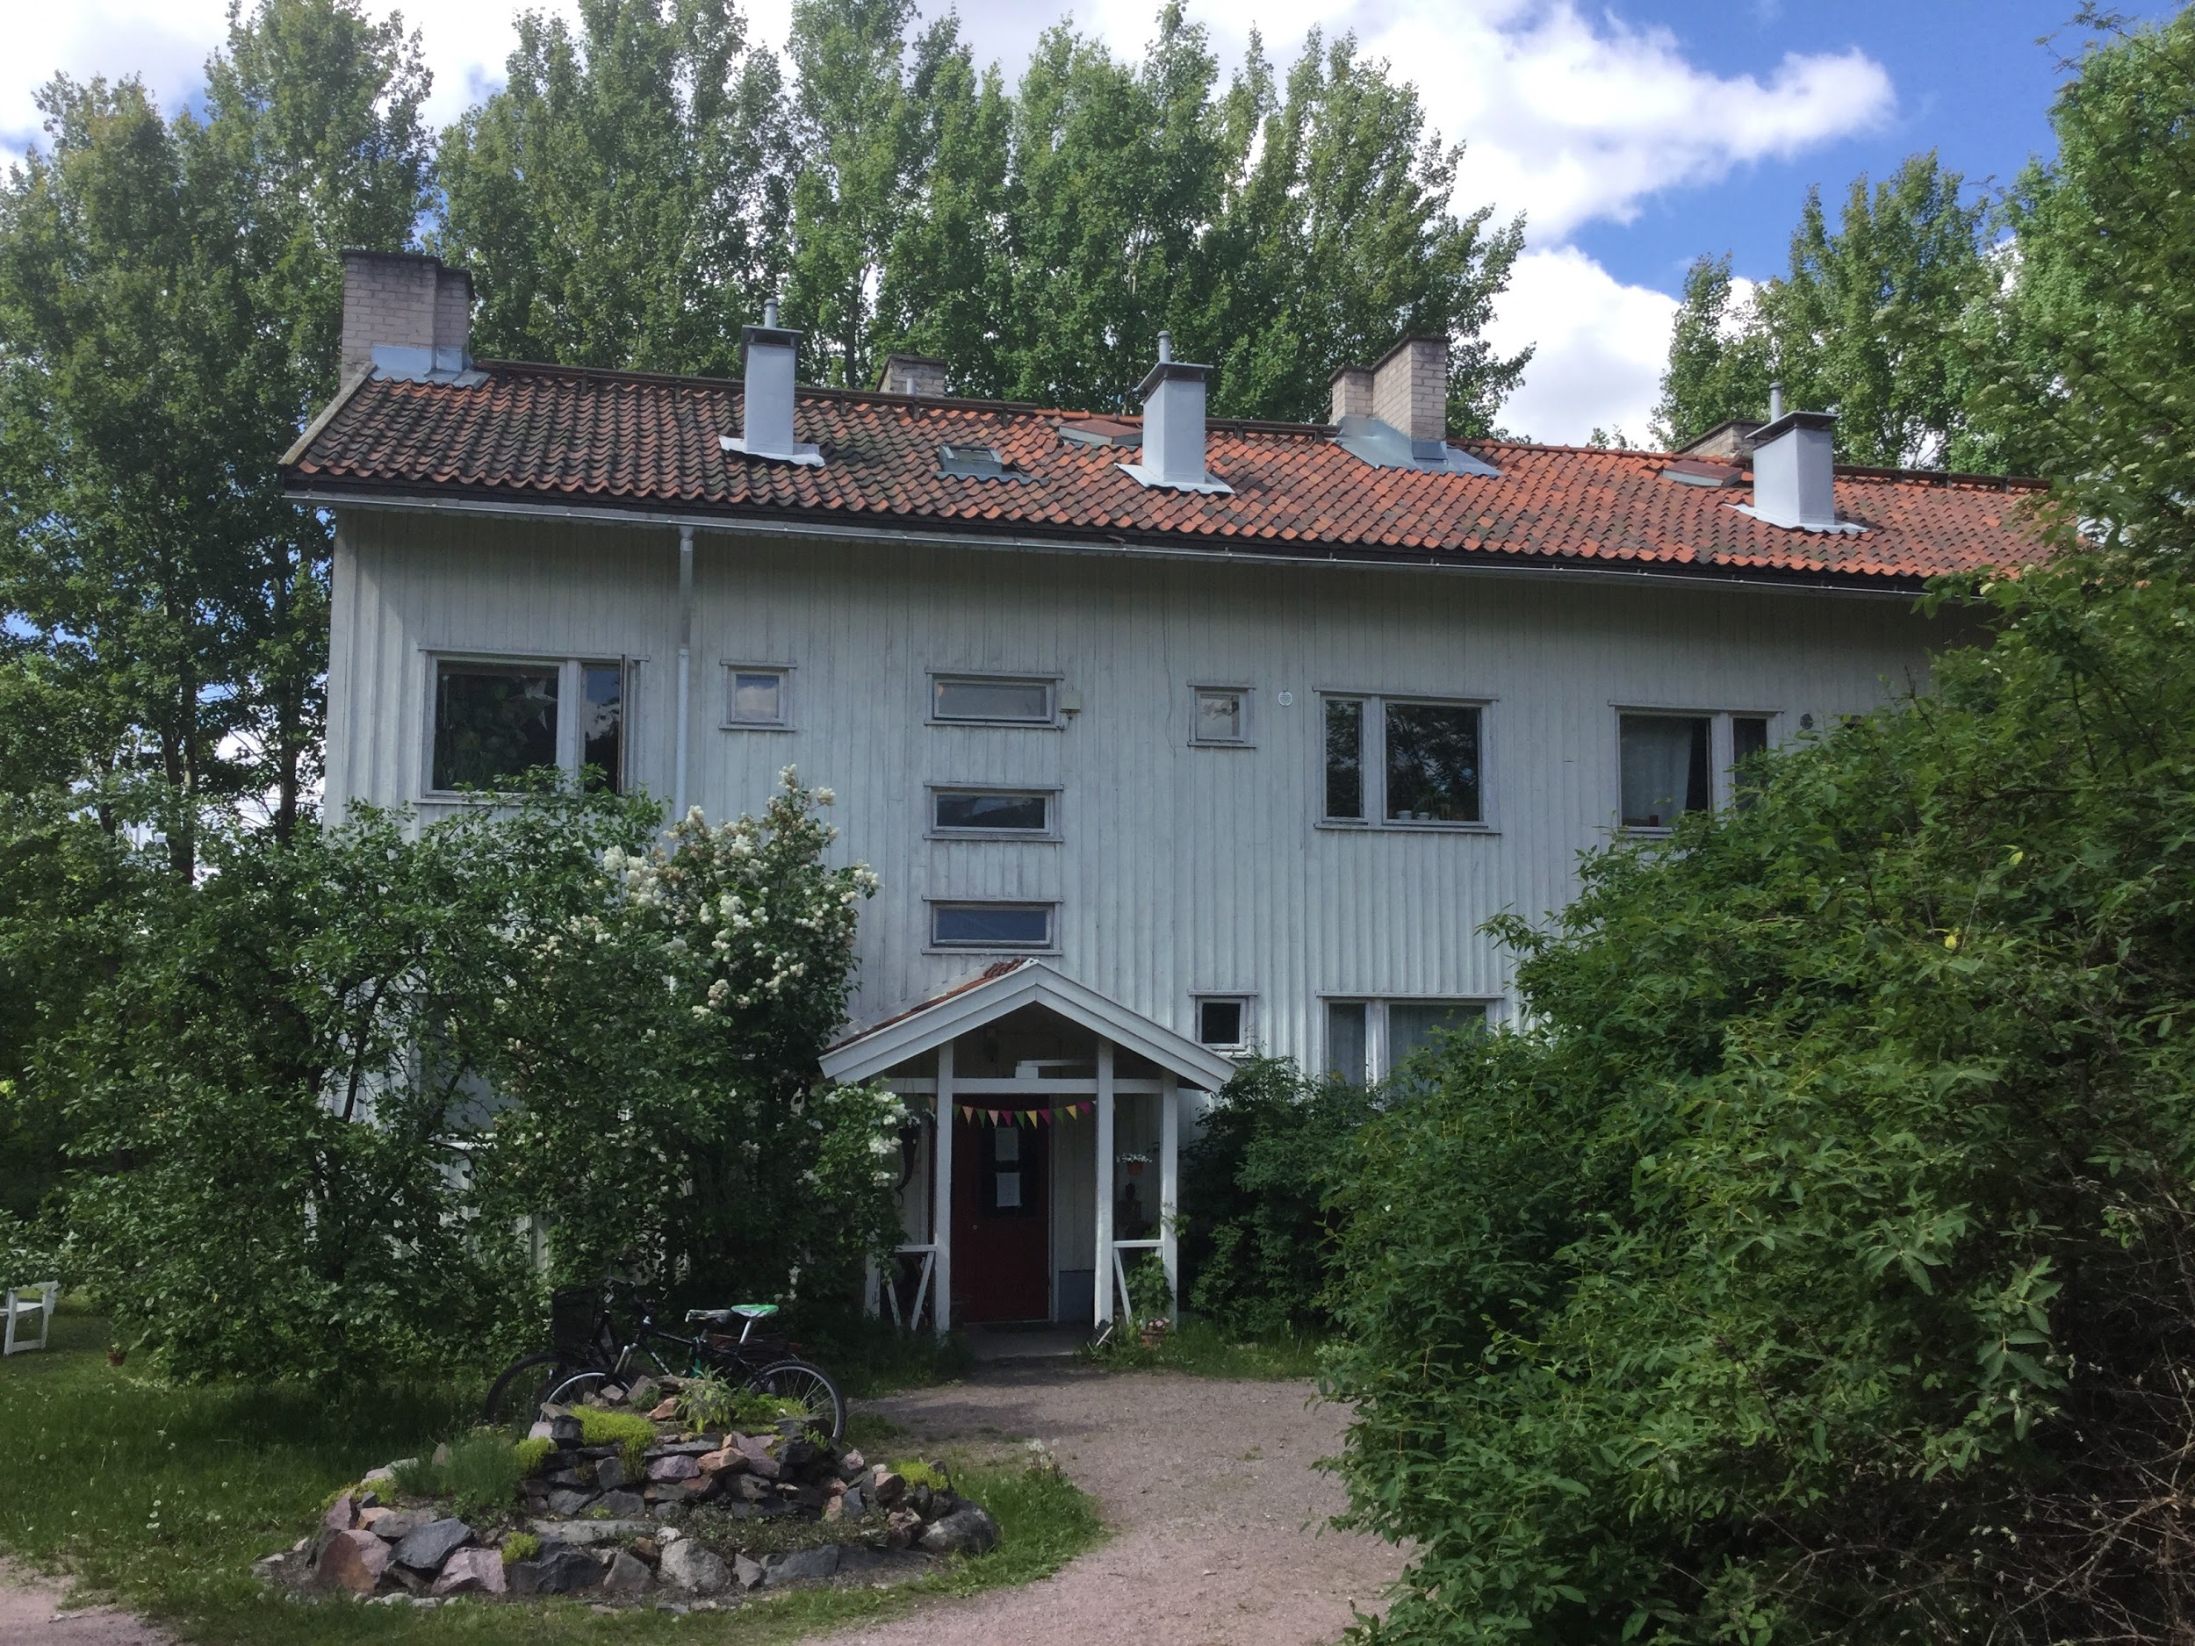

Slide 16
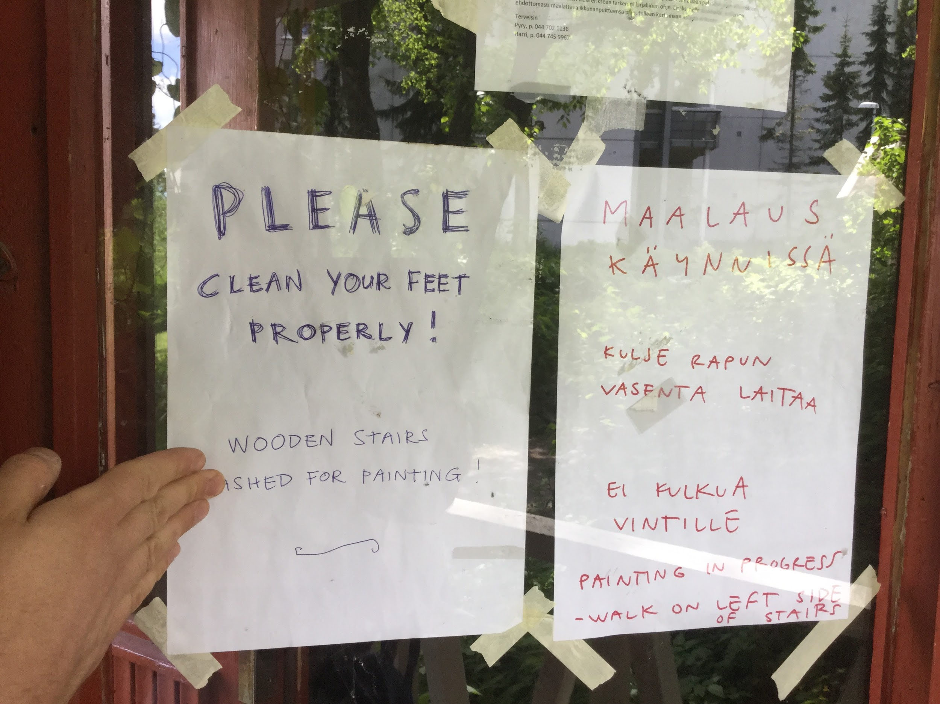
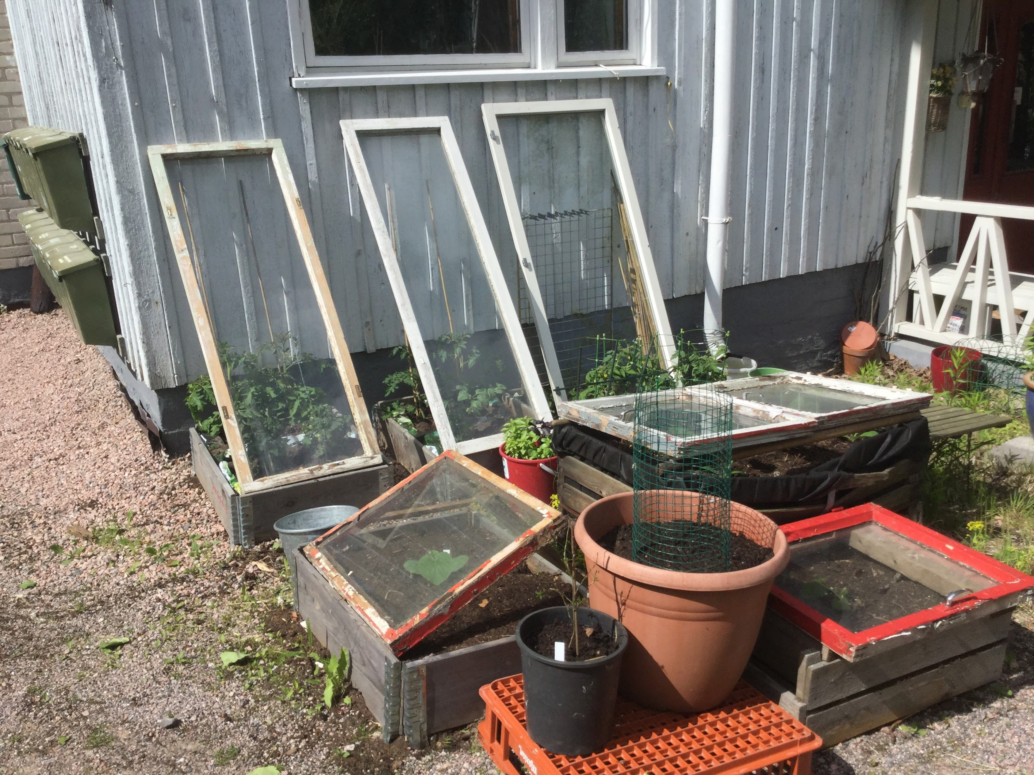

Slide 17




Notes:
Now I would also like to look at how we can try to disengage the exchange of housing for money and wealth. The current inequalities within the system might be slightly alleviated if we could include other more accessible currencies such as time and work. While still not ideal that we have some large hills to climb with actually getting a house - these other currencies also bring some additional benefits when connected to the attainment of housing, such as a better sense of belonging and an increased sense of purpose

Slide 18
Housing First
The Y Foundation | Helsinki, June 2017

Slide 19
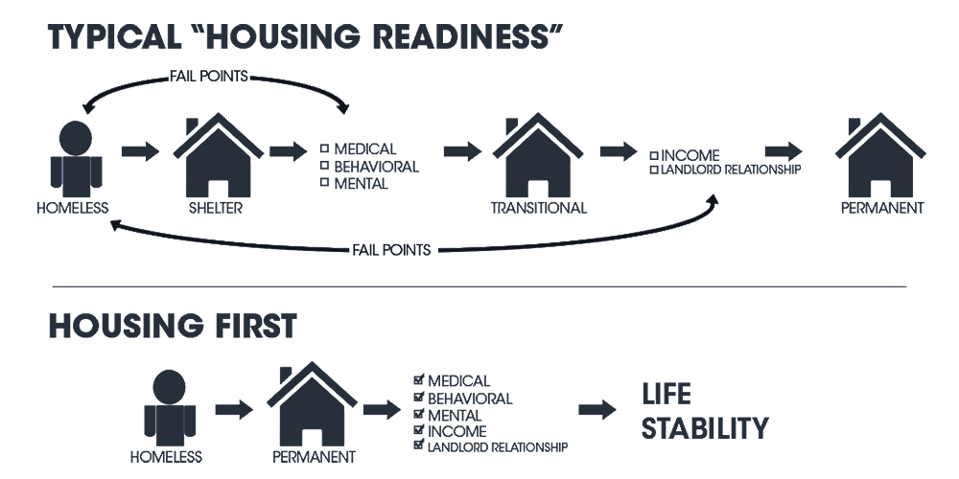

Slide 20
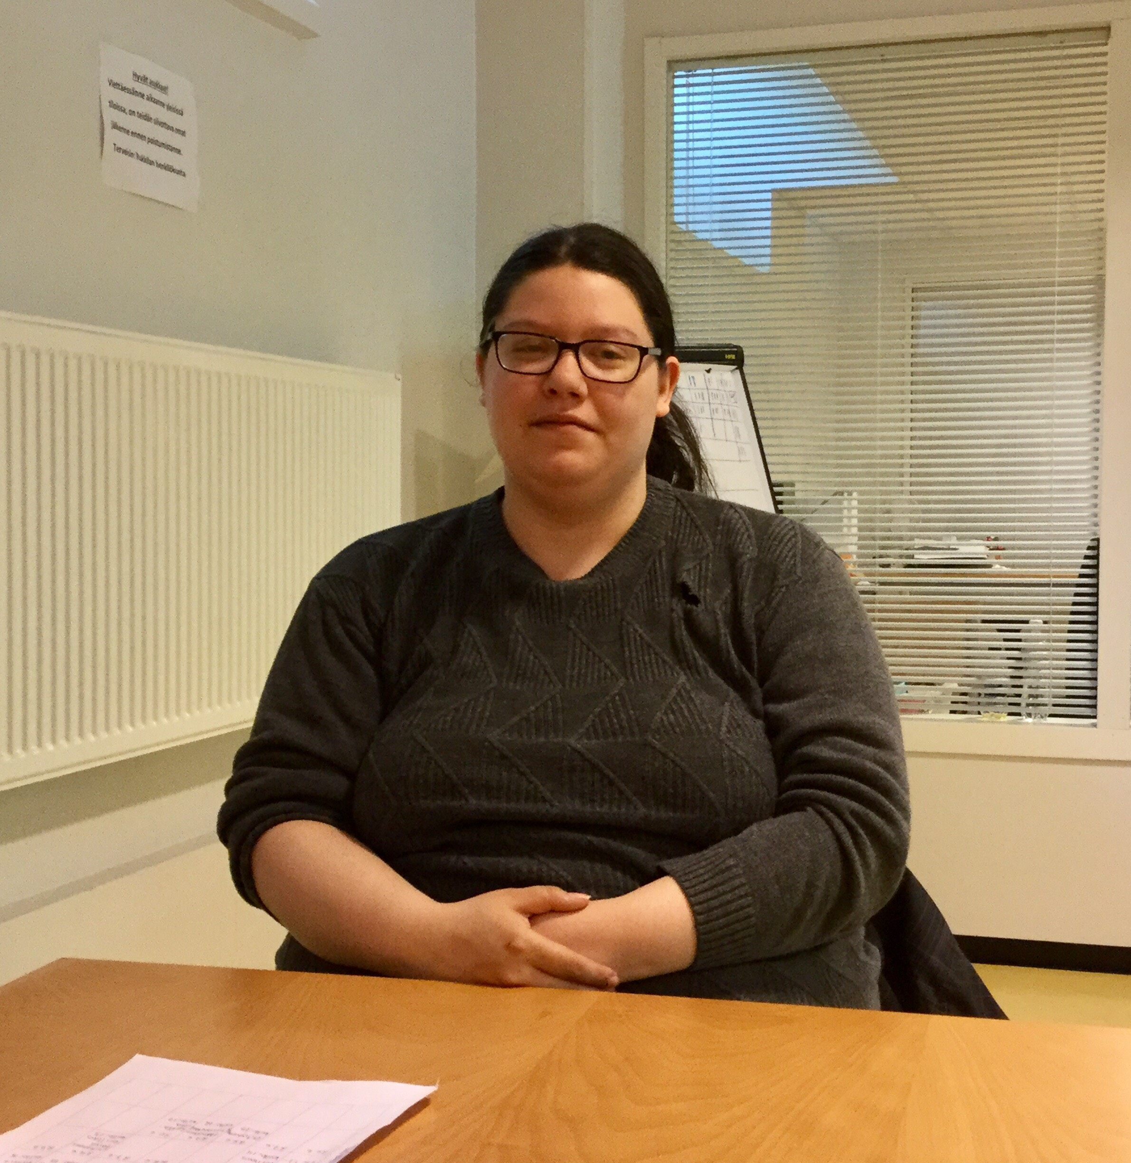
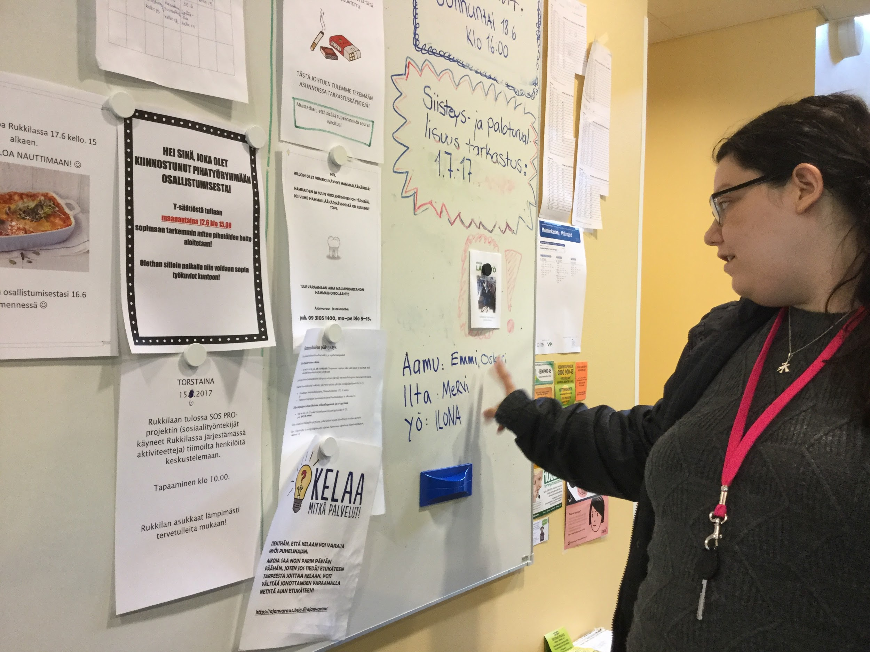

Slide 21
£20,128 per year
(At What Cost? Report, An estimation of the financial costs
of single homelessness in the UK Nicholas Pleace, Centre
for Housing Policy, University of York, 2015)

Slide 22
£4,298 - NHS
£2,099 - Mental Health Services
£11,991 - Criminal Justice System

Slide 23
A modern eco-village
Suderbyn | Gotland, Sweden July 2017

Slide 24
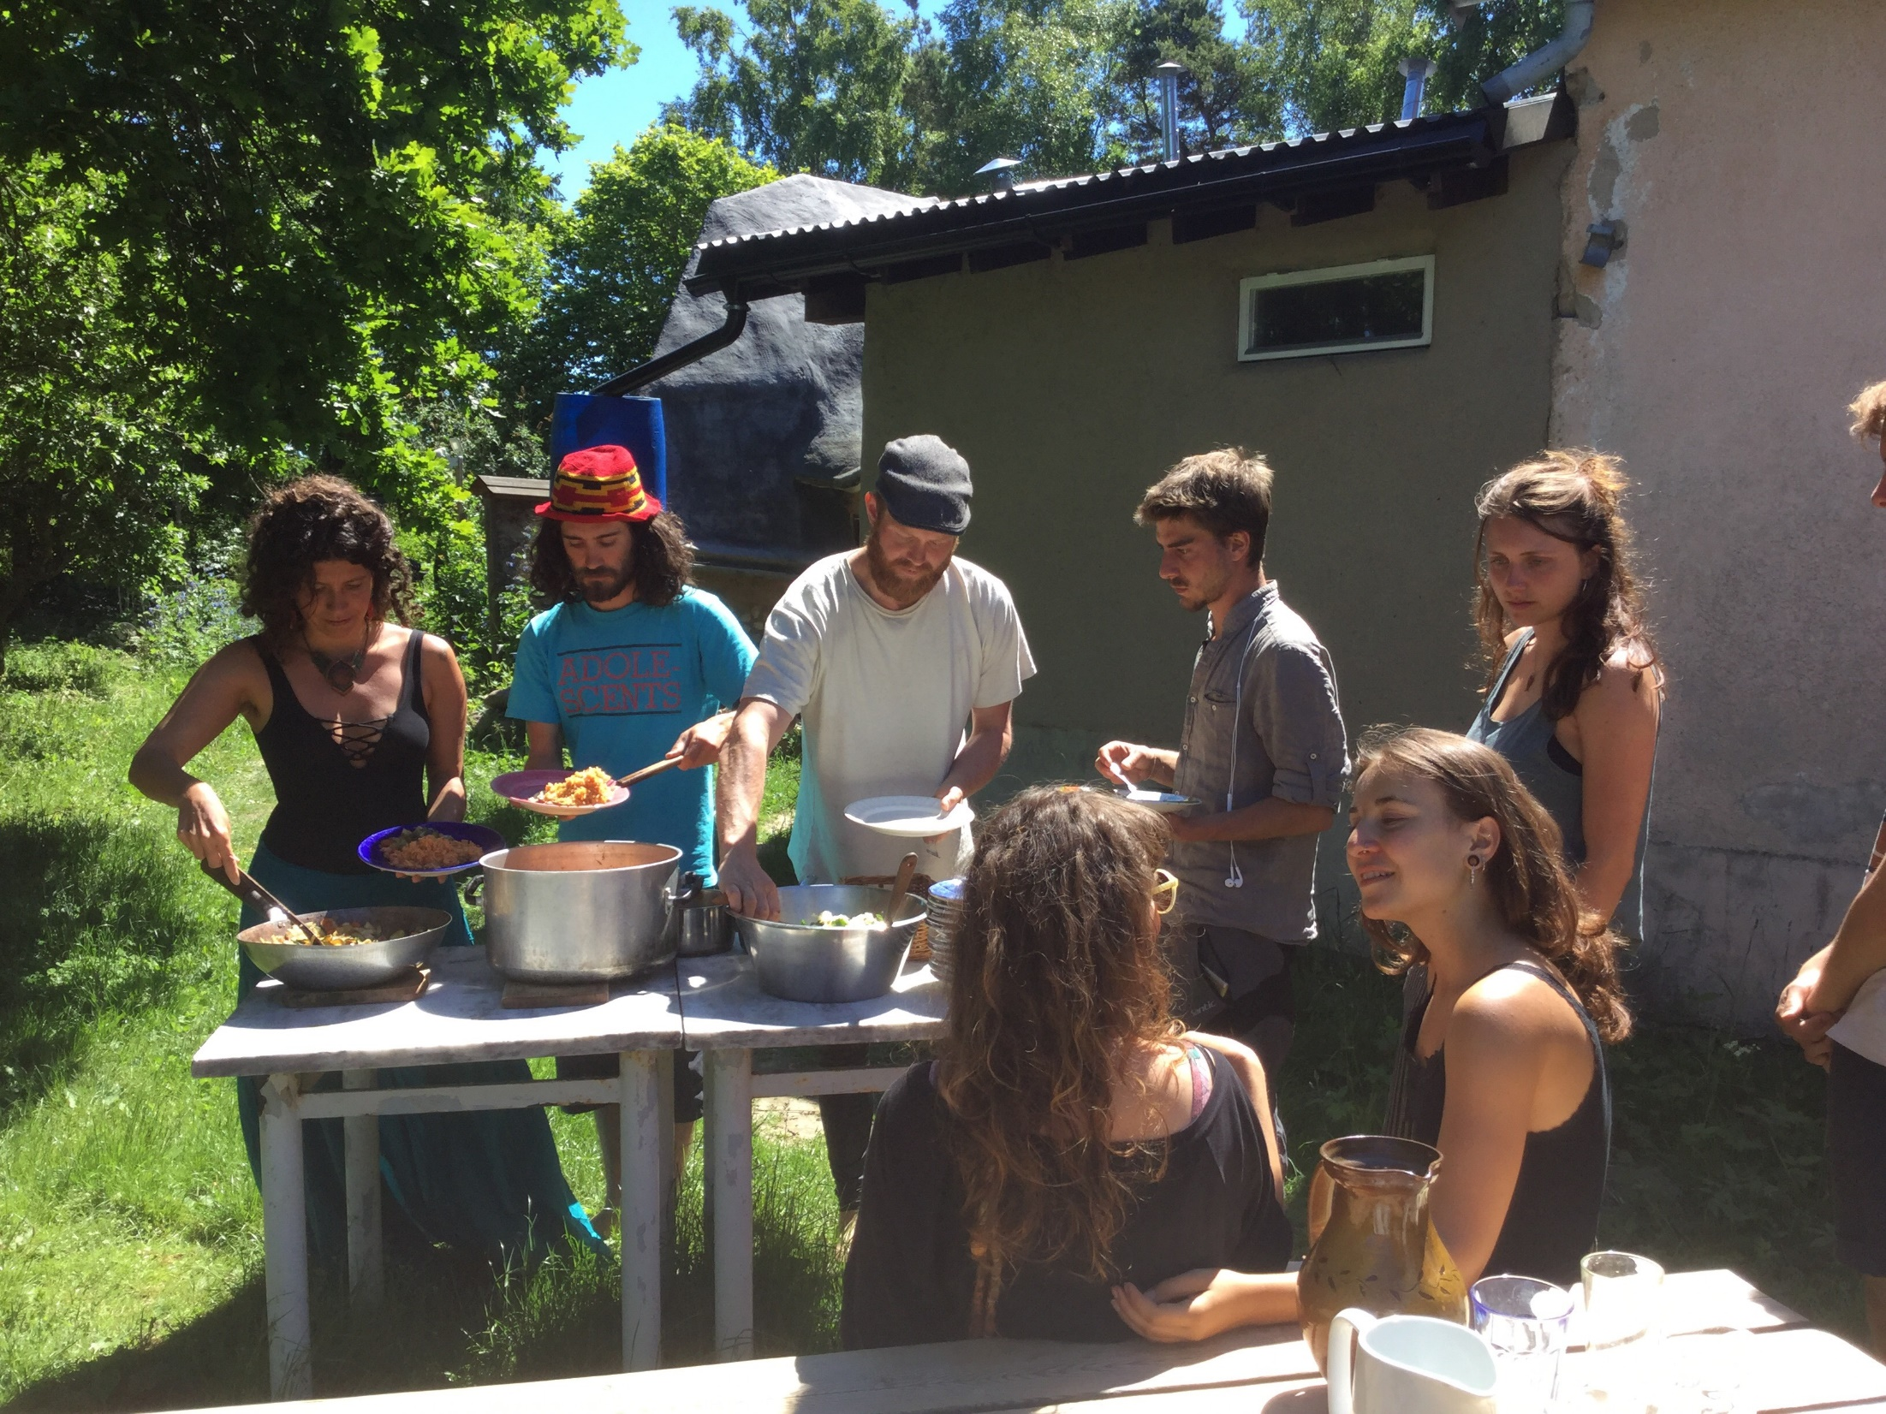
Notes:
I spent a week living in what I what describe as a high tech eco-community on the island of Gotland off the coast of Sweden in June 2017 - Suderbyn. I learned a lot from this community in relation to what seems to work in making people feel valued and that they belong. I also saw how they used both physical and social spaces to create opportunities for individuals to contribute to the community and their housing, which in turn brought that sense of belonging in a relatively short space of time. I wonder how we can incorporate more of this into our housing allocation processes here? Are there spaces where we could invite potential tenants to take some ownership over the housing process or give them the opportunity to contribute to the community that they are about to be part of?

Slide 25
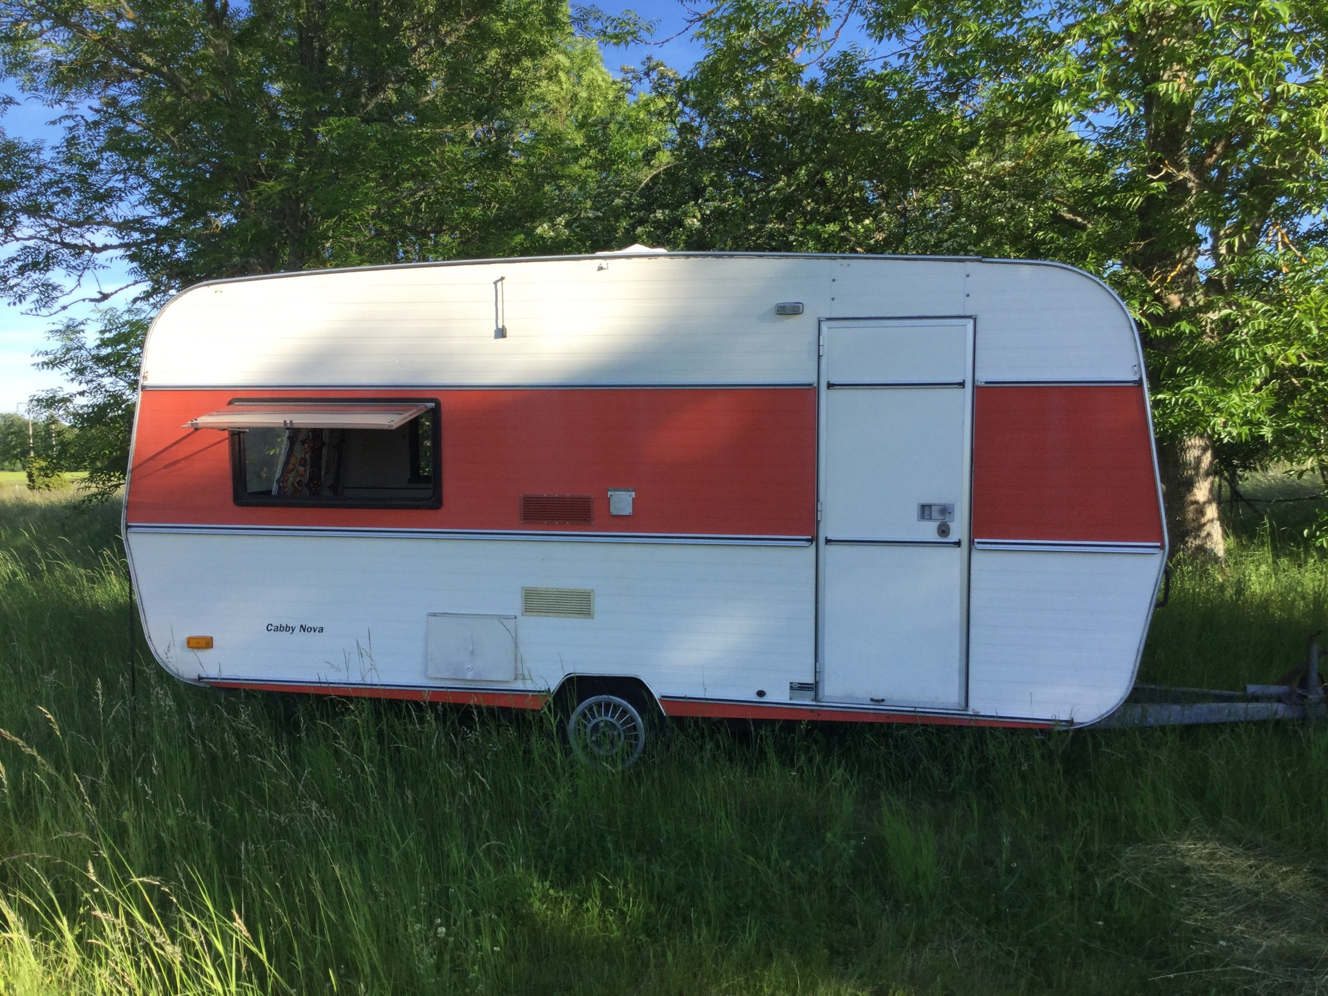

Slide 26
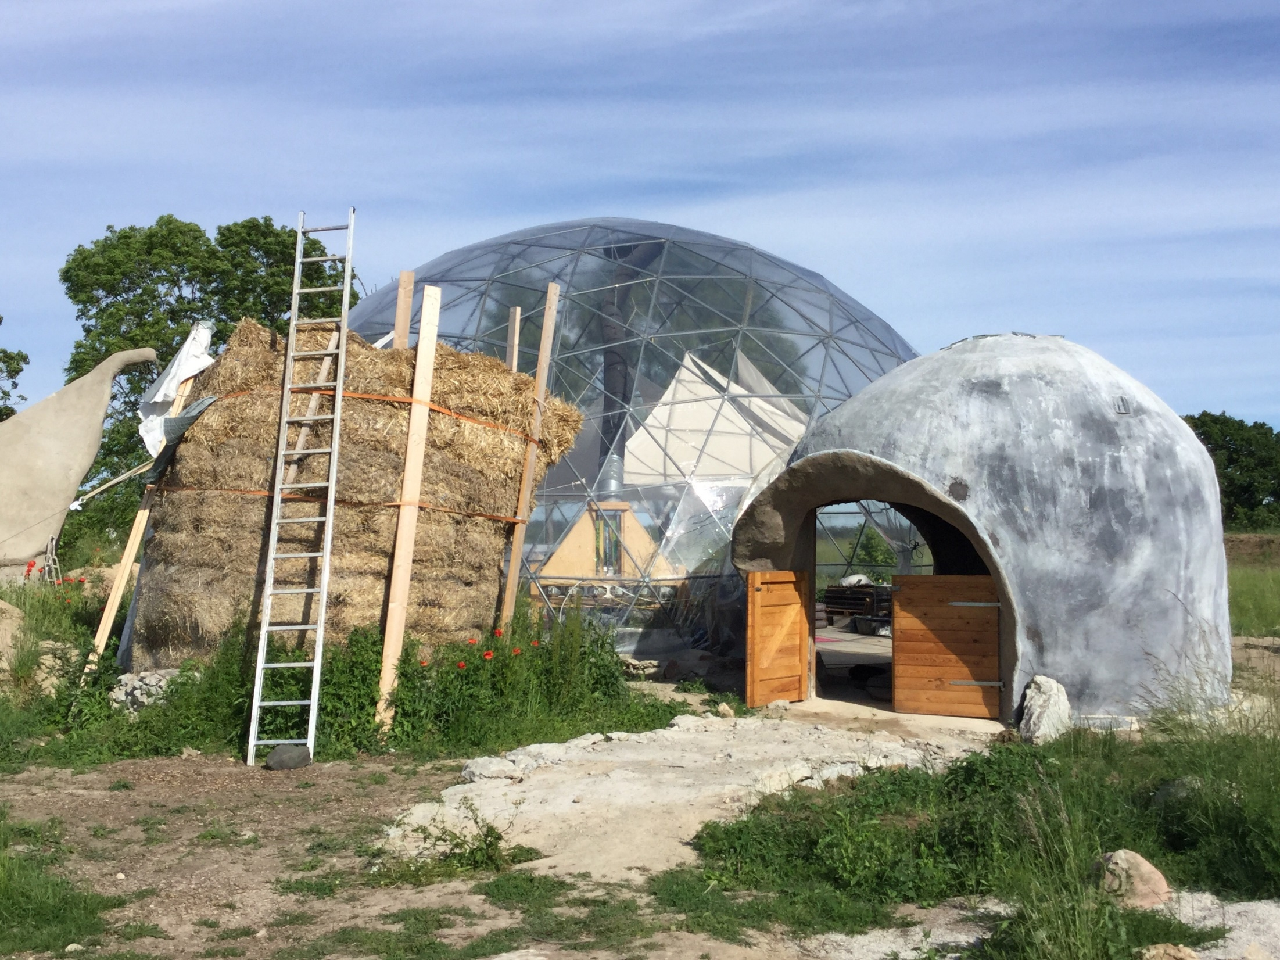
Notes:
Suderbyn is founded on a series of permaculture principles which has led to the development of self-initiated projects such as the biodome here which produces biogas, this fuels the car sharing project.

Slide 27
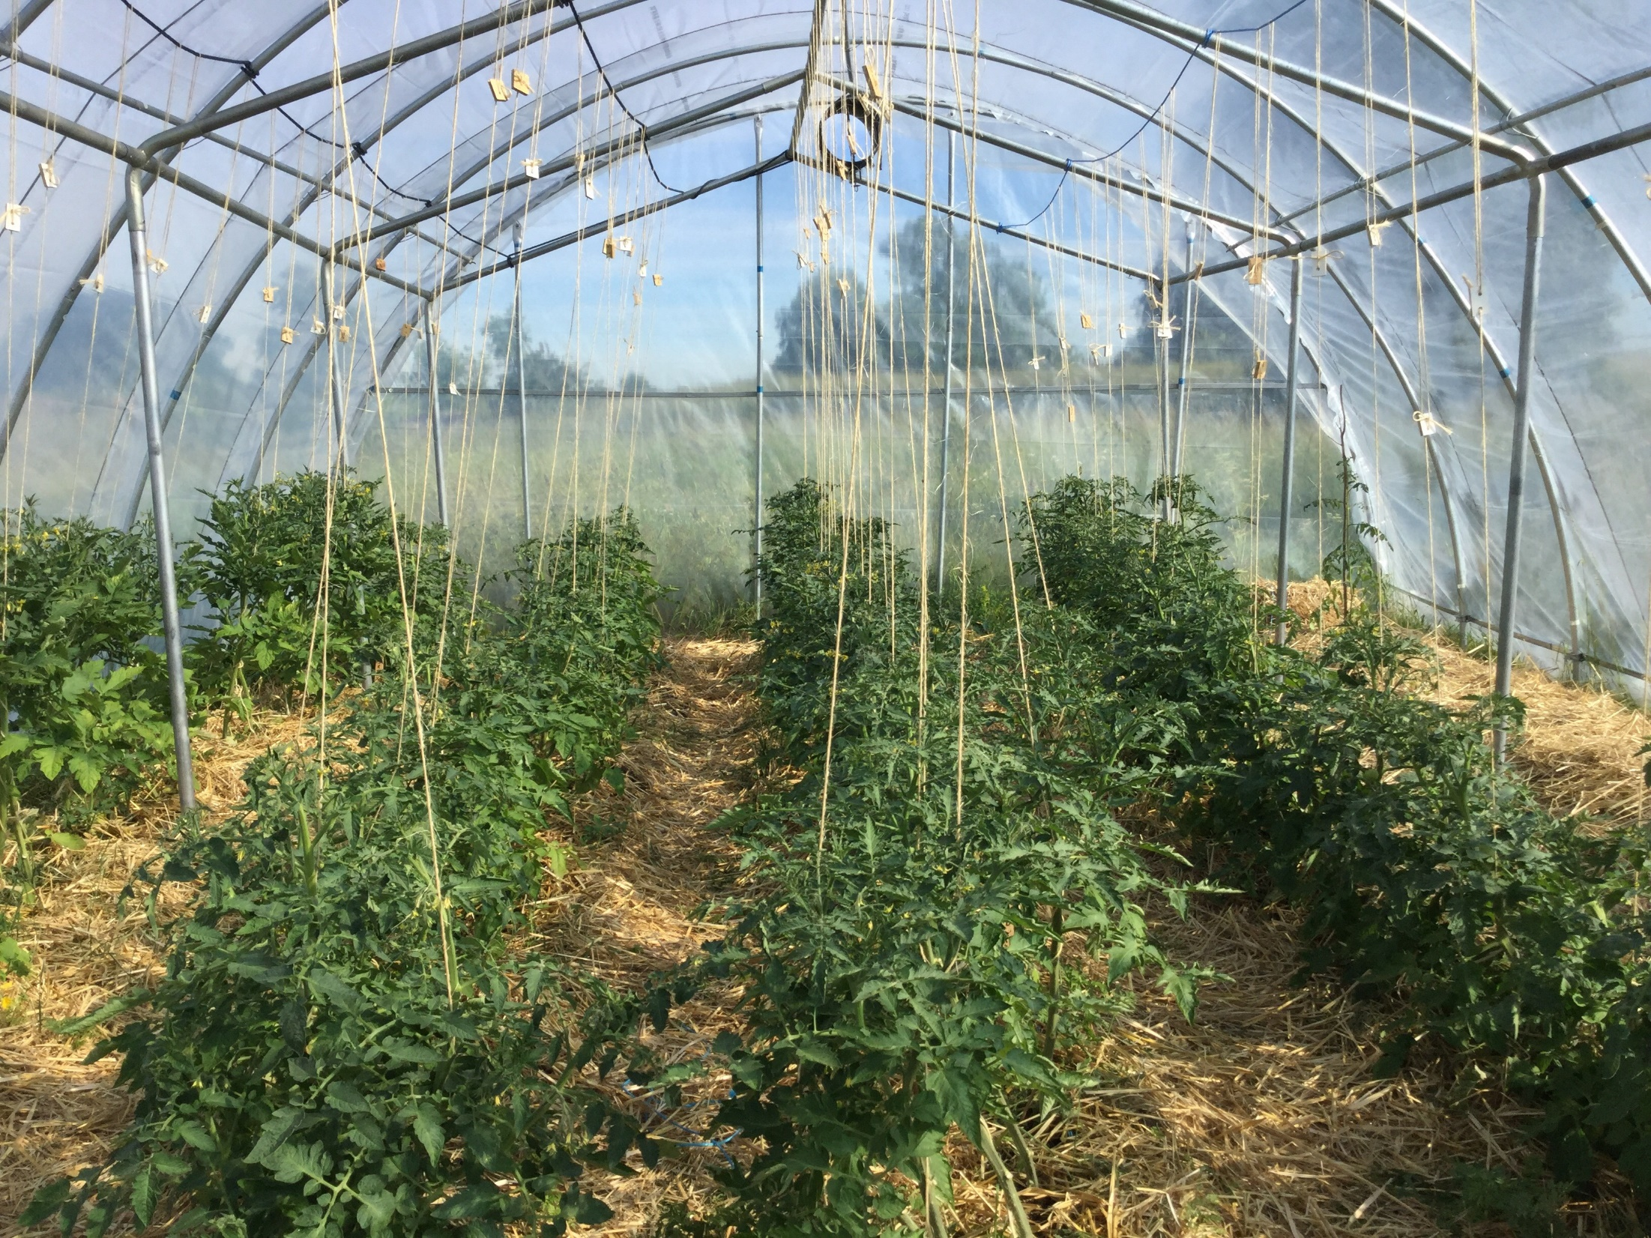
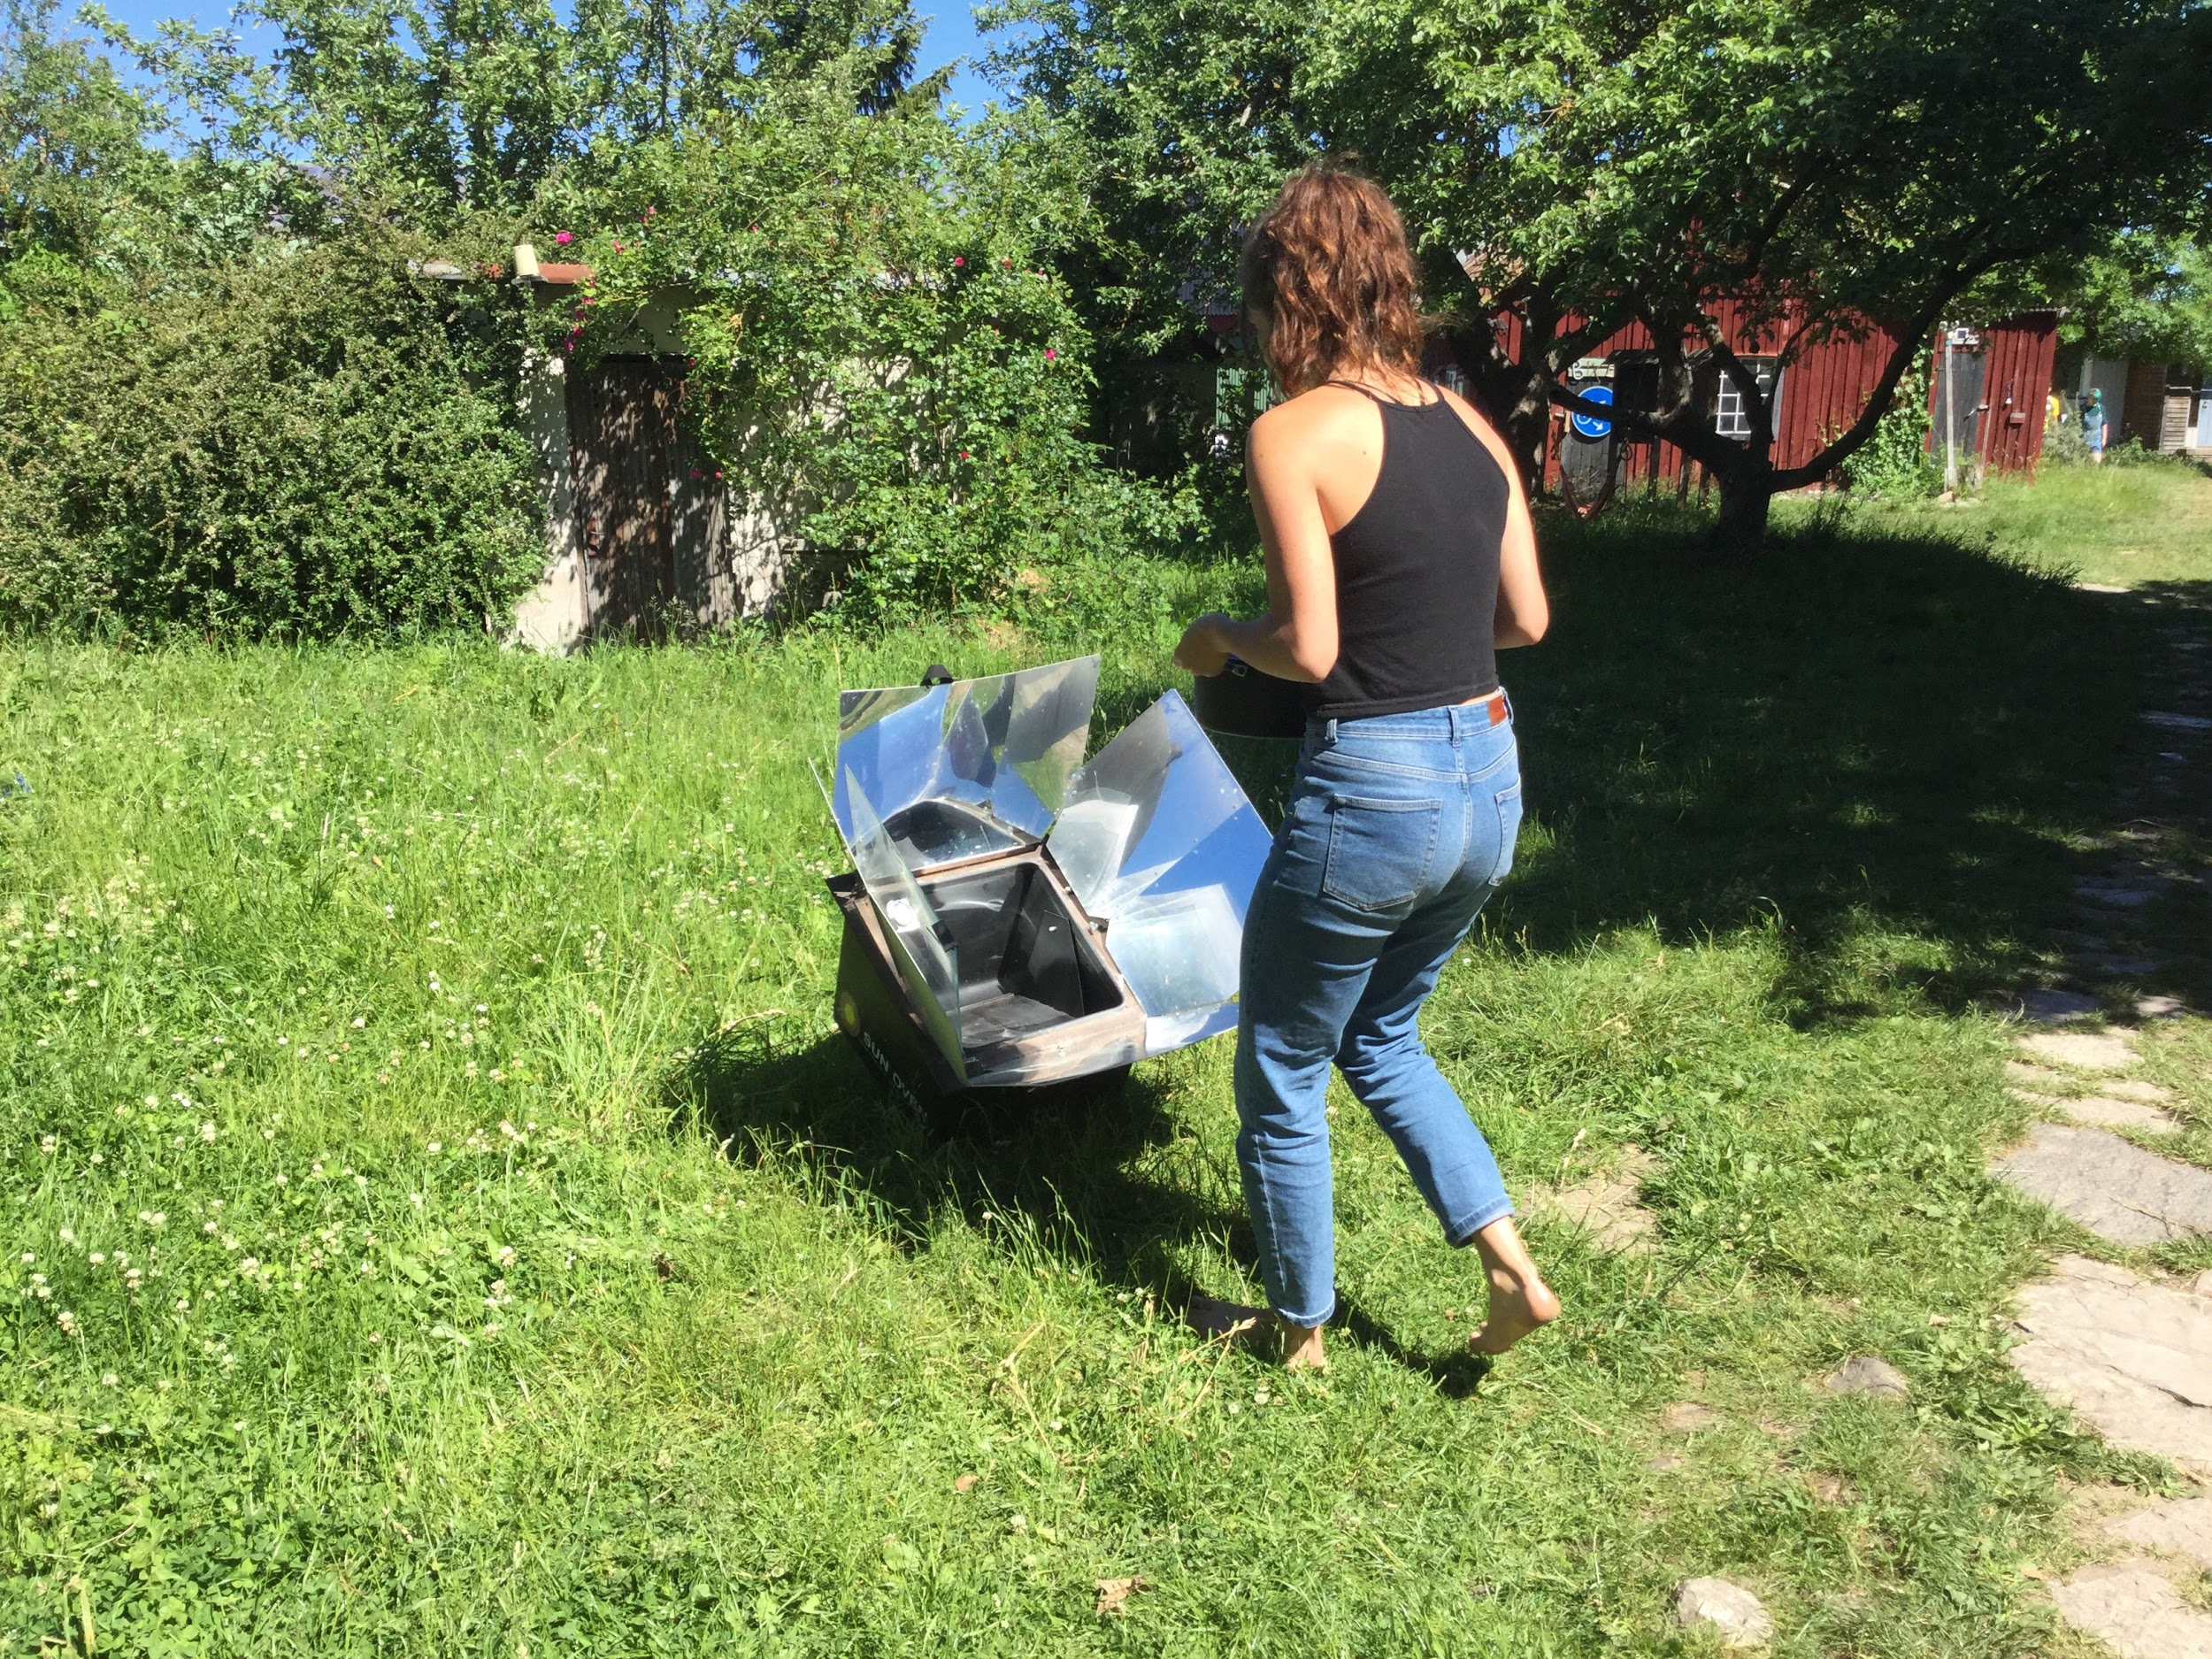
Notes:
Most of the systems within this community are closed loop and the community continuously seek members input on how they can use their skills to create more environmental innovation. People could pitch ideas at their weekly meetings and if the group agreed then they would gather a small sub-group to pursue the work such as the development of an anti-war festival, which is what was being worked on while I was there. Some of the people I met there were gardeners, youth workers, some were scientists and researchers, whilst others were starting young families. Each of us was treated as a resource of skills and time that could be given to the community, and importantly we were in charge of how we made that contribution. This ideology promoted a sense of both responsibility and freedom

Slide 28
Dignity Village
Self-governing, self-sufficient, city sanctioned homeless community | Portland, Oregon, October 2017

Slide 29
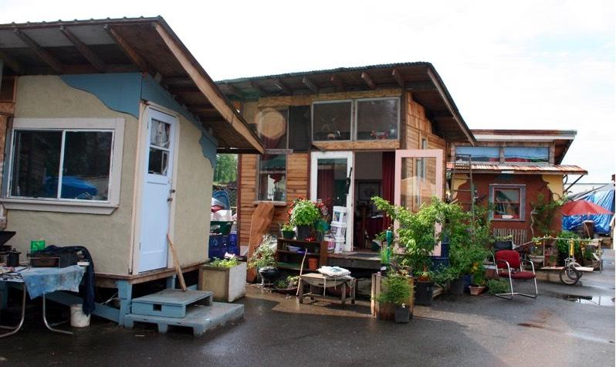

Slide 30
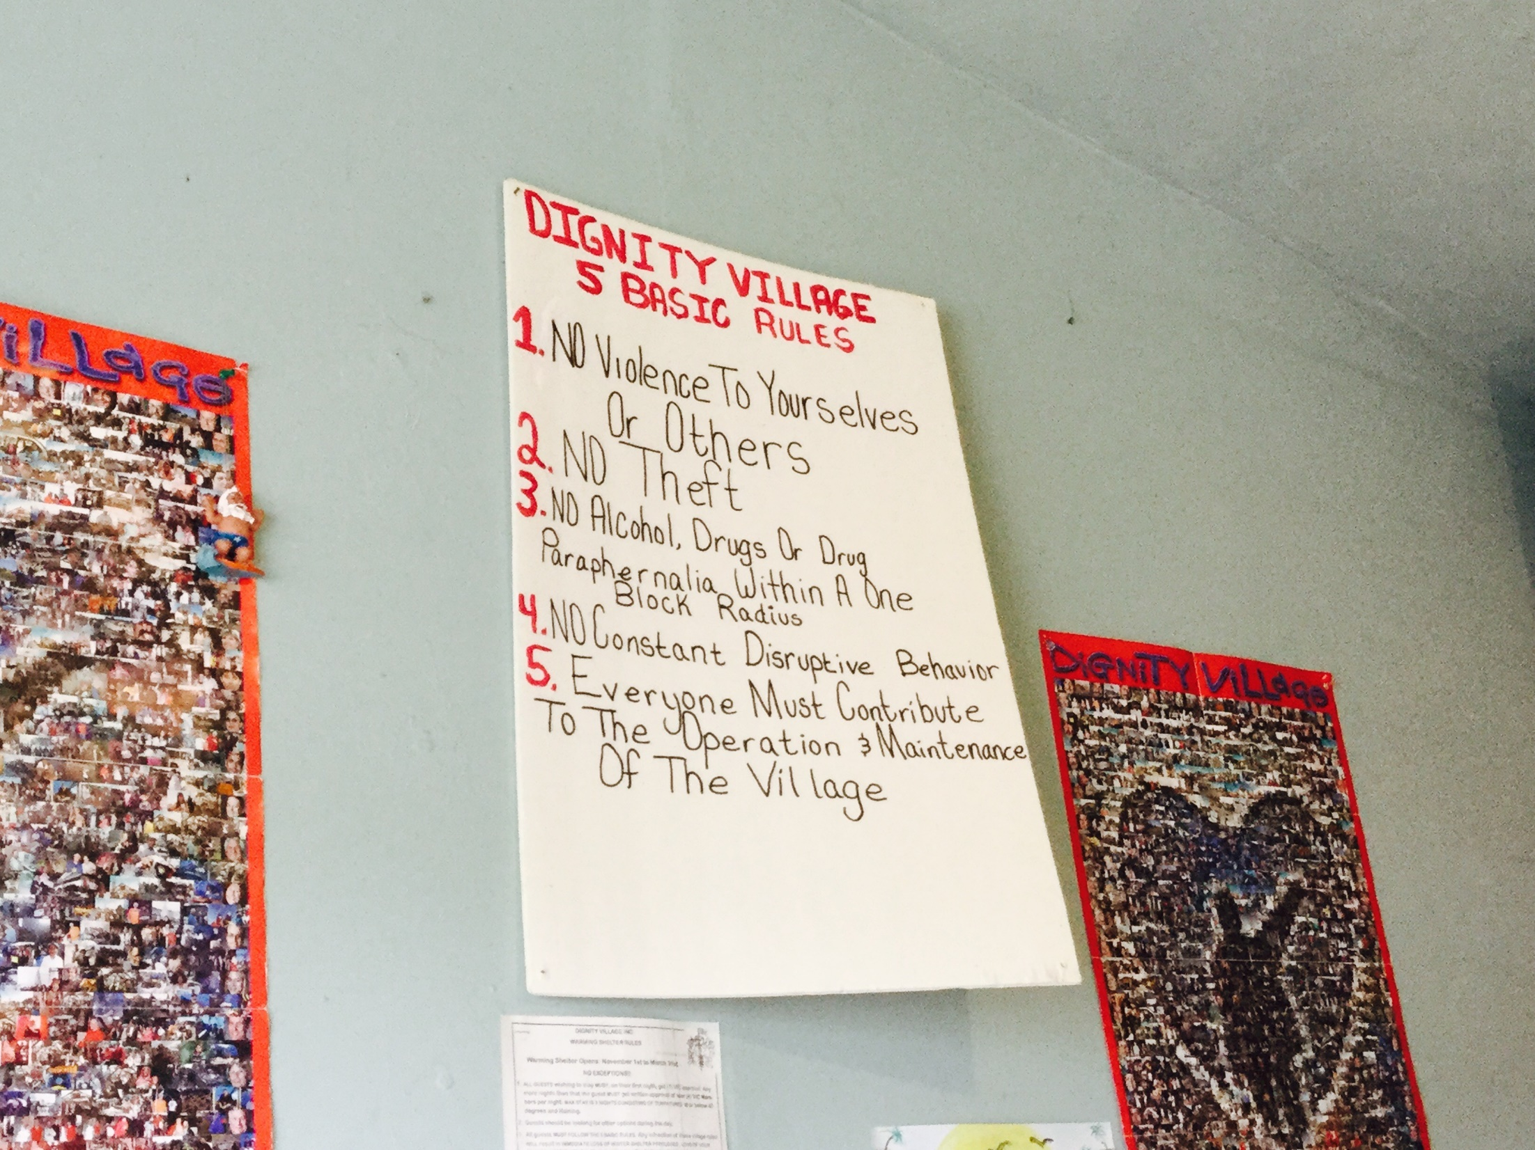

Slide 31
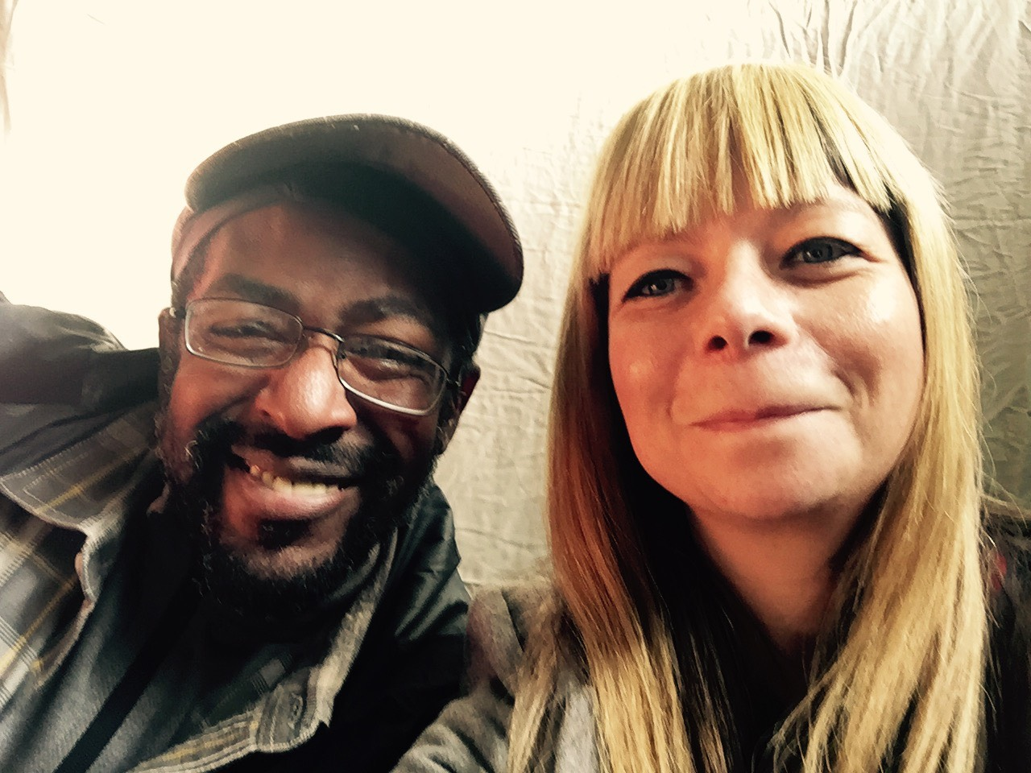
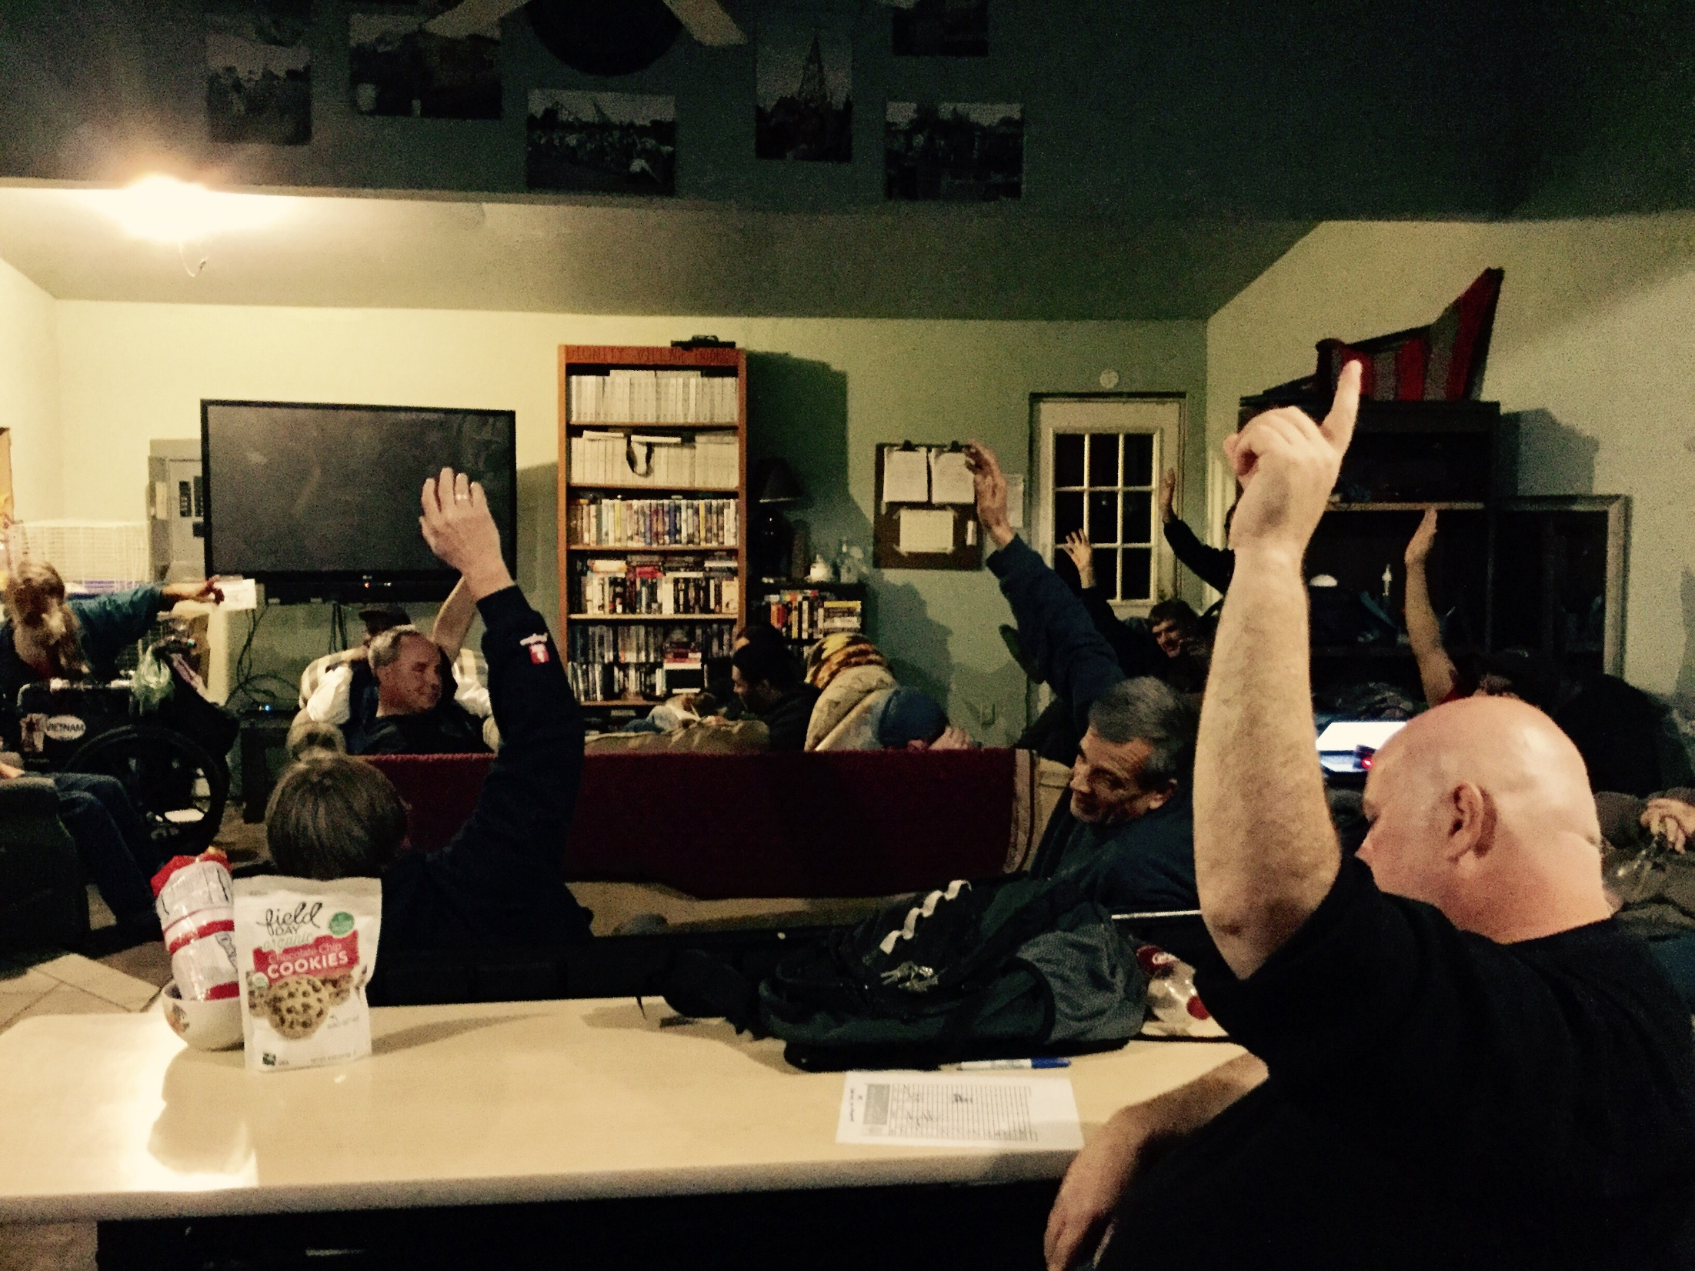
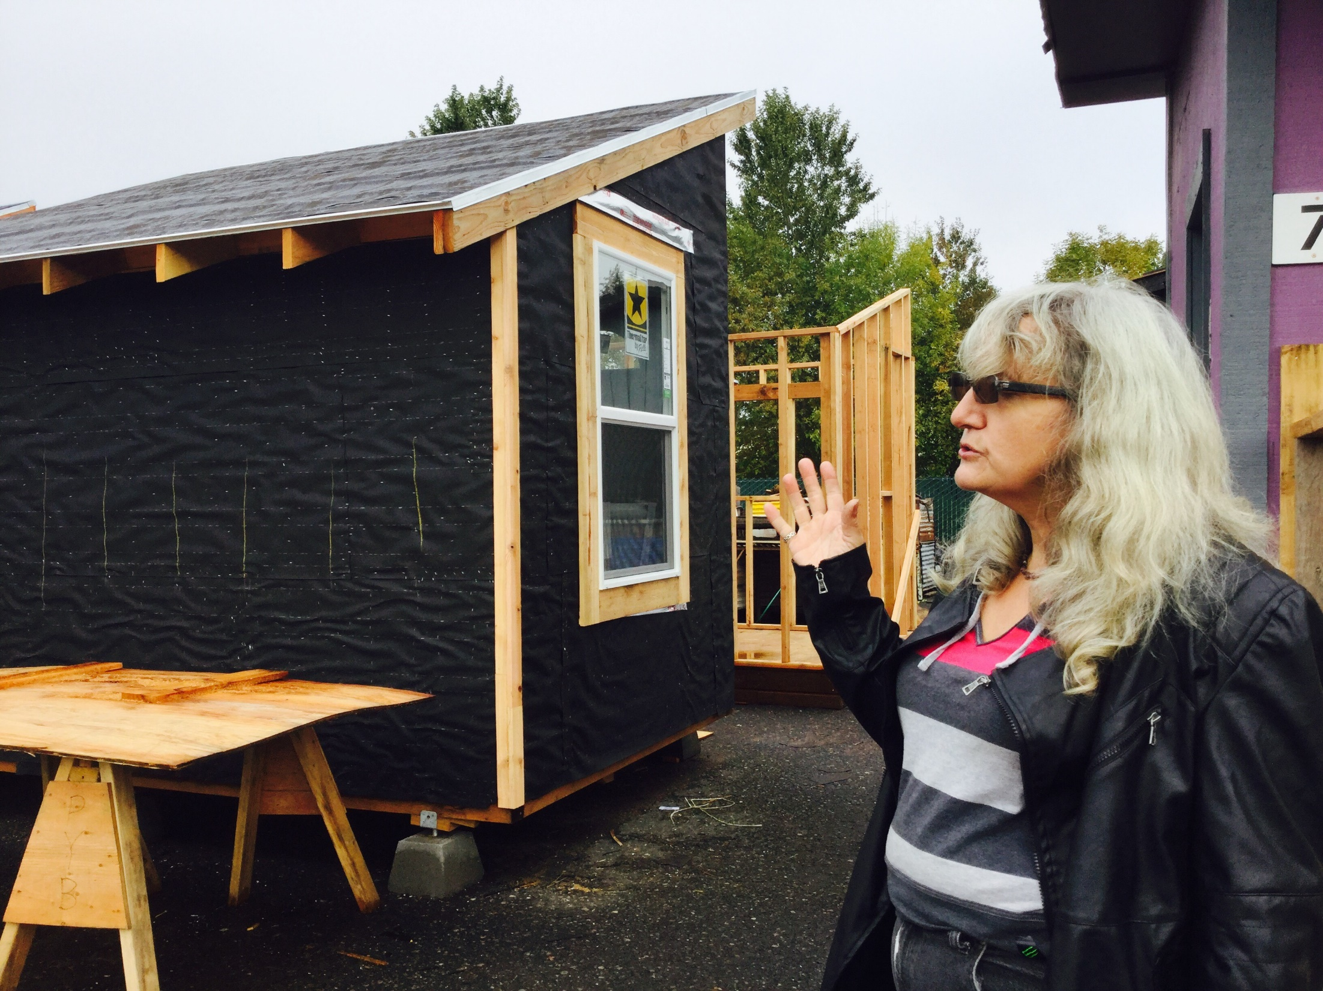

Slide 32
Cohousing & Co-operatives
Spreefeld, Berlin / Yorspace, York / SOA, Dublin /
Cohousing connections, N.I.

Slide 33
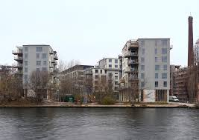
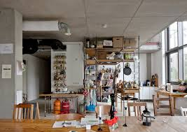

Slide 34
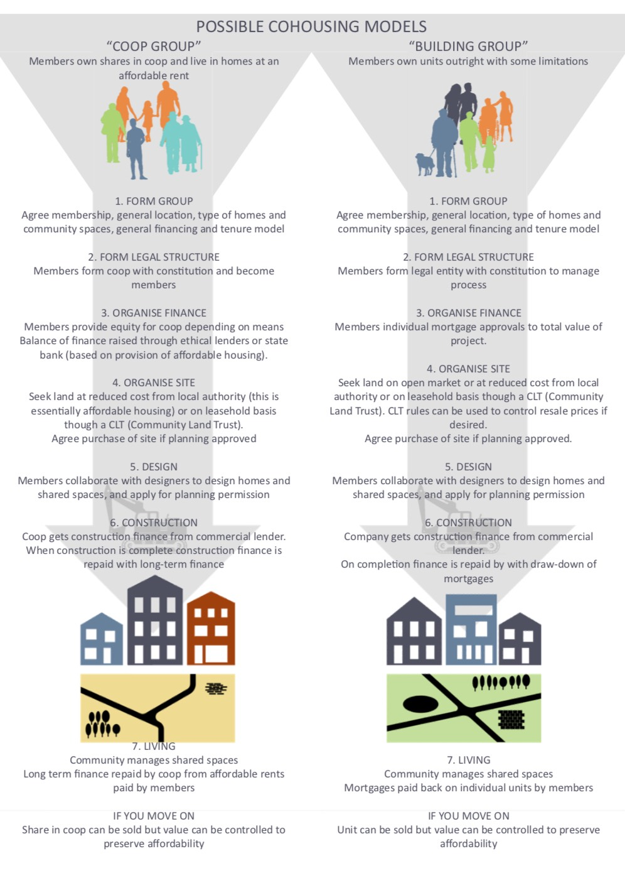

Slide 35


Slide 36
Homeless Veteran Village
Centre for Public Interest Design | Portland Oregon October 2017

Slide 37
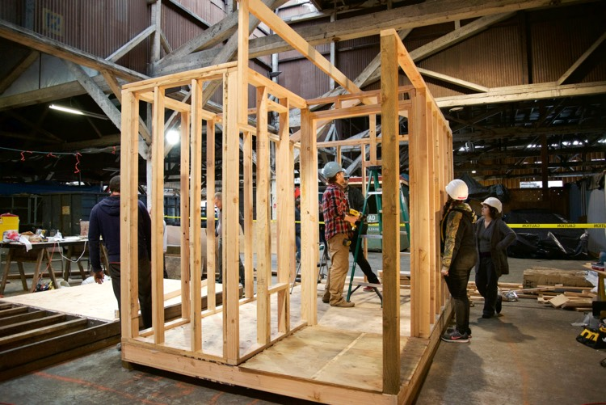

Slide 38
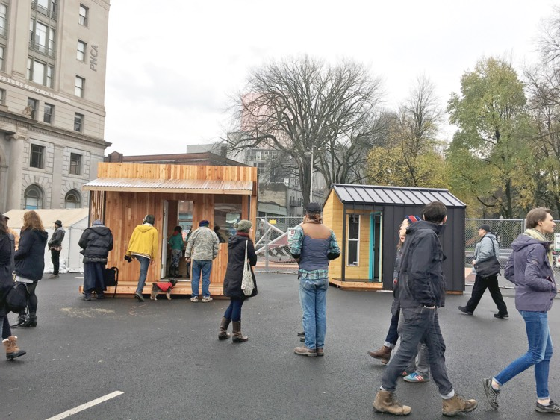

Slide 39

Trial 1 (2019): Small Living
This trial aims to bring together a community of interested organisations and individuals interested in tiny homes. We have formed Tiny Homes
Community Belfast, a collective of three charities and over 40 individuals interested in this type of housing.
Belfast Housing Lab
A collaboration between The Holding Project & EastSide Partnership
Funded by the Nationwide Community Foundation

Slide 40
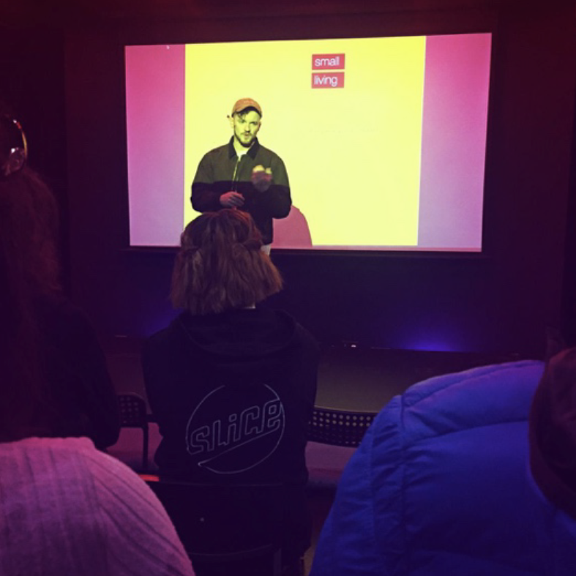
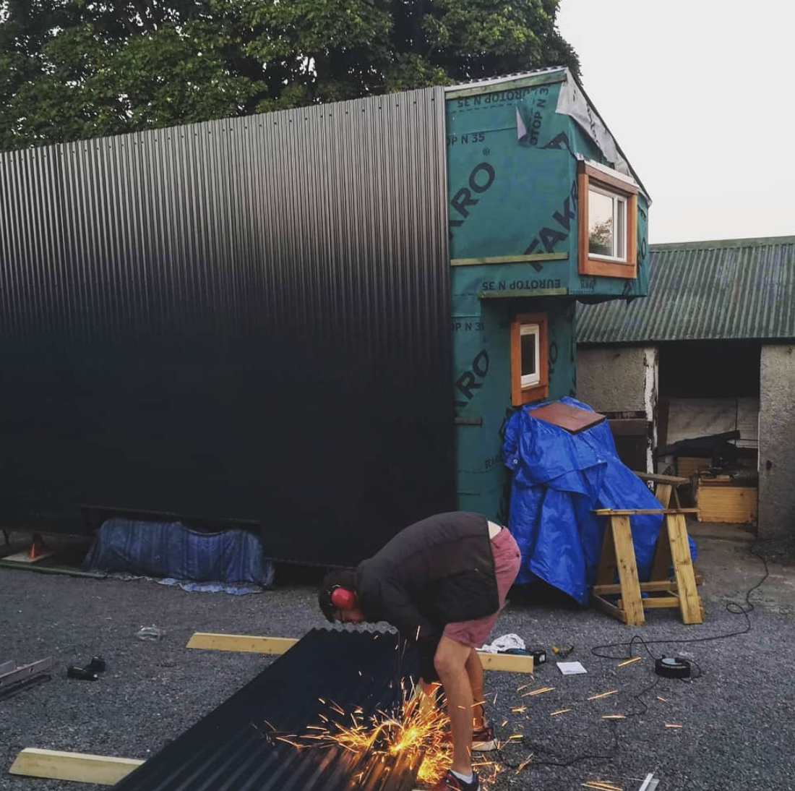
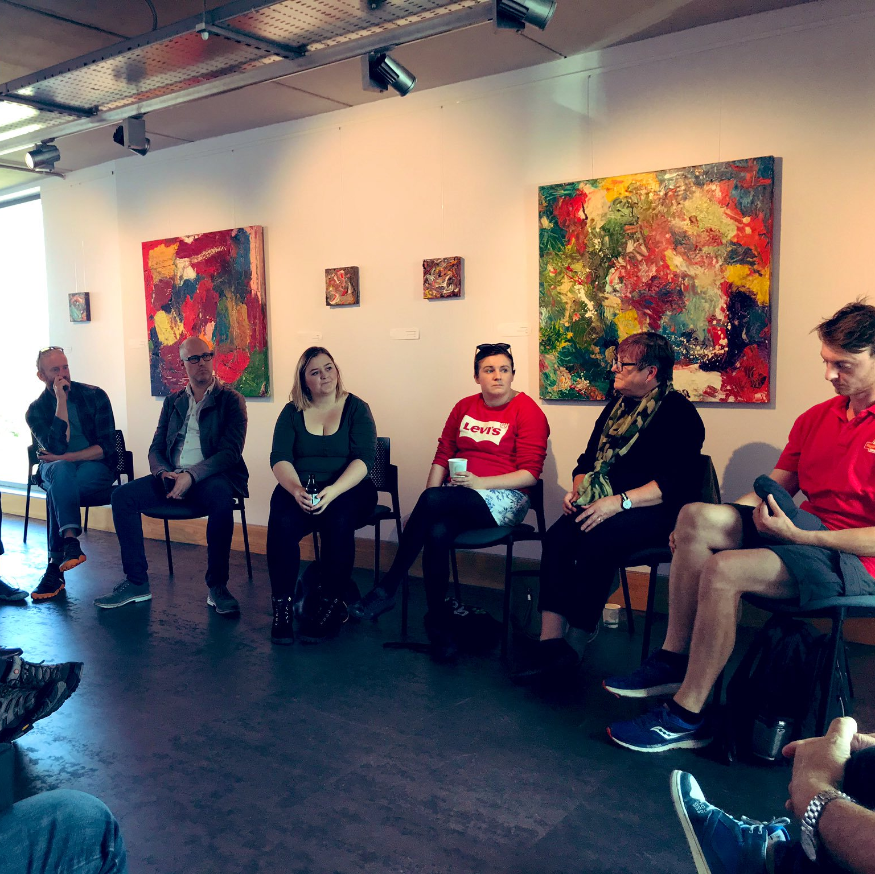
LEARN
BUILD
SHARE
Belfast Housing Lab
A collaboration between The Holding Project & EastSide Partnership
Funded by the Nationwide Community Foundation

Slide 41
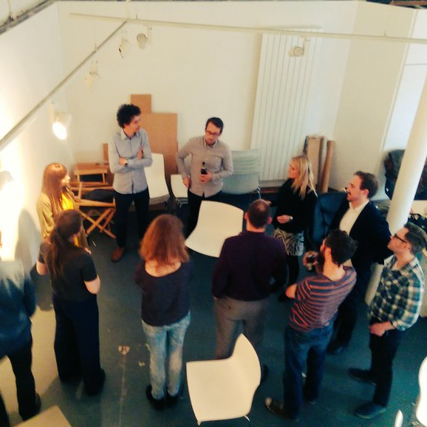
Trial 2 (2019): Matched Savings
This trial aids those in supported housing to save
for entering into the private rental sector. Over
three months, six individuals will save small
amounts of money and this will be matched by
BHL. The savings can be used for deposits, white
goods or undertaking educational courses.
Belfast Housing Lab
A collaboration between The Holding Project & EastSide Partnership
Funded by the Nationwide Community Foundation

Slide 42

Belfast Housing Lab
A collaboration between The Holding Project & EastSide Partnership
Funded by the Nationwide Community Foundation

Slide 43
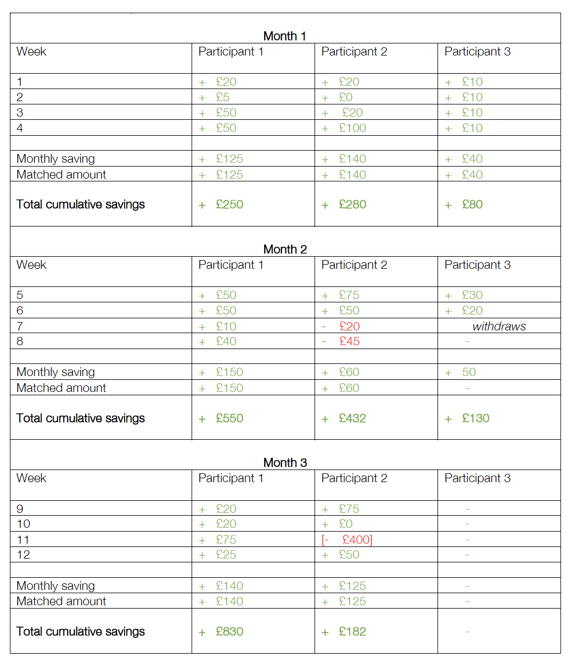
Belfast Housing Lab
A collaboration between The Holding Project & EastSide Partnership
Funded by the Nationwide Community Foundation

Slide 44
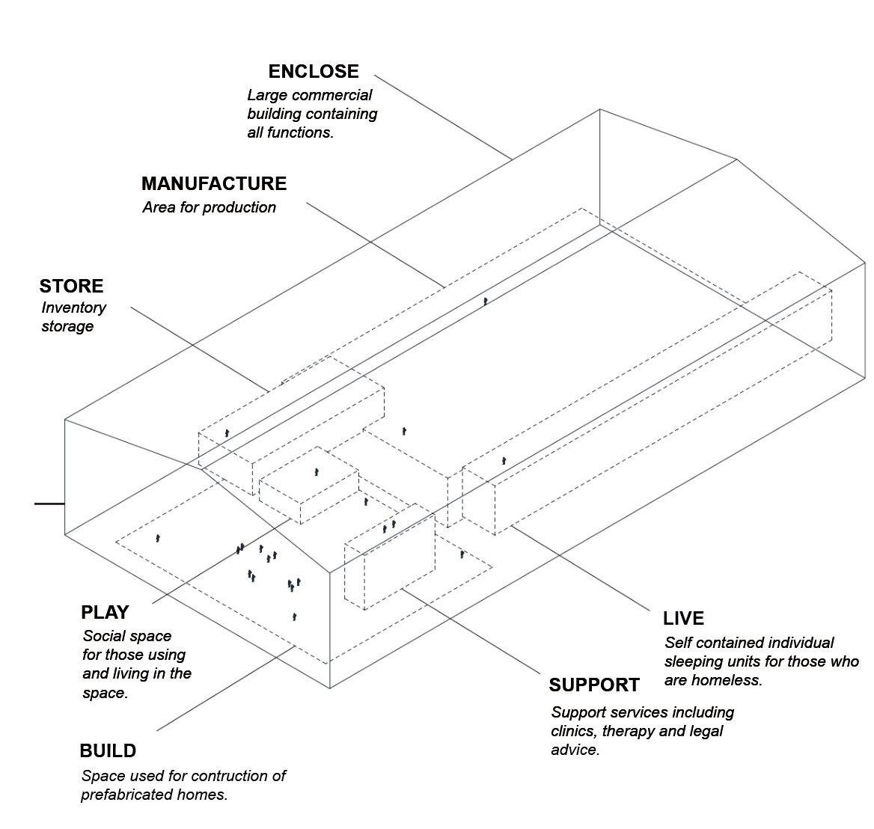
Trial 3: Under One Roof
Based on a project in Liverpool, Under One Roof
brings support services, employment, skills
training and social spaces to those who are
homeless in Belfast. The concept incorporates all
these aspects into one building in the heart of the
city that is accessible to those in need of vital
support, helping build new lives. BHL is working
to develop this project from concept to design
stage with a charity who work with people who
are homeless.
Belfast Housing Lab
A collaboration between The Holding Project & EastSide Partnership
Funded by the Nationwide Community Foundation

Slide 45
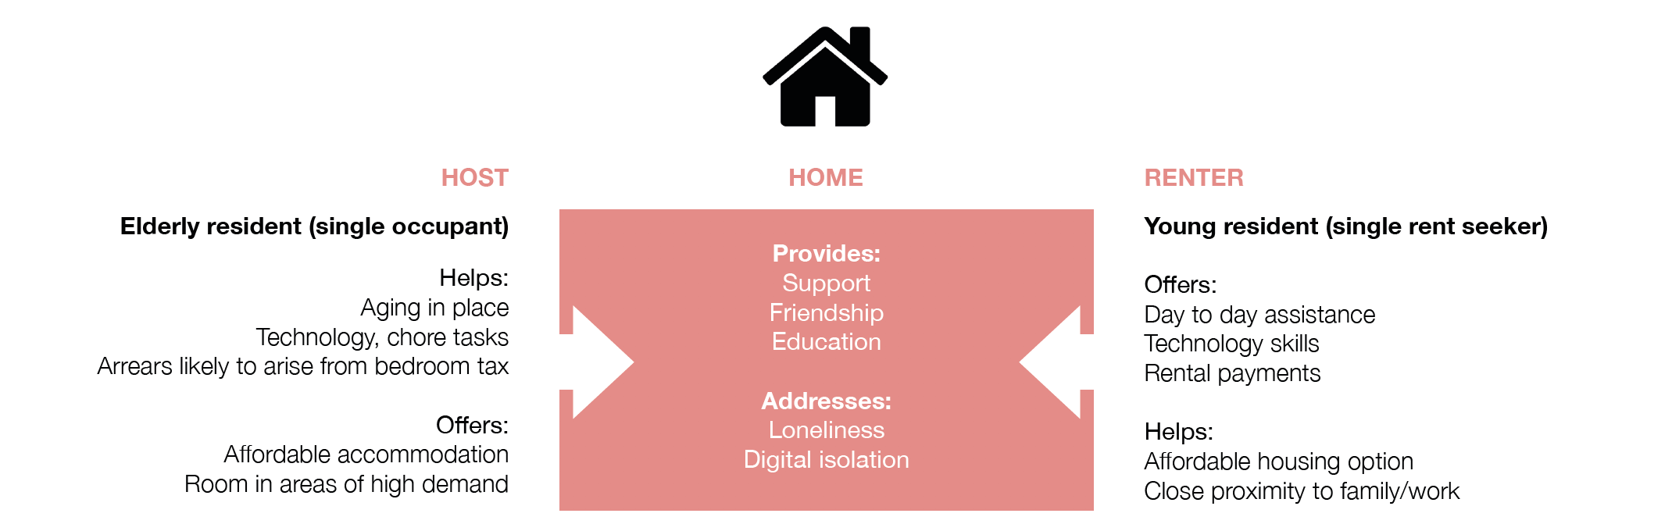
Trial 4: Spare? Share!
Homesharing project that aims to:
(1) encourage cross-generational living;
(2) reduce housing costs for hosts and renters;
(3) contributes to income of host.
Belfast Housing Lab
A collaboration between The Holding Project & EastSide Partnership
Funded by the Nationwide Community Foundation

Slide 46
Sean Cullen
@belfast_h_lab
belfasthousinglab@gmail.com
Belfast Housing Lab
A collaboration between The Holding Project & EastSide Partnership
Funded by the Nationwide Community Foundation

