Slide 1

Draft Programme for Government Framework 2016-21

Slide 2
Context
Stormont House & Fresh Start Agreements
Restructuring
Fiscal pressure
Need for change
Collaborative working

Slide 3
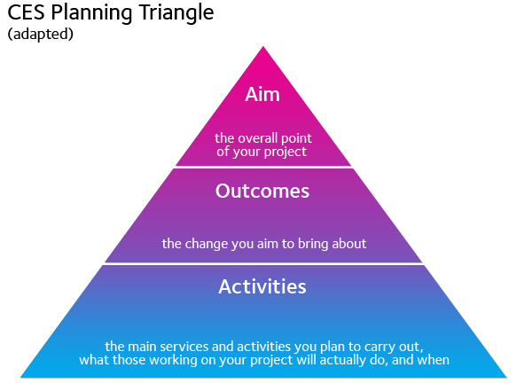

Outcomes “Pyramid”: the PfG Framework
PfG Framework
PfG Purpose: Improving wellbeing for all – by tackling disadvantage and driving economic growth
Outcomes, Indicators and Measures

Slide 4
PfG Framework Structure
Outcomes
14 succinct, high-level statements describing what we are trying to achieve
Indicators
42 specific changes we want to bring about Taken in the round, show direction of travel
Measures
Providing information on whether we are succeeding

Slide 5


Slide 6
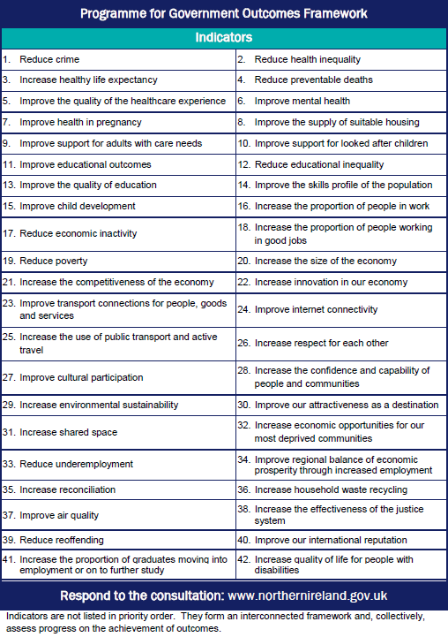

Slide 7
We enjoy long, healthy, active lives
Indicators:
Improve health in pregnancy
Increase healthy life expectancy
Reduce health inequality
Reduce preventable deaths
Improve mental health
Increase use of public transport and active travel

Slide 8
Measures
One per indicator
Indicator: Improve health in pregnancy
Measure: Proportion of babies born at a low birth weight
Current status: 6.1%

Slide 9
Outcomes “Pyramid”: the complete PfG
PfG Framework
Action Plans linked to indicators– and associated performance measures

Slide 10
Ambition and Detail
42 of the biggest issues facing society
Specific measures which are transparent and independently verified
Actions will be specific and measurable

Slide 11
Timeline
Stage | Date
Consultation on PfG Framework | 27 May – 22 July
Development of PfG Action Plans | By Sept 2016
Development of: Economic Strategy; Social Strategy; Investment Strategy; Budget | For public consultation by Oct 2016
Executive and Assembly Approval Processes | December 2016

Slide 12
Consultation
We need to know whether the outcomes, indicators and measures contained in the Framework are right and complete.
Please respond to the consultation – tinyurl.com/pfgni

Slide 13
Questions

