Slide 1
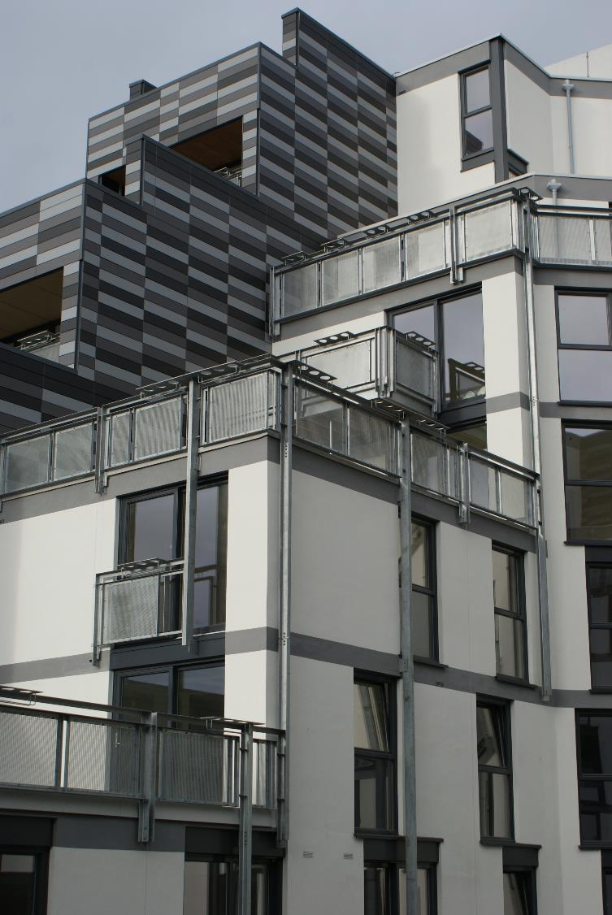
Mid-Market Rent The Scottish Experience

Slide 3
What we do
We work with government and others to achieve the legislation, regulation and funding necessary for our members to be strong, resilient and independent social businesses housing Scotland.
We develop and deliver modern and innovative services to our members so that they can achieve their ambitions
We represent housing associations and co-operatives across Scotland to broaden and strengthen the sector’s contribution to social justice and inclusive growth

Slide 6
Overview
1. MMR Origins
2. MMR Now
5.MMR Risks
3. MMR Supply and Customers
4. MMR Benefits

Slide 7
MMR Origins
2008 Financial Crash
Private house-building stops
2010 – 2012 NHT Model
Early Mid-Market Rent
More Homes Scotland

Slide 8
NHT Original Model
SG
Guarantor (Revenue & capital)
LA
Member
SFTI
Member
Developer
Member
LA
Lender
NHT LLP
MMR
Developer
M&M Agent

Slide 9
Market Viability – Early Orthodoxy
Edinburgh, Aberdeen, West End of Glasgow
£ Rent
Private Rents
£ Rent
Mid-Market Rent
Mid Market Rent Viable
East End of Glasgow, Ayrshire
Housing Market Area

Slide 10
More Homes Scotland – 50,000 new affordable homes
Social Rent
Mid-Market Rent and Low Cost Home Ownership
35,000
15,000

Slide 11
MMR Models
NHT Model
MMR Grant
LAR Housing Trust
HRA and General Fund

Slide 12
Mid-Market Rent Models
NHT Model
Scottish Government guarantee
Scottish Futures Trust + LAs or RSLs + developer create Limited Liability Partnership (LLP) to build
Uses LA / RSL prudential borrowing to build
LLP purchases the units from developer
70% of market value, 30% met by developer
On sale repays loan and any calls on SG guarantee
Managing agents (often but not always RSLs)
Let then sold 5 – 10 years later
No guaranteed sale to tenant (first refusal)

Slide 13
Mid-Market Rent Models
MMR Grant
Short assured tenancy – now Private Residential Tenancy
RSL and subsidiaries
Grant and private finance
Investment level of £46k (green), £44k
Low and moderate incomes in employment
Long term rent option

Slide 14
Mid-Market Rent Models
LAR Housing Trust
LAR is a charity set up in 2015– 25 year loan of £55M from SG and £65M of private funding
Plans to build 1,000 homes
Rental income pays back loans over time
LAR – Local Affordable Rent

Slide 15
Mid-Market Rent Model
LA HRA and General Accounts
Private Residential Tenancies (PRT)
Often through Section 75 Agreements
Loans are serviced through rent

Slide 16
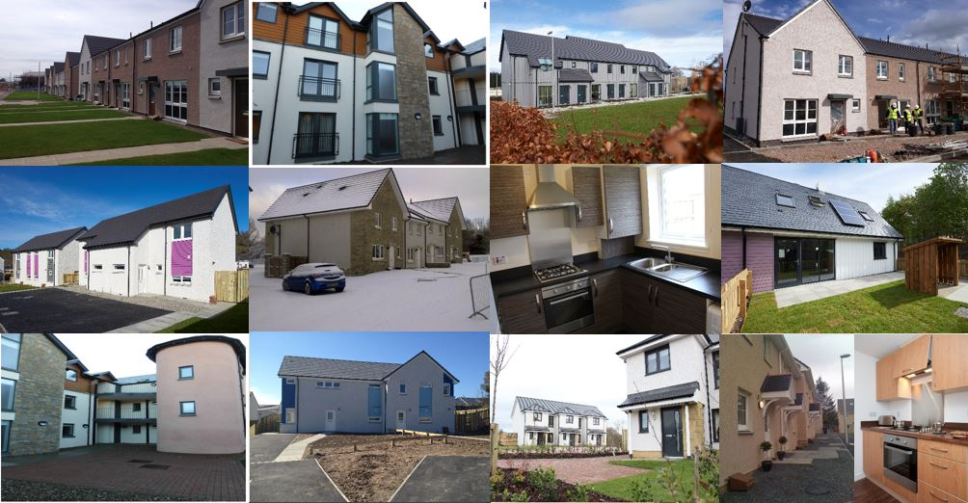
Notes:
Allowed a range of homes to be built that are more affor

Slide 17
MMR Now
More Homes Scotland
50,000 new homes
Targeted
Income Criteria
Rent Levels
No higher than LHA Rate
35,000 social
15,000 MMR and LCHO
Data
MMR Information Log

Slide 18
Current Supply and Customer Base
Estimate: 3,000 – 4,000 MMR homes across 21 local authorities
Most common property type – 2 bedroom flat
Typical MMR Tenants: single people or couples with modest household earnings, between £20,000 and £30,000

Slide 19
Key Demand Groups
Private Renters
Right Sizers
Nest Leavers
Generation Rent

Slide 20
Benefits
Benefits
Tenants
Landlords
Good Quality Homes
Reliable Landlords
High energy efficiency
Often more affordable
Diversify products available
Cross Subsidies social housing
Maximise development opportunities

Slide 21
Risks
Risks
Tenant
Landlord
Not a SST
Subsidiary
Higher costs / more risk
Different skill set
SHR still taking a view

Slide 22
1. MMR Origins
2. MMR Now
5.MMR Risks
3. MMR Supply and Customers
4. MMR Benefits

Slide 23
Zhan McIntyre
Policy Lead
SFHA
zmcintyre@sfha.co.uk
@ZhanSFHA

Slide 24
Useful Links
Anna Evans Consultancy
Research into the Potential Market For Mid-Market Rent in Glasgow
www.glasgow.gov.uk
LAR Housing Trust
www.larhousingtrust.co.uk

Slide 25
Useful Links
More Homes Scotland – Scottish Government
www.gov.scot
National Housing Trust
www.scottishfuturestrust.org.uk

Slide 26
Useful Links
Public Works Loan Board
www.dmo.gov.uk
Wheatley Group
Housing Need and Aspiration the Role of Mid-Market Rent
www.cih.org

