Slide 1

Impact of Welfare Reform on Housing in NI
Implications for the private rented sector
Karly Greene
Head of Research & Equality,
Northern Ireland Housing Executive
@karlygreene
@nihecommunity

Slide 3
Context
Private Rented Sector in NI
What we know from GB
What we know from NIHE tenants
Future research

Slide 4
Context
Private Rented Sector in NI
What we know from GB
What we know from NIHE tenants
Future research

Slide 5
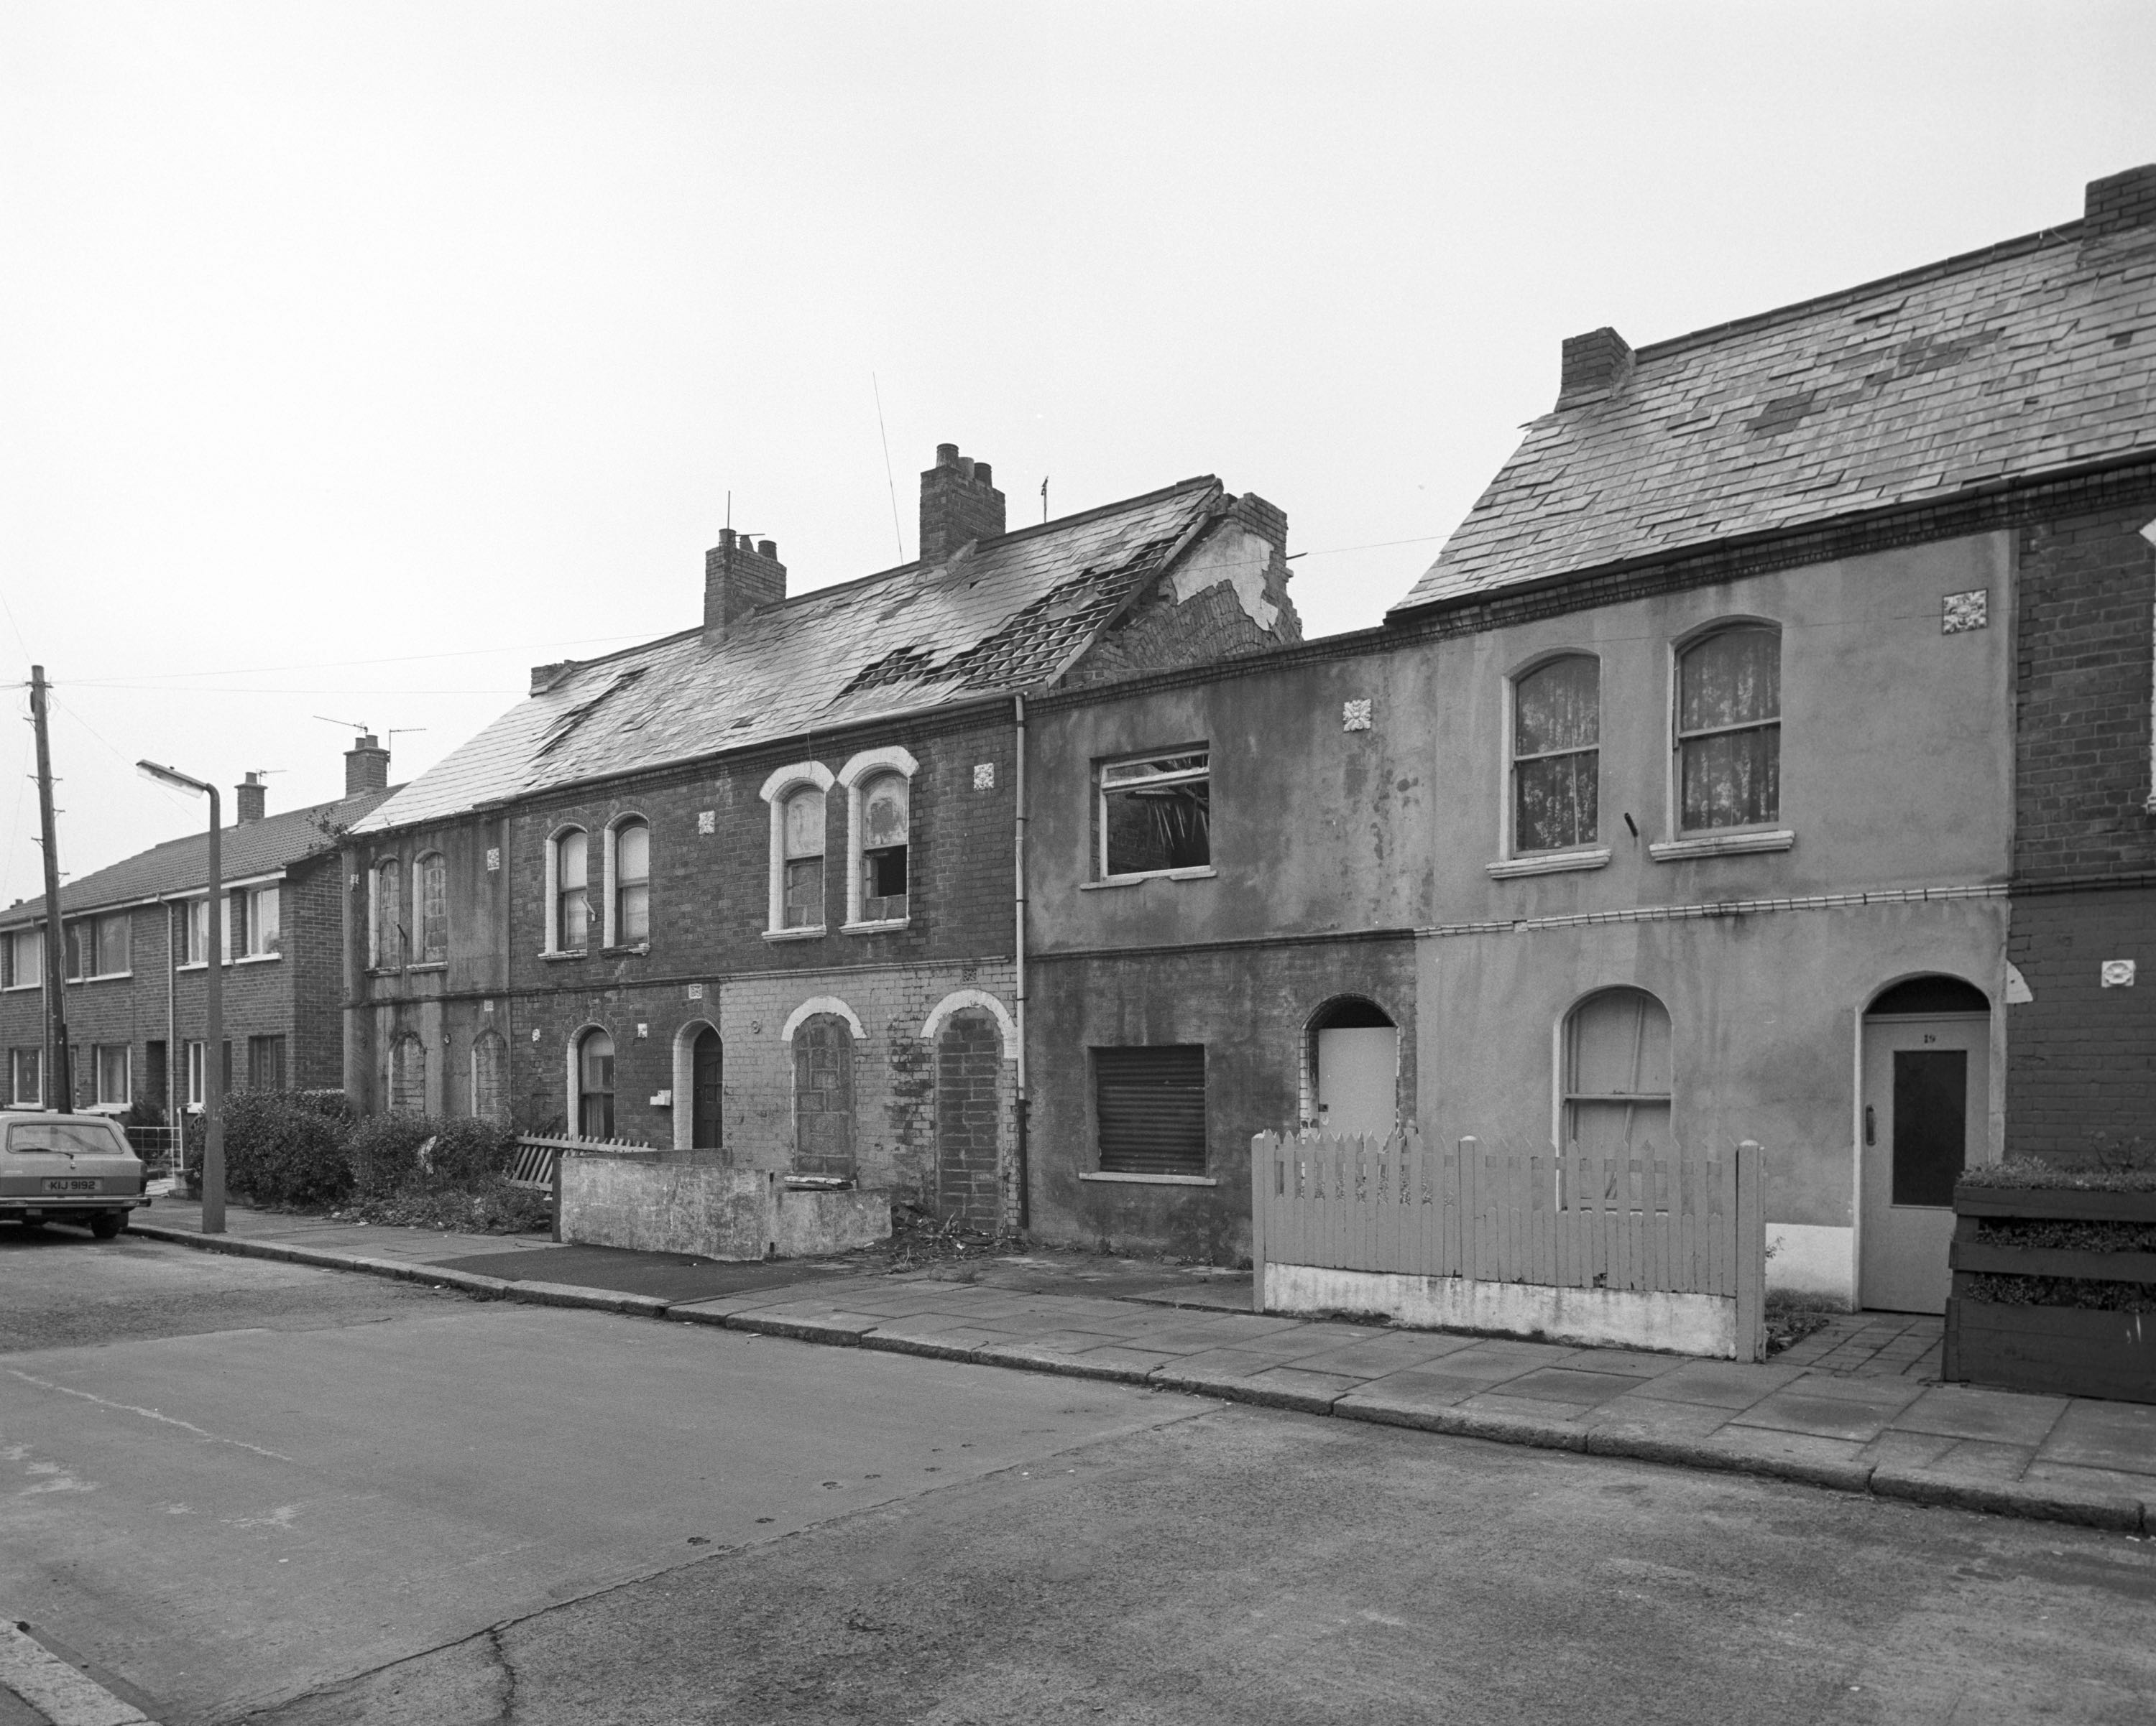
Housing Order 1981
housing conditions and need” and may “conduct or promote research into any matter relating to any of its functions”
Notes:
Historic and political context – political parties had using council housing powers to gain political and electoral advantage. Inadequacy in housing provision and unfair methods of allocation – first general cause of civil disturbance (pg 35)
61 local authorities, 3 development commissions and NI Housing Trust into one central housing authority – owned and managed 155,000 dwellings

Slide 6
NIHE Research Process
Identify
Design
Insights
Action

Slide 7
Welfare Reform and PRS
Welfare Reform Act introduced in NI 2015
  Mitigation package scheduled to end March 2020
  Focus today only on the following:
    Characteristics of the PRS to understand potential impacts
    LHA rates in PRS
    Housing Benefit - Universal Credit (housing costs)
  CROSS-TENURE and in and out of work
Notes:
BUT changes to benefits from 2008 (with LHA rates)
GB 2012- introduction welfare reform
Amendments in NI 2016
Mitigation package scheduled to end in March 2020
Dla to pip 1 in 10 in NI more than twice that than the rest of UK
Benefit cap 26k to 20k

Slide 8
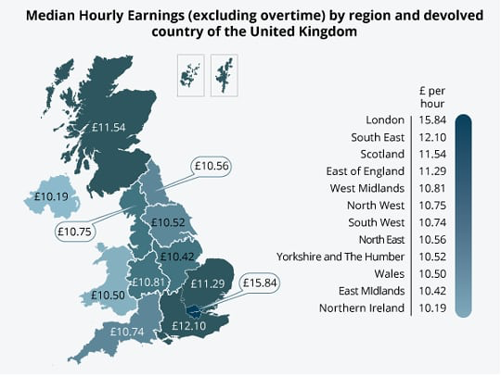
Notes:
ASHE 2014
Pay levels lower than a decade ago
JRF 2018
34% of those in Northern Ireland’s private rented sector are in poverty (compared to 37% in the UK); a slight fall from the proportion in 2003/06 (36%).
Since the Global Financial Crisis and subsequent recession, the poverty rate in NI has slightly
increased, with more working-age adults in poverty in 2013/14 than in 2008/9. By 2017, in-work
poverty accounted for 45% of income poverty in NI (JRF, 2016).

Slide 9


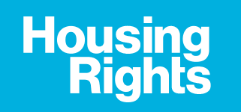





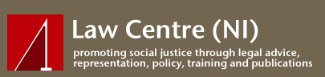
Welfare Reform Research Group

Slide 10
Context
Private Rented Sector in NI
What we know from GB
What we know from NIHE tenants
Future research

Slide 11
How we understand the PRS in NI
PRS and HB
Private tenants survey - affordability
Universal Credit

Slide 12
Understanding the private rented sector
Key Questions:
How affordable is the PRS?
What is the quality of the supply?
Who lives in the PRS?
What are the intentions and aspirations of tenants within the PRS?

Slide 13
Understanding the private rented sector in NI
Key Data Sources:
House Condition Survey
  Technical survey/research
  Social survey
Private Rental Indices
  Local Housing Allowance (LHA) data (collected by NIHE)
  PropertyNews data (obtained by UU)
Private Tenants Survey
  Social research
Notes:
Dedupe, validate, weight, analyse

Slide 14
2006
a) The House Condition Survey and the private rented sector
2016
17%
12%

Slide 15
a) Who are private renters?
Younger : under 40 – with children
Working
Middle income bands (29% £10-£15,500)
Urban - terraces
Urgent repairs – Mean £553
Mean SAP – 65.33
Notes:
Overall 18% (136,000 households)
Increase in households with children living in the PRS over time 22% in 2011 – 29% in 2016. 7% increase
WITHIN PRS almost half adults with children
51% younger than 40
57% HRF working
Almost half had less that £15,600 per year
Around half on HB 70% in HCS we know from admin data around half

Slide 16
b) Private Rental Index:
Lettings 2013-2017 (sample)
Notes:
Lettings have declined assuming more people staying in homes
NI
Belfast
Everywhere else

Slide 17

b) Private Rental Index:
Average rents - 2017
Apartment/Flat
£574
Semi-Detached House
£598
Detached House
£737
Terrace/Townhouse
£574
Notes:
£598 average rent for NI 2017

Slide 18
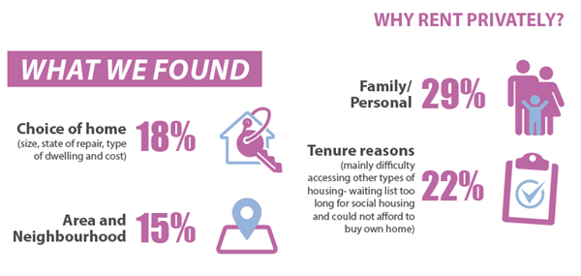
c) Private Tenants Survey:
Using social research to build the picture

Slide 19
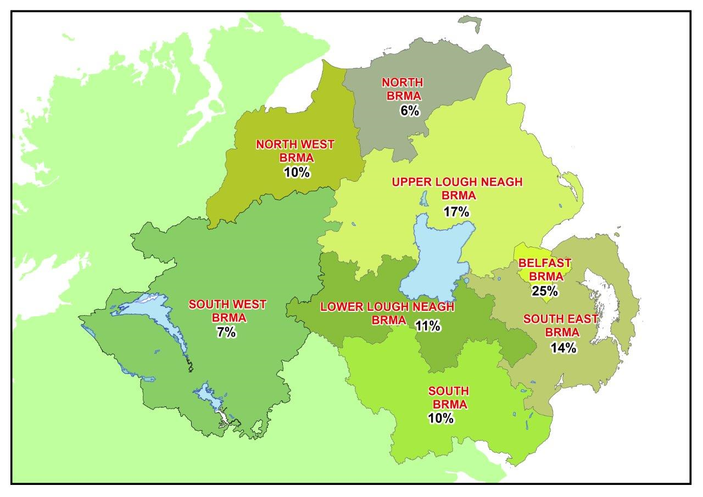
PRS and HB
Notes:
95,215 renting according to 2011 census – we know now according to HCS this is likely 136,000 (or 17%)

Slide 20



Average weekly rents of those on HB
Housing Association
Housing Executive
£98.28
£89.50
£66.11
Average weekly market rent in N Ireland
£138
Notes:
99.18 for those with size criteria

Slide 21
Renters and changes to benefits NI – a timeline
Phased UC
LHA 50%
Single <35
2008
2011
2012
2015
2017
2019
LHA cap
Managed migration
LHA 30%
Notes:
Local Housing Allowance (LHA) are set based on size criteria and area (BRMA)
LHA 2008 – 50th percentile of market rents
LHA 2011 – 30th percentile of market rents
LHA 2012 – shared rate for single, living alone up to the age of 35
LHA 2015 – rates capped
19 LHA have increased 3% from 2015 with additional govt funding

Slide 22




£150.69
£42.15
£108.54
£42.15
Notes:
Sam from Belfast 23 single, living alone
Average rent £653 (£150.69 per week)
Entitled to shared accommodation rate £42.15 per week
HB/UC pay £182.65 and Sam pays £470.35 per month

Slide 23

Housing Benefit
38%
61%
74%
26%
RESEARCH & INTELLIGENCE UNITH
Notes:
MARCH 2018 SHBE
Over 1/3 of all HB applicants are in PRS
1 % unknown
1 quarter (26%) without bedroom size criteria – this is legacy cases?
74% with bedroom size criteria
REPRESENTS HALF OF PRS SECTOR!
REPRESENTS ABOUT 4 OUT OF 5 IN SOCIAL SECTOR
5% no bedroom tax criteria in PRS
10% in PRS not working age (65 onwards) WITH bedroom size criteria compared to 0% in social sector

Slide 24





Housing Benefit – PRS profile
49% single households no dependants
37% single with dependants
35% aged 16-34
87% have shortfall in HB claim
RESEARCH & INTELLIGENCE UNITH
Notes:
86% singles (with dependents or not)
54% of all HB with 0 dependents (whether in a couple or single)
Household type
Single Compared to 54% single social
Dependents Compared to 34% single dependents in social
Age Compared to 26% in social housing
SHORTFALL Compared to 11% NIHE, 49% HA
Attitudes to social welfare and reform NISRA - Only 15% were aware that Discretionary Support could provide financial help for people
with low incomes in times of crisis.
MORE WOMEN IMPACTED BY BEDROOM SIZE CRITERIA for both PRS and social (59% and 63%)

Slide 25
PRS % of tenants HB claim in excess of LHA
RESEARCH & INTELLIGENCE UNITH

Slide 26


Slide 27
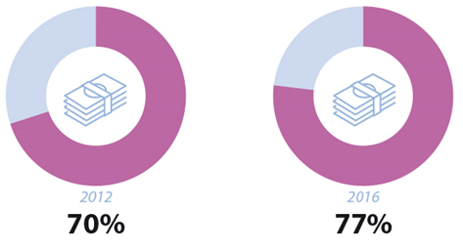
Upfront Costs
Average upfront cost £794
79% in receipt of HB paid upfront cost
Affordability: Easy 52% Difficult 47%
1 in 3 received help to pay upfront cost
RESEARCH & INTELLIGENCE UNITH
Notes:
Affordability important part of the Survey
% upfront cost
Upfront costs are an important part of affordability within PRS
Upfront costs refer here to rent in advance and/or deposit
77% paid an upfront cost, increased from 70% in 2012
Upfront cost £
£794
Housing Benefit
79% of people who were receiving HB paid an upfront cost
Affordability
Roughly equal proportions of people found it easy or difficult to afford
One in three people said they had received help to pay their upfront cost – the main source family/friends
Very few people had paid additional upfront costs - such as background checks, letting agent fees, fuel provided by landlord/agent
Only one in five had moved into a property that was fully furnished
Help out there – rent/deposit guarantee schemes – 85% not aware of these
Upfront cost could be barrier to access PRS – people who don’t have the money at disadvantage (characteristics of these people). Housing vulnerable people/low incomes/discharge homeless duty. Welfare changes on way too.
What is Rent deposit/guarantee schemes
Way operates varies from one scheme to another. Most schemes have a list of landlords with available properties
Some schemes in NI operate by giving your landlord a guarantee. Other schemes may allow you to pay the deposit over the course of your tenancy
SmartmoveNI is the only agency offering any kind of deposit scheme in Northern Ireland. They may agree to pay the deposit for you and allow you to pay it back over a period of time – conditions

Slide 28
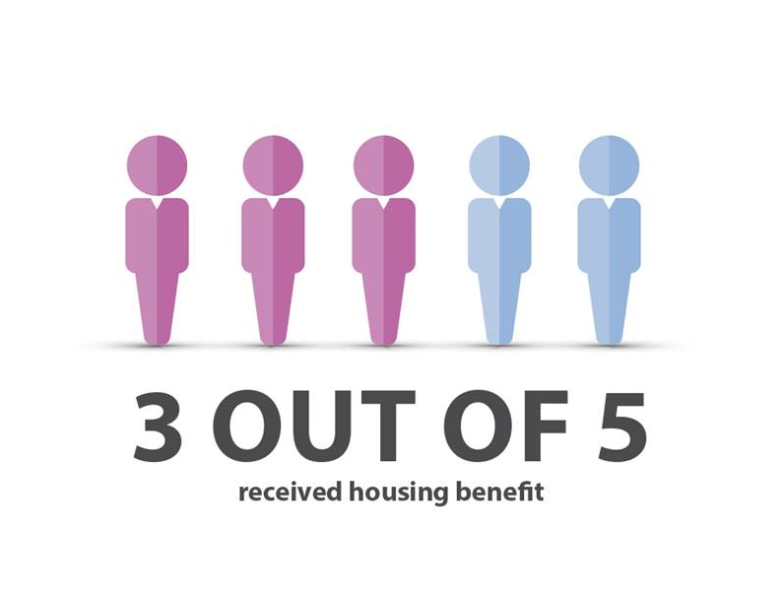
Rent and Affordability
£106 average weekly rent
88% responsible for all/part of the rent
Affordability: Easy 65% Difficult 34%
RESEARCH & INTELLIGENCE UNITH
Notes:
Housing Benefit
Affordability is crucial to sustaining the PRS – HB an important part of this
3 out of 5 were in receipt of HB – similar proportion in 2012
For comparative purposes – looked at HB data and HCS data – 50% private tenants receive HB – indicator of effect of welfare changes
Average weekly rent
£106 – increased from £99 in 2012
UU carry out the RPI index on our behalf – looks at rents in NI over time and cut by variables, including LGD
Responsible
While 59% received HB, overall 88% were responsible for paying all, or part, of their rental charge
HB not covering rents, even when entitled to HB
Affordability
Afford – Easy: 65% Difficult 34%
92% said they had been up-to-date with their rent in the last 12 months
Only those who received HB and the HB did not cover all the rent were asked (smaller numbers) – 57% not aware of DHP
As said, affordability crucial to sustaining the sector - also been highlighted as one of the key challenges facing the sector - welfare changes key part of this
LHA rates have been frozen at the 2015/16 rates for four years from April 2016
Proposal to apply LHA rates to social – pockets NI affected - welcome that it was scraped in Nov
Research carried out by CIH in 2016 revealed 80% of LHA rates had already fallen below the 30% threshold, partly result of rates capped in recent years
More households liable to pay shortfall/greater shorter
Inability to meet shortfall potential for arrears, possible eviction and homelessness – Welfare Reform exacerbate issues facing tenants (supply also)
Supply side – vital meeting housing need. Negative equity amongst accidental landlords and increases in interest rates could drive up rents
Continued research is vital in this area – we are looking at this - recommendation from CIH research to review BRMA – we are doing this

Slide 29
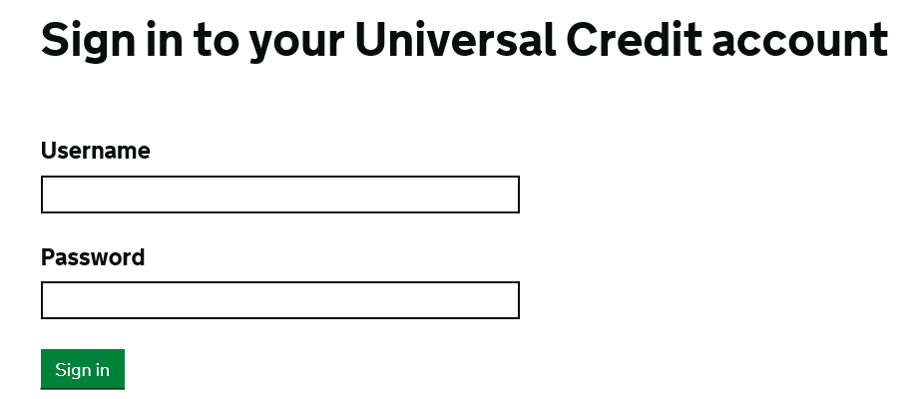
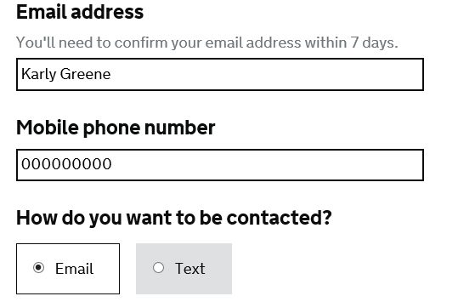
DfC recognise three vulnerable groups:
1. Financially vulnerable
2. Socially vulnerable
3. Weak IT skills

Slide 30
Potential barriers
Must have:
Rates details
Rent details
Landlord details
Mobile phone
Email address
Bank/building society
Access to the internet
11%
45%
21%
26%
Notes:
BOXES – WHAT WE KNOW FROM NIHE TENANTS

Slide 31
Date Universal Credit starts | Jobs & Benefits / Social Security office
27 September 2017 | Limavady
15 November 2017 | Ballymoney
13 December 2017 | Magherafelt and Coleraine
17 January 2018 | Strabane and Lisnagelvin
7 February 2018 | Foyle and Armagh
21 February 2018 | Omagh and Enniskillen
7 March 2018 | Dungannon and Portadown
16 May 2018 | Newry and Downpatrick
30 May 2018 | Lurgan, Newcastle and Kilkeel
13 June 2018 | Falls and Shankill
27 June 2018 | Andersonstown and Banbridge
5 September 2018 | Holywood Road and Ballynahinch
19 September 2018 | Newtownabbey and Newtownards
3 October 2018 | Shaftesbury Square and Carrickfergus
17 October 2018 | Knockbreda and Bangor
31 October 2018 | Lisburn and Larne
14 November 2018 | North Belfast and Cookstown
5 December 2018 | Ballymena and Antrim
Notes:
NEW APPLICANTS UC roll out dates
Migration is between July 19 and march 23

Slide 32
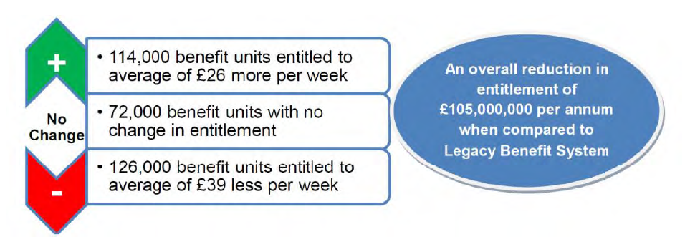
DfC 2017 impact assessment
RESEARCH & INTELLIGENCE UNITH
Notes:
WHEN FULL ROLL OUT IS COMPLETE

Slide 33

Evidence from GB

Slide 34
Tenants
Roll out - 10% claimants in GB (June 18)
25% of claims in 2017 paid late
Rent arrears (1 year to recover)
Delays in first payment linked to arrears
Lengthy application process
Demand for advisory services
Demand for foodbanks (30%)
Notes:
The 42 day rule was in place in Northern Ireland until 14 February 2018, when the waiting period
was reduced from six weeks to five.
43% of referrals to trussell trust ‘benefit change’ or ‘benefit delay’
Detail in scoping report

Slide 35
Landlords
Change of circumstance during assessment
RLA research
Shelter research
Notes:
84% landlords in NI have only 1 or 2 properties
Change of circumstance during assessment – e.g. moving house
RLA research 13% of landlords willing to let to UC tenants
Shelter research 1 in 10 landlords having to deal with rent arrears (2 months or more)

Slide 36
NI specific
Mitigation (for most) scheduled to end March 2020
UC Direct payments for landlords
UC Twice monthly payments to claimants
Funding advice sector (e.g. welfare reform line)
Notes:
Direct to claimant in GB and change of address doesn’t trigger UC
GB every month
Anecdotally softer approach to sanctions

Slide 37
Context
Private Rented Sector in NI
What we know from GB
What we know from NIHE tenants
Future research

Slide 38
Welfare reform – NIHE tenants
Levels of awareness and concern about welfare reform
Direct impact of benefit changes and awareness of welfare supplementary payments
Sources of advice and assistance on welfare reform
Household expenditure and experiences of budgeting and financial management
Notes:
2,600 tenants throughout CTOS 2017
This is Based only on 874 tenants (working age) across NI – Q3 and Q4 2017

Slide 39




Awareness and Concern
aware of welfare changes, but unsure how it will affect household
feel poorly informed
47%
31%
Obtain information via ‘other sources’ such as media/word of mouth
not at all concerned
57%
60%
RESEARCH & INTELLIGENCE UNITH
Notes:
ALL
ALMOST HALF Poor/very POORLY INFORMED (46%)
40% HAVE CONCERNS
Staff information and training
Letters, checklists, forms
Further research
Digital inclusion strategies
Arguably PRS could be worse as NIHE DfC etc have been communicating with tenants and assisting them?

Slide 40
Digital Inclusion – 5 year view
74% working age adults
81% NI population
RESEARCH & INTELLIGENCE UNITH
Notes:
NI 81% of households nisra figures
WORKING AGE - Three-quarters (75%) of tenants in urban areas stated that they had access to the internet from home compared to 64% of rural tenants
Almost three fifths (57%) of older adults reported they had access to the internet at home but this was much lower compared to those in the middle age band (75%) and amongst younger adults (87%). 55+ 12% ‘confident’ in filling forms
Almost two-thirds (65%) of those respondents with a disability, illness (or both) which limited activity had home access to the internet, compared to 82% of those with no reported health problems.

Slide 41
However…
84% never completed an official government form online
Impact of location
Internet access from home
Urban
Rural
75%
64%
RESEARCH & INTELLIGENCE UNITH
Notes:
39% of 55+ in the PRS on HB representing 11,785 people
Age 16-54 – 79%

Slide 42
Impact of age – 55+
Impact of health – disability/illness
Internet access from home
57%
65%
Comfortable filling out online forms
12%
17%
RESEARCH & INTELLIGENCE UNITH
Notes:
39% of 55+ in the PRS on HB representing 11,785 people
Age 16-54 – 79%

Slide 43
Potentially most impacted
Lone parents
Single under 35, living alone
Older working age (55+)
Those with disability/illness
Those in rural areas
Challenges measuring impacts
Notes:
Direct to claimant in GB and change of address doesn’t trigger UC
GB every month

Slide 44
Context
Private Rented Sector in NI
What we know from GB
What we know from NIHE tenants
Future research

Slide 45




The continuing role of research and data:
Evidence based decision making
Corporate Plan
Evaluation and impact assessment
UK collaboration
Notes:
Feed into corporate plan/business planning and KPI monitoring
Statutory duty – client led research programme
Housing Order 1981 statutory responsibility to “regularly examine housing conditions and need” and may “conduct or promote research into any matter relating to any of its functions”
Role of research
Corporate plan
Evidence to influence change
Evidence based decision making
Pre-evidence and impact assessment
Evaluation
Connections with GB best practice, leading research techniques

Slide 46
Future PRS research
Awareness and impacts of welfare changes
    Private landlord survey
    Private tenant survey
    Review of Broad Rental Market Areas

Slide 47



Recognition
Customer Service Excellence Award
National Statistics Accreditation
Market Research Society Accredited Company Partner

Slide 48
Karly Greene
Head of Research & Equality,
Northern Ireland Housing Executive
karly.greene@nihe.gov.uk
For further information and updates, visit our webpage:
www.nihe.gov.uk/index/corporate/housing_research.htm
@karlygreene
@nihecommunity

