Slide 1
An Evolving Private Rented Sector: Its Contribution and Potential
The Evolving Private Rented Sector:
Its Contribution and Potential
Julie Rugg and David Rhodes

Slide 2
Overall structure of presentation
Changing contexts for the PRS
Selected themes
Recommendations
Questions

Slide 3
Changing contexts for the PRS
Policy ambivalence
Welfare Reform
Homelessness Reduction Act
Tenure blur
Devolution

Slide 4
Themes
Growth in the sector
Supply-side characteristics
Marketization and financialization
Changing demographics
Property conditions
Can the PRS deliver social housing?

Slide 5
Growth in the sector

Slide 6
Growth in the sector

Slide 7
Themes
Supply-side characteristics

Slide 8
Themes
Marketization and financialization

Slide 9
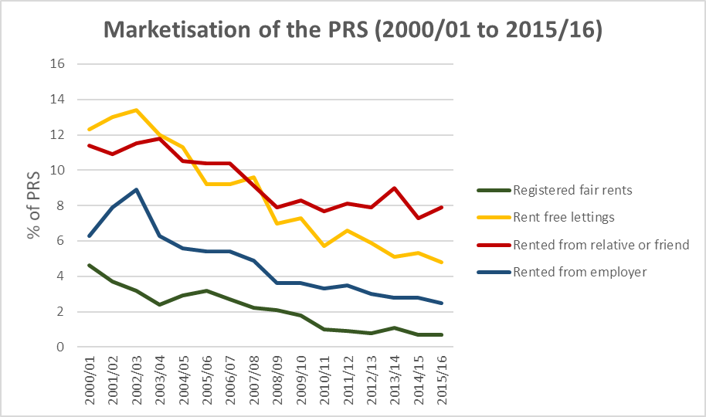
Marketization and financialization

Slide 10
Themes
Changing demographics

Slide 11
Selected characteristics of the PRS (2001/02 to 2015/16)
Selected characteristics | 01/02 (%) | 03/04 (%) | 05/06 (%) | 07/08 (%) | 09/10 (%) | 11/12 (%) | 13/14 (%) | 15/16 (%)
Rented unfurnished | 68 | 68 | 73 | 72 | 76 | 79 | 80 | 79
Lived at address for <1 year | 40 | 38 | 38 | 41 | 39 | 36 | 27 | 26
Lived at address for 1 to <3 years | 28 | 30 | 31 | 29 | 33 | 33 | 37 | 36
Lived at address for 3 to <10 years | 17 | 19 | 19 | 19 | 18 | 22 | 28 | 30
Lived at address for 10+ years | 15 | 12 | 13 | 11 | 10 | 10 | 9 | 9
Single person households | 36 | 33 | 34 | 34 | 32 | 29 | 27 | 30
Couples with dependent children | 14 | 15 | 14 | 17 | 19 | 20 | 22 | 22
Households with a child aged under 5 | 12 | 13 | 13 | 16 | 17 | 19 | 21 | 20
Households with dependent child of any age | 24 | 26 | 26 | 27 | 31 | 32 | 35 | 34
HRP in work (full or part-time) | 65 | 68 | 68 | 70 | 69 | 73 | 73 | 75
HRP retired | 12 | 9 | 10 | 9 | 7 | 7 | 6 | 6
Claimants’ full rent not covered by HB/LHA | 68 | 68 | 67 | 72 | 74 | 82 | 84 | 85

Slide 12
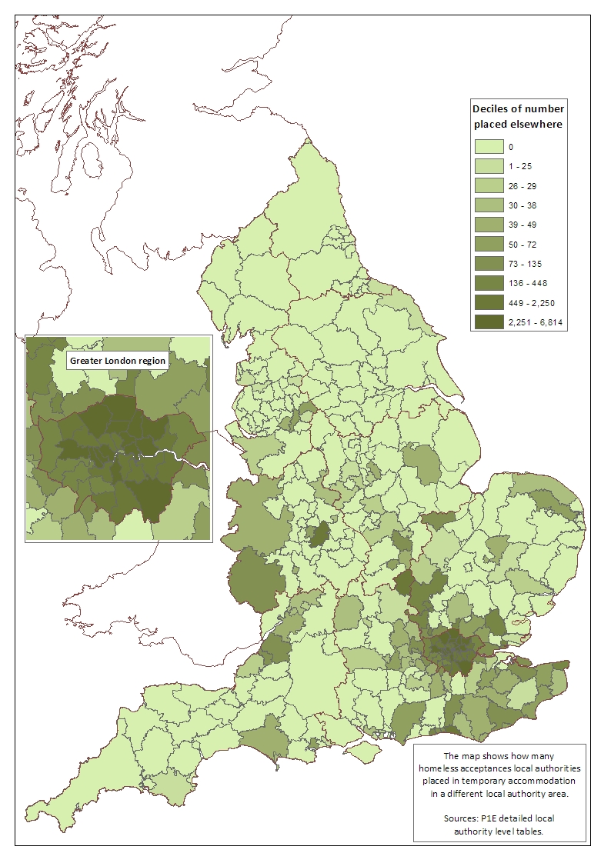
Temporary accommodation
Local authorities’ use of out of borough placement in 2017/18

Slide 13
Themes
Property conditions in the PRS

Slide 14
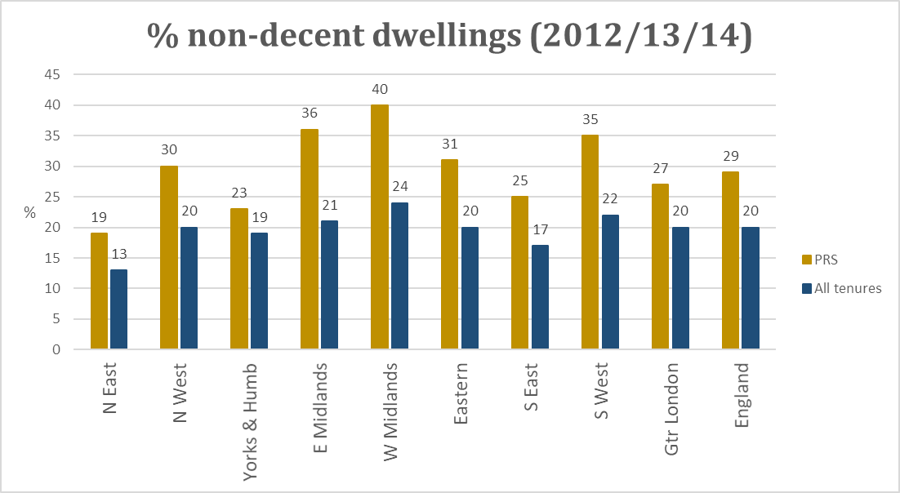
Property quality

Slide 15
Selected recommendations
Security and insecurity
Devise a strategy
Deconstruct silos
Adopt a new approach to regulation
  Property MOT
  Landlord register
  HMO register
Support the HB market

