Slide 1
A view from the ROI: Sustaining tenancies in challenging times
Gavin Elliott
Legal officer
Threshold

Slide 2
THE PRIVATE RENTED SECTOR
RTB | 2016 | 2017 | Q2 2018
#Tenancies | 325,372 | 339,447 | 339,905
#Tenants | 705465 | 714,364 | 711,014
#Landlords | 175,250 | 174,001 | 173,725
 | 2016 (CSO) | 2017 (RTB)
Renting | 20% | 30%*
Owner Occupier | 71% | 67.6%
*The RTB figure is a rough estimate. The AHB tenancies are considered in this figure, whereas the CSO figures calculate AHBs as part of LAs and so are not part of the rental figure.

Slide 3
THE PRIVATE RENTED SECTOR
The majority of landlords rent only 1 property – 70%

Slide 4
Social Housing in the Private Rented Sector
Number of HAP tenancies in the PRS Q218 - 12,358*

Slide 5
Rent Affordability
Average Rents (RTB Q2 2018 Rent Index) | Euro | GBP
National | €1,094 | £971
Dublin City | €1,549 | £1375
Limerick City | €880 * | £781
Cork City | €1,123 | £996
Galway City | €1,065 | £945
*Standardised rents at city or town level do not show reality of the unaffordability of rents. The standardised average rent for Limerick City is listed in the RTB index Q2 as €880, while the standardised average rent for Limerick City West is €1,010.84, considerably more than that for the city as a while.

Slide 6
Rent Increase
Source RTB Rent Index Report Q1 2018

Slide 7
Rent Control in Ireland
Contained in Section 19 Residential Tenancies Act 2004 – 2016
Prior to 24th December 2016 rent level constrained only by ‘Market Rent’ which required a comparison of three similar properties.
The average rent for those tenancies, registered with the RTB in the previous quarter, must be above the average national rent for the quarter.
The annual rate of rent inflation in the area must have been 7% or more in four of the last six quarters (i.e. over the pervious 18 Months)

Slide 8
Rent Pressure Zones
R x (1 + 0.04 x t/m)

Slide 9
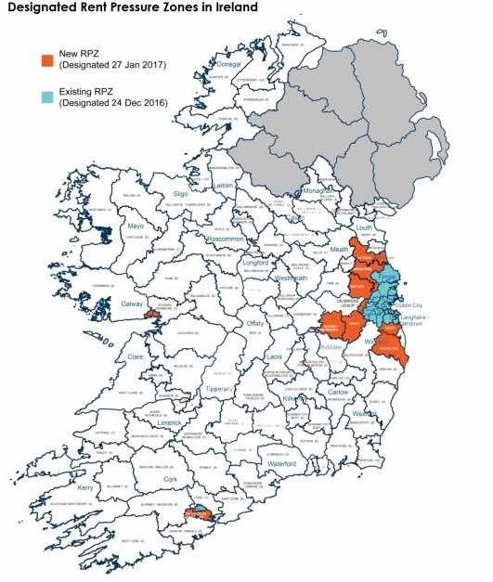
57% of registered tenancies are in a Rent Pressure Zone

Slide 10
Exemptions
Where, in the period since the rent was last set, a substantial change in the nature of the accommodation has occurred and if the rent were to be set after the change it would be different to the rent before it.
OR
Where the dwelling has not been the subject of a tenancy for 2 years prior to the designation as a rent pressure zone.

Slide 11
Threshold
Threshold was founded in 1978. It is a registered charity whose aim is to secure a right to housing, particularly for households experiencing the problems of poverty and exclusion.
They do this by:
Campaigning for suitable housing delivered on a rights base approach
Analysing existing problems and seeking innovative approaches and solutions through quality research
Providing independent advisory and advocacy services
Working in collaboration with others for those disadvantaged by the housing system.
Regional advice centres in Dublin, Cork and Galway, providing frontline services across Ireland to people with housing problems in the private rented sector.

Slide 12
Threshold Helpline
Threshold is on course to receive 77,966 calls in 2018. (RTB 130,000 in 2016)
In 2017 Threshold saved 4376 tenancies which were deemed to be seriously at risk.
Threshold provided representation at 218 RTB cases Jan- mid Nov 2018. This is a substantial increase on the 90 in 2017.
The majority of cases we provided representation at were for invalid notices standing at 57% nationally. There are some regional differences, it was 70% of cases in Cork, 55% in Galway and 45% in Dublin.

Slide 20
Thank you

