Slide 1
The ‘Frustrated’ Housing Aspirations of Generation Rent
Dr Kim McKee, Co-Investigator CACHE
Senior Lecturer, University of Stirling
@kim_mckee
Co-author: Dr Adriana Soaita, University of Glasgow

Slide 2
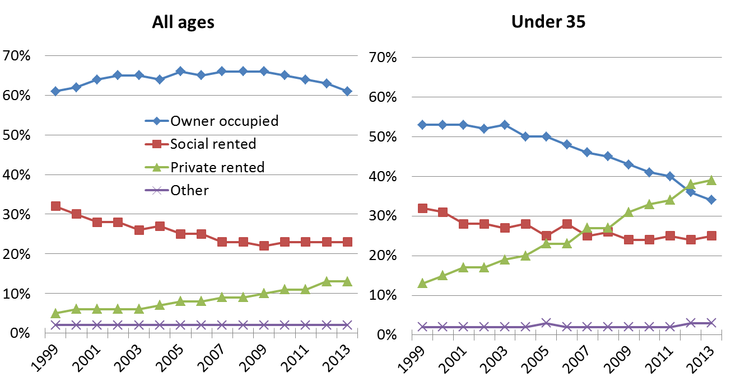
Housing Tenure Shifts (Scotland)

Slide 3
Who are Generation Rent
Young people’s housing pathways changing
Reflects challenges accessing other tenures
BUT also wider patterns of inequality
Narrative of inter-generational inequality
YP not an homogenous group (e.g. income, geography)

Slide 4
Private Housing (Tenancies) Scotland Act 2016
1 December 2017 all new PRS tenancies open-ended
18 statutory specified criteria for repossession
Rent increases once every 12m with 3m notice
Appeal excessive rises to rent officer
Possibility to regulate rents in hot spots via RPZs
Act builds on raft of previous interventions in PRS

Slide 5
The Project
Give voice to low-income households
Semi-structured interviews YP (35 and under)
Living in PRS
Not in full-time education
Located in England or Scotland (comparison)
Low to moderate incomes

Slide 6
Summary Findings
Long-term aspirations for homeownership
Levelling down of expectations to own
Importance of income and family background
Where people live matters
Precarity and financial stress

Slide 7
Aspirations v Expectations
“In the future, when I'm older, I would like to own a house. Like I said, I never used to really see the point but, you know, now that I’ve experienced renting and I know the lack of control you have as a tenant and the risks involved, I would like to own a house. However, you know, people my age...you know, we’re not going to be buying houses for a very long time unless you’re lucky enough to have family that can help. You know, I don’t think I'll be buying a house until... maybe mid-30s” (Ella, 22, Newcastle).

Slide 8
Levelling Down
“I wonder if my...well, if my attitude doesn’t change for renting, I’d probably feel like a bit of a failure in a way. I think my parents would be asking the question of why aren’t you a home owner? Because as much as I out-earn both my parents but at the same time still can’t afford to own a property. Whereas it’s very much a done thing” (Briana, 26, Edinburgh).

Slide 9
Family Support
My family doesn't have that sort of money. I have brothers and sisters, and my mother doesn't have enough money to provide thousands of pounds to any one of us (Lucas, 32, Edinburgh)
Notes:
.

Slide 10
Insecurity and Precarity
It does feel like there’s the possibility that we might be forced to leave at any moment. And that’s precarity […] there’s always that at the back of your mind and I think it’s the sense of maybe feeling not entirely comfortable (George, 27, London)

Slide 11
Financial Stress
Every year I have to move, I have to scrape together enough money for a deposit, agency fees, and the first month’s rent, which comes to £2,000, which is near impossible for someone to save, but I do. But I do that by making a lot of sacrifices, like in the food that I eat and that kind of thing. And that makes me really angry, because I feel like, it’s not fair to ask someone to pay £2,000 up front, and it makes me anxious just because it’s a very uncertain position (Salena, 21, Bristol)

Slide 12
Key Policy Messages
Insecurity and un(affordability) challenges for LI h/holds
Letting agent fees real issue in England
Longer tenancies crucial; but alone not enough
Scottish reforms welcome; not address (un)affordability
Regulation only achieve so much; affordable housing
Changes in housing pathways permanent?

