Slide 1
Department for Communities David Polley Acting Director of Housing Supply Policy

Slide 2
DfC PRS update:
PfG and the Private Rented Sector
Review of the Role and Regulation of the Private Sector
Houses In Multiple Occupation

Slide 3
PfG and the Private Rented Sector

Slide 4
Context - Draft Programme for Government: Stress and Supply
Indicator 8
Reducing the number of households in Housing Stress
Indicator 48
Reducing the gap between the Houses that we have and the Houses we need
Notes:
All of our work over the next 4 years must be set within the draft PfG
Housing has 2 key indicators: reduction in Housing stress and reducing the gap between the houses we need and the houses we have (supply). These are primary indicators for Outcome 8 (we care for others and help those in need) and Outcome 11 – We connect people and opportunities through infrastructure.

Slide 5
Achievements/Successes
Major investment in past 10 years: 18,019 new social homes and 7,500 new affordable homes
Government investment in the region of £1.2 billion;
Increase of 76,000 (10%) in NI’s total housing supply in 10 years;
Landlord Registration; and
Tenancy Deposit Scheme.
Notes:
**Research commissioned by the Department for Social Development from the University of Ulster (‘Addressing the Economic Downturn: the Case for Increased Investment in Social Housing’) estimates the Northern Ireland multiplier for construction projects to be 1.7 meaning that for every 10 jobs created or sustained in the construction industry through housing projects a further 7 jobs are sustained in other areas of the economy.
(B) Research carried out in Great Britain on behalf of the UK Contractors Group highlighted the broader economic benefits of construction activity. This research, illustrated at Figure 1, calculates that every £1 spent on construction output generates a total of £2.84 in total economic activity.
76000 homes built in NI since 2008 – including 25000 social or affordable

Slide 7
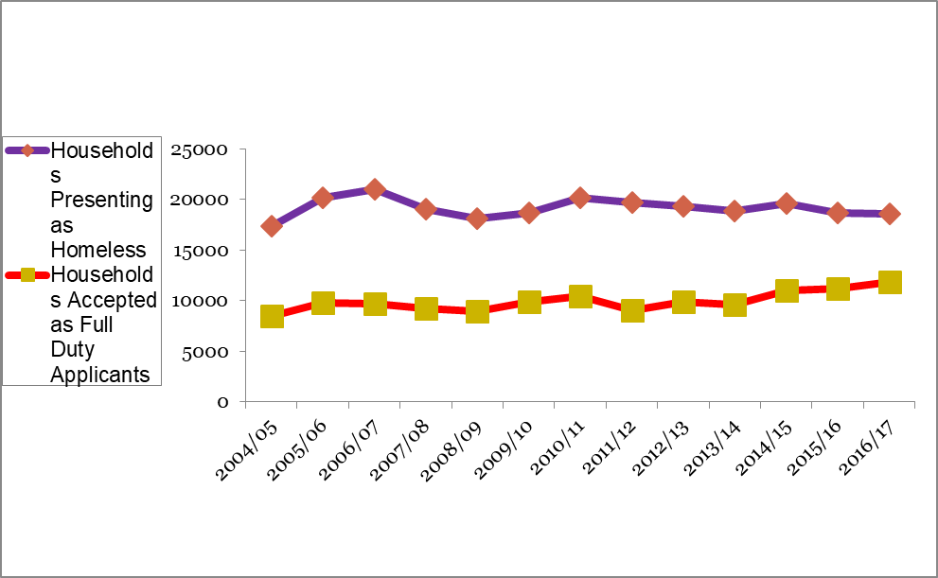

Slide 8
Headwinds and Risks
Current demand more than neutralising activity;
ONS Decision;
NIHE Stock;
Welfare Reform;
Current paradigm of resource and policy insufficient.
Notes:
So despite current interventions, housing stress continues to increase. This means that we need to critically examine our current activity and intervention in the entire housing system, and move to a more innovative supply strategy.

Slide 9
Turning the Curve – the PRS
PRS is growing fast – 11% in 2006, 17% in 2016;
People typically living in the PRS have changed;
Housing is typically poorer quality and older, with insecure tenure;
Very little new Supply from the PRS.

Slide 10
Review of the Role and Regulation of the Private Sector

Slide 11
PROPOSALS FOR CHANGE FULLY SUPPORTED
Ensure private tenants issued with written tenancy agreement
Review impact of CIH training course
Fund landlord advice line
Mandatory smoke & carbon monoxide detectors
Financial case for independent housing panel

Slide 12
PROPOSALS FOR CHANGE- HIGH LEVEL OF SUPPORT
Introduce regulatory framework for letting agents
Explore shared housing through Fresh Start
Develop tenant information pack
Restrict rent increases to once in 12 month period
Mandatory periodic electrical checks

Slide 13
PROPOSALS FOR CHANGE HIGH LEVEL OF SUPPORT
Properties built before 1956 subject to rent control
Introduce Fast Track Eviction
Greater involvement for Housing Associations in PRS
Gauge appetite of institutional investors
EPC rating of private properties to be higher than ‘E’ rating

Slide 14
PROPOSALS WITH DIVIDED OPINION
Change minimum notice to quit period from 4 to 8 weeks
Amend landlord registration regulations to incorporate fitness declaration at point of registration

Slide 15
Progress to Date
Landlord helpline pilot from January 2017
100% satisfaction rate
Permanent landlord helpline from September 2018
330 landlords/letting agents CIH level 2 certificate in Letting & Managing Residential Properties
Support for NICHA Rent to Own pilot

Slide 16
Further Work being considered
Development of a tenant information pack
Possible pilot of mediation service
Advice on letting agent fees to tenants
Refine policy papers for proposals which require legislative change

Slide 17
Houses In Multiple Occupation

Slide 18
Implementation Update
Houses in Multiple Occupation Act 2016;
Regulations in final stages of preparation;
Final Stakeholder engagement on proposals underway;
Preparation with Council Colleagues for transfer of functions well advanced;
Aim to transfer on 1 April 2019.

Slide 19
Conclusion

Slide 20
Our traditional policy responses are not proving effective;
The emergence of the PRS, the role it is taking and its characteristics form a part of that;
Our response needs to change and our review of the role and regulation of the PRS will take into account the need to increase supply and reduce housing stress;
Ultimately we need primary legislation to make substantial changes;
What can we usefully do in the meantime.

