Slide 1
Falling Behind
Exploring the gap between Local Housing Allowance and the availability of affordable private rented accommodation in
Northern Ireland
Dr Martina McAuley
Housing Rights
October 2019

Slide 2
Family Resources Survey Data – Tenure in NI

Slide 3
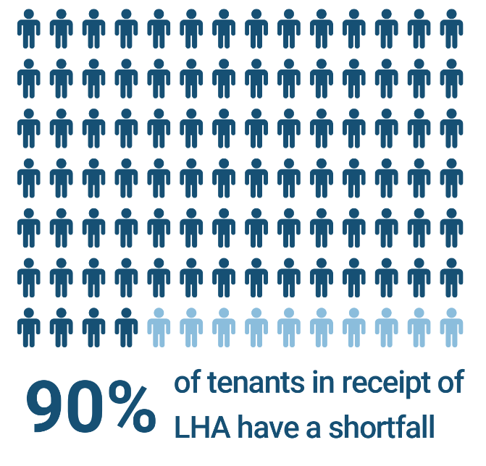

Slide 4
Shared Accommodation
One Bedroom
Two Bedroom
Three Bedroom
Four Bedroom

Slide 5
2008
LHA rates introduced
Cheapest 50% of market rents
2011
Reduced from 50% to 30% of market rents
5 property types
2012
2013
2015
Shared accommodation rate now applicable to single adults under 35 (previously under 25)
LHA rates capped at previous years’ value – up-rated by CPI inflation
LHA rates frozen
Subsequent up-rating for some rates only – up to 3% p.a.

Slide 6
Percentage of properties available at or below LHA rate by year

Slide 7
Percentage of properties available at or below the LHA rate by property type in all BRMA areas

Slide 8
Percentage of properties available at or below the LHA rate by property type and BRMA area
BRMA1 BRMA2 BRMA3 BRMA4 BRMA5 BRMA6 BRMA7 BRMA8
South North L Neagh N West S West S East L Neagh Belfast
Lower Upper

Slide 9
Percentage reduction in properties available at or below LHA rate by BRMA area and property type between 2009 and 2018

Slide 10
Comparison of average rent to LHA rate – all BRMAs - between 2009 and 2018

Slide 11
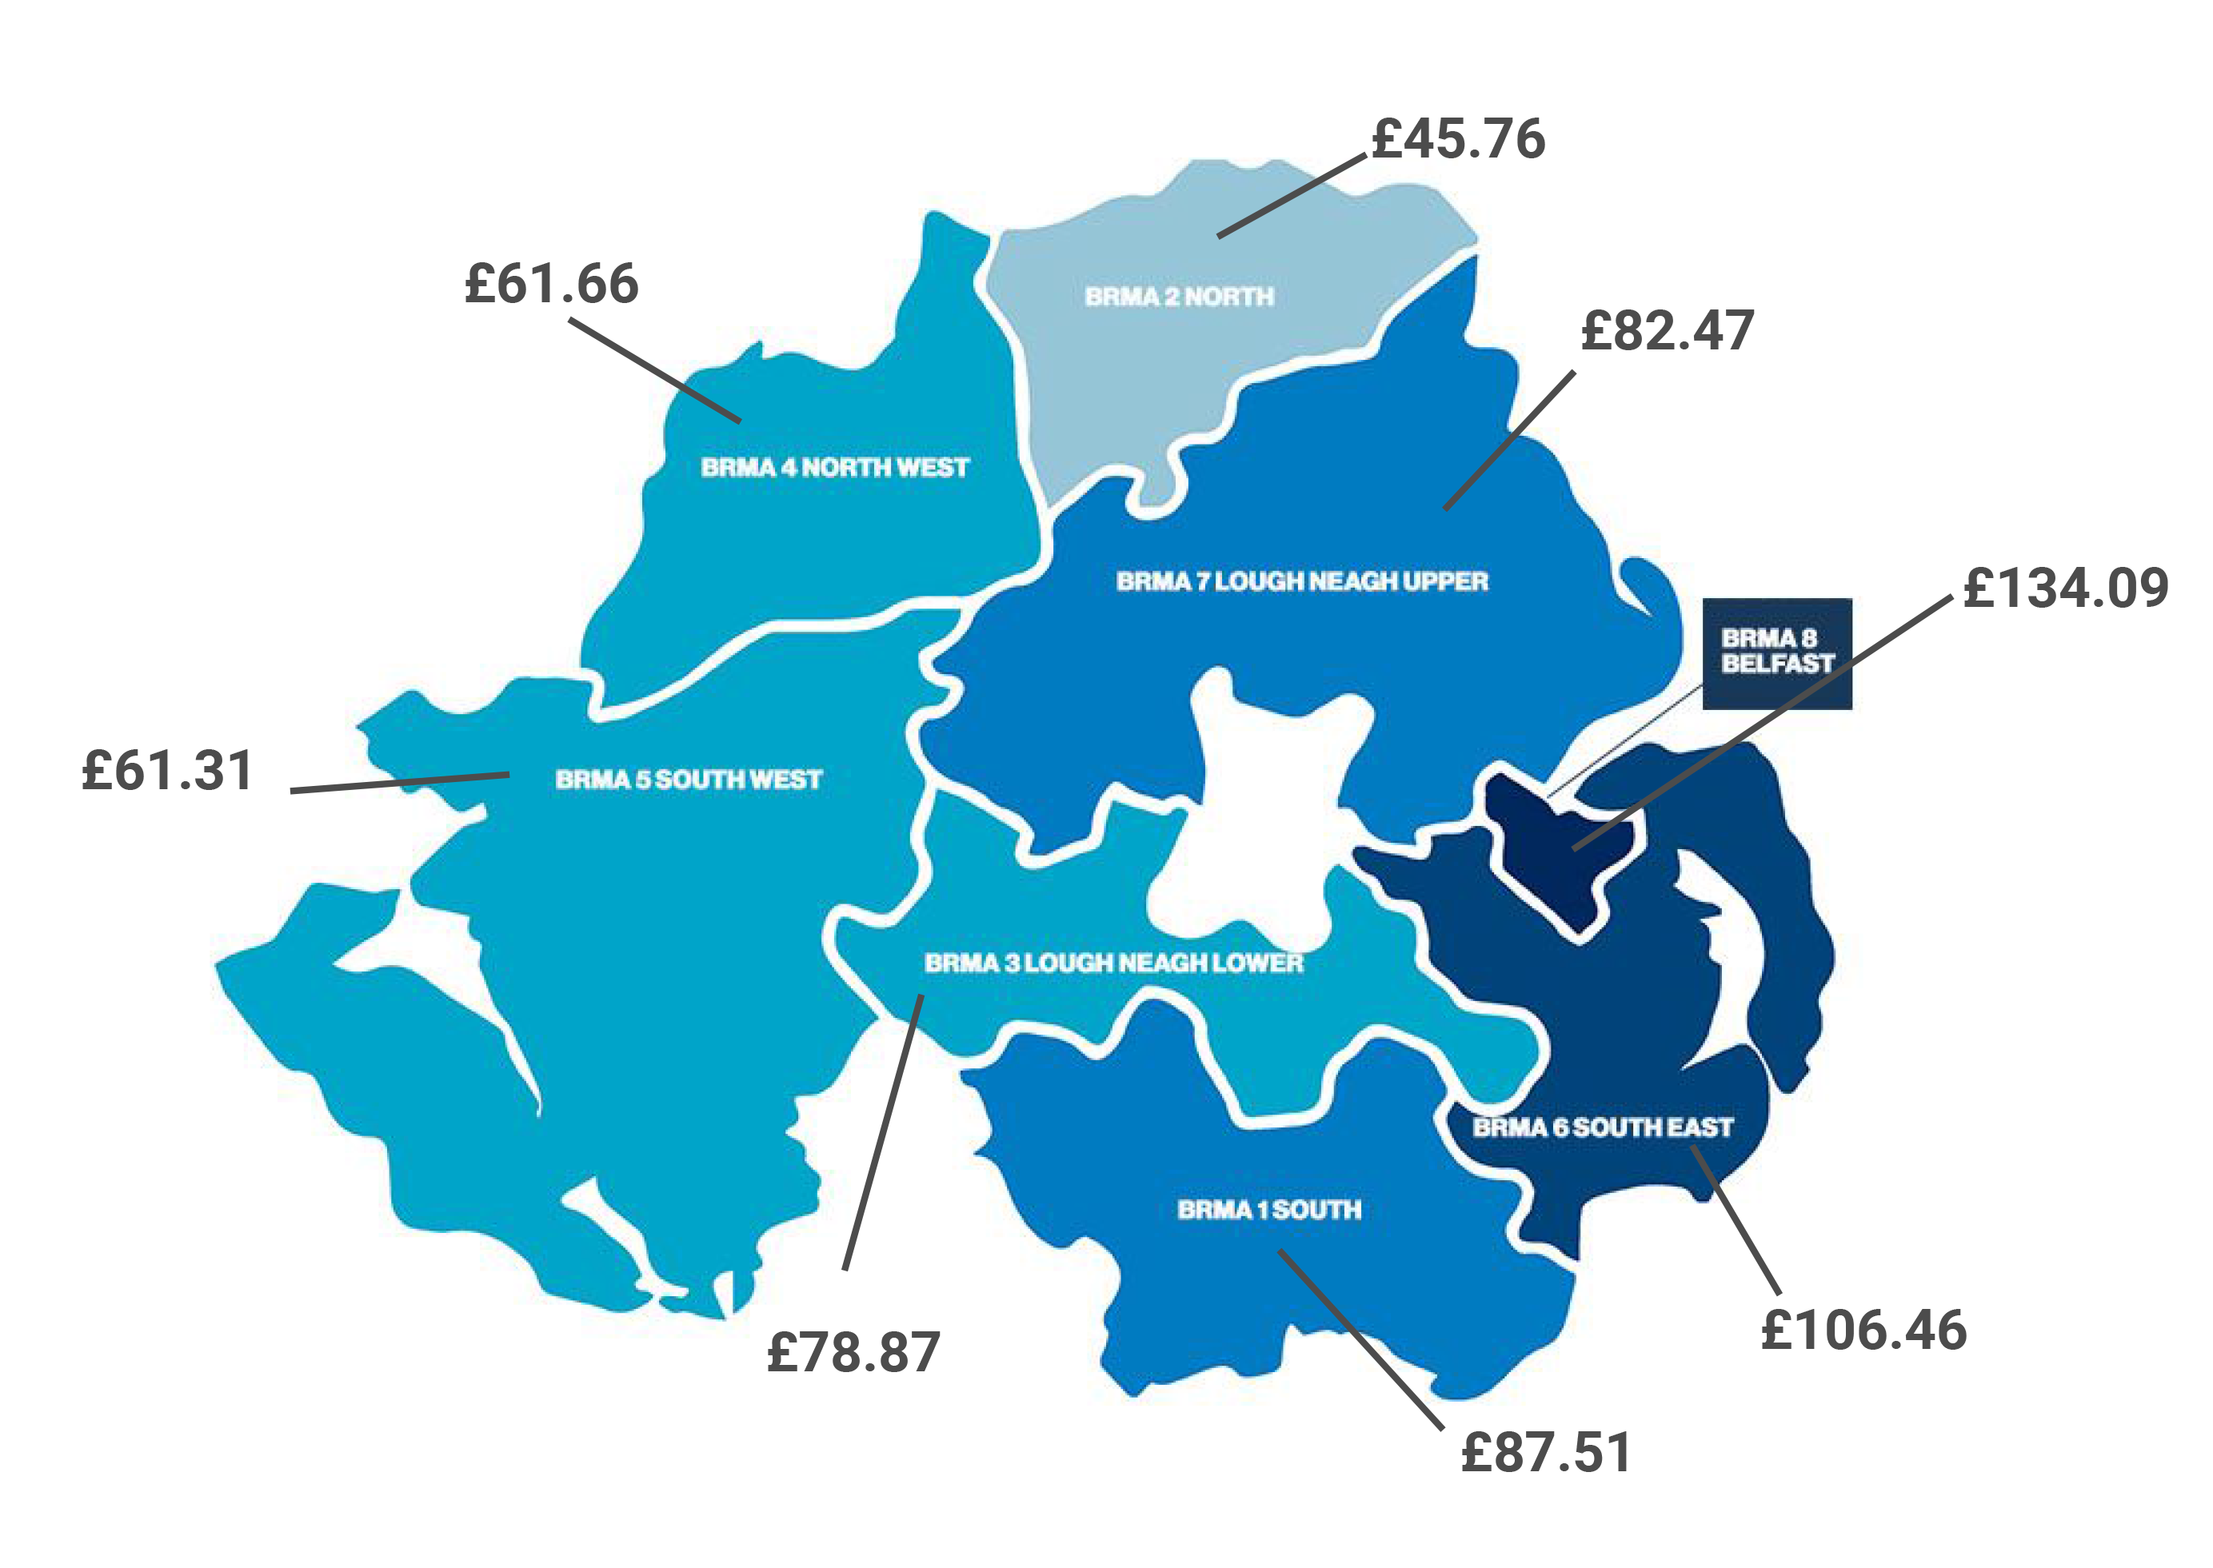
Shortfall between average monthly rents and LHA rates for all BRMA areas 2018

Slide 12
Rental at the top and bottom of the market – 2009 and 2018
 |  | Bottom 30% of Rental Market |  |  | Top 30% of Rental Market
BRMA | Property Type | 2009 Avg | 2018 Avg | % Diff | 2009 Avg | 2018 Avg | % Diff
2 North | 2 bed | £72.69 | £81.48 | 12 | £101.67 | £107.57 | 6
2 North | 3 bed | £81.04 | £91.28 | 13 | £104.24 | £118.52 | 14
4 NW | 2 bed | £77.46 | £91.49 | 18 | £109.72 | £117.83 | 7
4 NW | 3 bed | £86.31 | £96.53 | 12 | £116.23 | £129.08 | 11
6 SE | 2 bed | £83.65 | £93.44 | 12 | £133.26 | £135.93 | 2
6 SE | 3 bed | £90.40 | £103.39 | 14 | £138.71 | £159.09 | 15
8 Bfast | 2 bed | £85.04 | £94.63 | 11 | £142.37 | £143.49 | 1
8 Bfast | 3 bed | £91.58 | £104.71 | 14 | £147.25 | £170.89 | 16

Slide 13
Key Findings – analysis by postcode area
Analysis by Postcode area – 2018 rental costs and LHA rates
Detailed analysis by postcode area and property type
Analysis focused on proportion of properties available at or below the LHA rate and proportion of properties incurring at least £10 per week shortfall (based on CIH research)
No areas had more than 20% of available properties below LHA rate
Between 55% and 88% of all properties would incur a shortfall of £10 or more p.w.
E.g. BT12 – NO one bed or single room properties available at LHA

Slide 14
Percentage of all cases recorded from Housing Rights’ PRS clients which include enquiries relating to a shortfall between 2010 and 2017

Slide 15
Key Findings – qualitative data
Lived Experience
Data taken from HR Advice Pro over 8 years
Thematic analysis of case notes – all clients reporting ‘shortfall’
Low DHP compared to shortfall

Slide 16
Key Findings – qualitative data
Work
Related Issues
Age
Related Issues
Arrears and Debt
Market
Forces
Accessing Alternative Accommodation

Slide 17
Conclusions
Implications of LHA calculation
Impact of welfare reform on PRS tenants
Ability to sustain tenancies – impact on homelessness
Importance of context
Double movement

Slide 18
Falling Behind
Exploring the gap between Local Housing Allowance and the availability of affordable private rented accommodation in
Northern Ireland
Dr Martina McAuley
Housing Rights
October 2019

