Slide 1
Affordability in the owner occupied/mortgage sector
Mark Graham
Chief Executive of Co-Ownership

Slide 2
Jennie’s Co-Ownership Story
"We lived in a rental property for 8 years. As we have 3 children, we found it impossible to save a deposit… We both only work on temporary contracts so most banks wouldn't offer us a mortgage…
…a brand new home....it was the most incredible feeling, knowing that it was ours! It instantly felt like home… When we rented privately, we always worried that one day our landlord would sell.
This is our forever home …we would never have been able to do it without Co-ownership!!”

Slide 3
What do people think about home ownership?

Slide 4
“My landlord wouldn't let me paint my daughter’s bedroom pink”
“Some security for the kids, something to leave them”
“… but mostly it’s about security for me. With landlords you know they can pretty well chuck you out if the wind changes”
“I don’t want that for my children, growing up on a council estate that’s my background and I want better for them”
“It’s cheaper than renting”
“Paying some one else's mortgage”
“I’ve children, but I’m not allowed to have pets”

Slide 5
The rise and fall of home ownership

Slide 6
Tenures Trends in Northern Ireland

Slide 7
Home Ownership and Millennials

Slide 8
Housing Tenures in Northern Ireland
NI Housing Statistics 2017/18
Private rented
14%
Home ownership
69%
Social rented
16%
Co-Owner
ship
1.7%

Slide 9
Affordable for whom?

Slide 10
Co-Ownership Prices 1970 - 2016

Slide 11
Bank of England Interest Rates
1973 to 2019

Slide 12
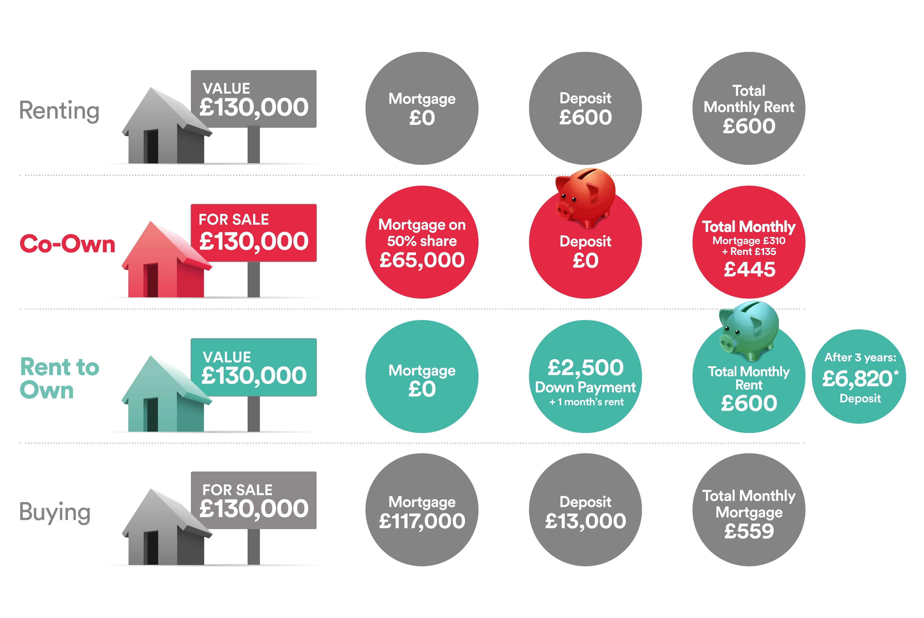
Assessing Affordability

Slide 13
Other barriers to getting a mortgage
Deposits
Employment
status
Debt

Slide 14
How governments have intervened to increase home ownership
Shared Ownership
Equity Loans
Rent to Own
Help to Buy ISA
Starter Homes

Slide 15

Housing Options
Social Housing
Private Rented
I want a home. I am currently employed & my annual earnings are less than £26,000.
Shared Ownership
Home Ownership

Slide 16
Co-Ownership Customers Age Range 2018

Slide 17








Co-Ownership Household Composition 2018
39% single persons | 22% couples | 29% couples with children | 9% single parents

Slide 18
Co-Ownership Incomes 2018
Average Household Annual Income £30,000
Average Applicant Annual Income £21,000

Slide 19
Co-Ownership Previous Tenure 2018

Slide 20
An aging population

Slide 21
Creating a housing system that works for everyone

Slide 22
An effective housing system is …
Affordable
High quality
Secure
Accessible
Sustainable

Slide 23
Thank You

