Slide 1
Delivering Genuinely Affordable Homes
Monday 14th October 2019
Skainos Centre
Belfast

Slide 2
Planning for affordable housing:
the challenge for local government

Slide 3
Overview of presentation
Context
Current local government activity
The challenges we face
Moving forward - What do councils need?

Slide 4
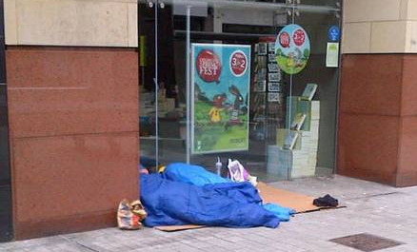

Slide 5
Context
Brexit
Austerity/Instability at Westminster
1000 days with no Assembly, inadequate governance
Inadequate financial models eg for NI Water
No route for new/amended legislation
Poverty, homelessness, end of welfare mitigations

Slide 6
Current Local Government Activity
11 community plans in place – first progress reports Nov 19
11 local development plans underway – all at slightly different stages
Confidence/performance improvement on development management in most areas - some delays on major applications

Slide 7
Current Local Government Activity
Shift in focus to place-shaping/place-making
What do we want our places to look like?
How do we work across internal silos and with partners to deliver ‘on the ground’?
Preparation for ‘Whole System’ audit – opportunity to improve

Slide 8
The challenges we face
Cultural change – moving to a plan-led system – pressure to build individual houses in the countryside
Ensuring our data is accurate and relevant – e.g. HGIs
Uncertainty re plan ‘soundness’ – new system and also e.g. due to transport plans

Slide 9
The challenges we face
Community activism – positive and negative
Stigma associated with social housing
Pressure from developers to maximise profit
Elected member understanding of and adherence to policy (MLAs and Cllrs)
Meeting need v meeting policy aspirations

Slide 10
The challenges we face
Impact on land value of council decisions
Lack of ‘room’ to try new things: trial and error can lead to ‘trial by media’
Political confidence in councils becoming ‘too involved’ in housing – limits possibility
Local decision-making can lead to perceived lack of consistency

Slide 11
Moving forward - What do councils need?
NILGA and councils’ views on the recent consultation on definition of affordability strongly aligned to that of Housing Rights.
Much more work is needed to address the issues for housing supply and delivery in NI – for all tenures
NILGA will be lobbying strongly to overcome the spiralling infrastructure deficit – roads, water

Slide 12
Moving forward - What do councils need?
To improve council delivery times, we need better resourced partners – particularly statutory consultees and the PAC
When we eventually get some form of government that can legislate, we need a review of planning legislation – primary, secondary – as well as strategic policy - to ensure any glitches in the system are removed

Slide 13
Moving forward - What do councils need?
Please engage with your local council, in the preparation of the LDPs, in implementation of the community plans, and in the planning application process
To innovate, we need to collaborate

Slide 14
Thank you
Karen Smyth
K.smyth@nilga.org
(028)90798972
@ksmyth2010

