Slide 1
Affordability in the context of social housing A view from Rethinking social housing NI Justin Cartwright Cert CIH National director NI Chartered Institute of Housing

Slide 2
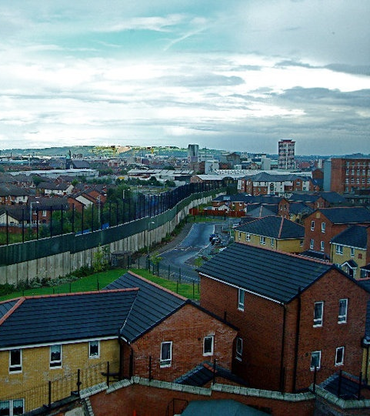
Exploring the NI context
Unique political and policy context
Traditional housing market and local strategic housing policy much unchanged this century
There is a change context
Notes:
Change context:
social security policy – welfare reform, universal credit
review of housing allocations policy
proposals for change in PRS policy – social housing and private is interlinked
reclassification and implications for ‘RTB’
changing profile of tenants – older, economically inactive, disadvantaged groups

Slide 3
What did the project show? People told us…
Themes raised by research participants | %
Creating security and stability – primarily in terms of a home for life, but also homes that are safe | 74%
Housing that is about meeting need, or is for people in need | 73%
Affordability or housing that is low cost | 69%
Notes:
Creating security and stability – primarily in terms of a home for life, but also homes that are safe – was raised in 74 per cent of responses. Secure tenancies were seen as central to maintaining communities. Some people considered security of tenure as an important factor in creating a sense of ‘home’ and ‘ownership’, as well as a foundation upon which tenants were able to build their lives.
Housing that is about meeting need, or is for people in need, was mentioned in 73 per cent of responses. However, here was no strong and consistent view about the definition of need. A number of people raised arguments that there is insufficient allocations priority at present for people in financial need such as those paying expensive market rents.
Affordability or housing that is low cost was raised by 69 per cent of participants. While people participating in the research did not explore the definition of affordability, several responses highlight the relationship between affordability and/or rent levels and: state assistance (capital subsidies, social security/welfare reform); the not-for-profit status of social landlords; and community stability.
Others:
Building and maintaining a community including through social and tenure mixing was mentioned by 63 per cent of participants. There was a good amount of commentary around what those communities should look like. ‘Sustainable, mixed’ communities that feature income, social and religious mixing were seen as desirable, including as a way of addressing the relationship of social housing to community segregation.
Good quality housing, including high standards and well-maintained homes, came up in 54 per cent of responses. Many people discussed what good quality means to them, including standards and design. In relation to design, differences in appearance between social and private housing was raised as contributing to a ‘stigma’ surrounding social housing.
Housing that is or should be for everyone was raised by 53 per cent of participants. There is a tension evident in the research between social housing being for people in need and social housing being for everyone. In some responses ‘everyone’ referred to universal access, with allocations still made on the basis of need. However other participants want to see a broader mix of tenants living in social housing.
Housing that interacts with the private sector, such as stepping in to fill gaps in the market or enabling home ownership through the house sales scheme (right to buy), came up in half of the responses. Social housing was seen as part of a housing system. Sometimes its nature and value was defined as ‘what the private sector might not have’ such as tenure security, affordability and quality. There was also commentary around the house sales scheme, on which opinion was very much split.

Slide 4
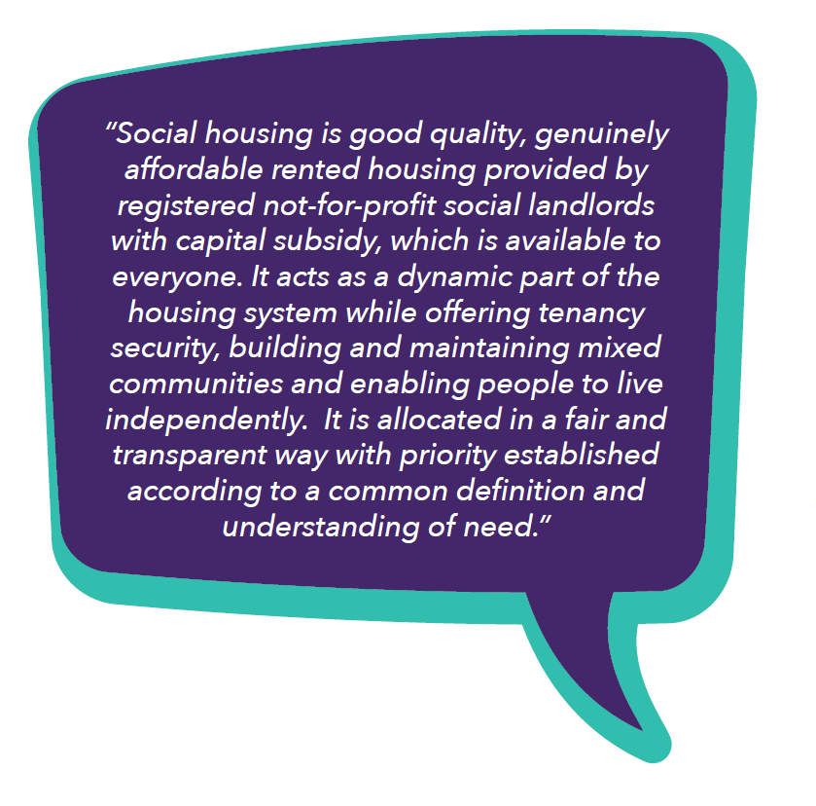
CIH’s definition for NI
Notes:
Based on the evidence review and research findings, we offer this definition of the future role and purpose of social housing in Northern Ireland for government, the housing sector and related sectors to consider.
“Social housing is good quality, genuinely affordable rented housing provided by registered not-for-profit social landlords with capital subsidy, which is available to everyone. It acts as a dynamic part of the housing system while offering tenancy security, building and maintaining mixed communities and enabling people to live independently. It is allocated in a fair and transparent way with priority established according to a common definition and understanding of need.”
But how do we ensure social housing fulfils this role and purpose?
During the project we were constantly told about the value of social housing. We were reminded of the major role it plays in improving public health, reducing poverty and building a strong economy.
However we were also challenged by the areas where change is required.

Slide 5
Recommendations for change
Supply
Mixing
and stigma
Eligibility and priority
Security and independence
Notes:
Supply
Fundamentally, for social housing to be available to more people, its provision needs to be subsidised, more of it needs to be built and more existing stock needs to be retained.
Provide the investment in social housing required to reduce housing stress
End the right to buy
Mixing
Social housing and what is offers was valued by research participants. At the same time they do not want to see large, single-tenure social housing estates being built. Instead, mixed-tenure developments are valued as they are seen to support sustainable communities. They can also facilitate a mix of people from different community and income backgrounds.
We believe a ‘whole system approach’ to social housing is needed that also serves to tackle the stigma and false perceptions surrounding the tenure. It is important that social housing works better with the private sector generally.
Implement systems of planning obligations for social and affordable housing
Challenge negative perceptions through educating the public on the benefits of the regulated social housing sector
Eligibility and priority
There was a strong sense in the research that people believed everyone should be eligible for social housing, while almost three quarters of people said that social housing should meet need or be for people in need. Many participants felt that greater priority should be given to people with certain needs, such as people in financial need (for example, those paying expensive market rents).
preserve universal access and adopt a common definition and understanding of need
Security and independence
We support secure tenancies and their function as a suitable approach that plays a vital role in maintaining communities, enabling tenants to enjoy a sense of place without fear of unreasonable tenancy termination and the stress that this can induce.
At the same time, security of tenure does not have to mean remaining in the same property indefinitely – social housing providers require flexibility in pursuit of tenancy sustainment and good stock management, particularly in the context of welfare reform. We therefore support the principle of ‘security of tenancy’ to reflect the distinction.
Participants also saw tenant participation as an important tool in sustaining communities. In our view, participation is also an important tool in enabling tenant independence through empowerment.
protect security of tenancy within social housing but review relevant policy and practice to ensure there is flexibility to relocate for sound housing management reasons
enable tenants to live independently, including through support where tenants want or need it, while avoiding paternalistic approaches
promote tenant empowerment through participation.
Copies of the report are available.
Some of these recommendations have been taken up or are being worked on. Others need further development.

Slide 6
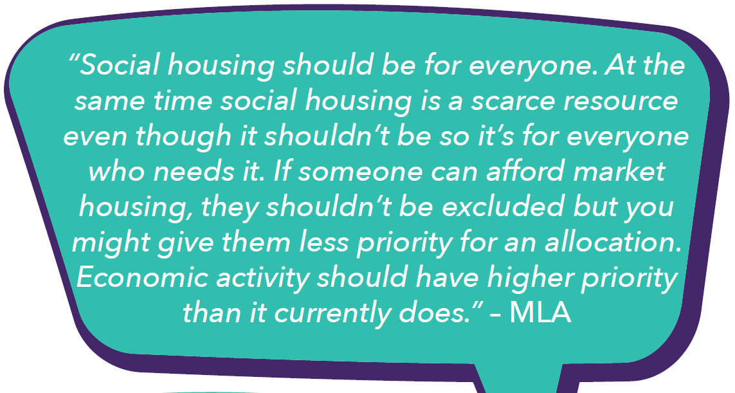
Recommendations for change
Eligibility and priority
CIH recommends that central government preserve universal access and adopt a common definition and understanding of need.
Notes:
Prime candidate for further development.
Acknowledge department’s allocations review. CIH Northern Ireland is generally very supportive of the departmental recommendations. Furthermore many of them serve to address some of the issues that research participants raised. The proposals would:
• preserve universal access
• maintain needs-based allocations, while applicants with similar levels of need are allocated a home based on the time spent on the waiting list through a hybrid points-banded system – this could increase fairness and transparency, helping to address ‘points chasing’ and perceptions of ‘queue jumping’
• abolish intimidation points, which many stakeholders consider a perverse incentive that is abused, for a fairer and more proportionate approach to addressing intimidation.
“Social housing should be for everyone. At the same time social housing is a scarce resource event though it shouldn’t be so it’s for everyone who needs it. If Someone can afford market housing, they shouldn’t be excluded but you might give them less priority for an allocation. Economic activity should have a higher priority than it currently does.”

Slide 7
Next steps – working groups
Supply and mixing
Eligibility, priority, security and independence
Notes:
Supply and mixing – Niall Sheridan
Mention dropping stigma and benefits to society report.
Eligibility, priority – Eileen Patterson
Anna Lancaster and John Lewis – Housing Executive
Group of people from across the sector as a sounding board

Slide 8
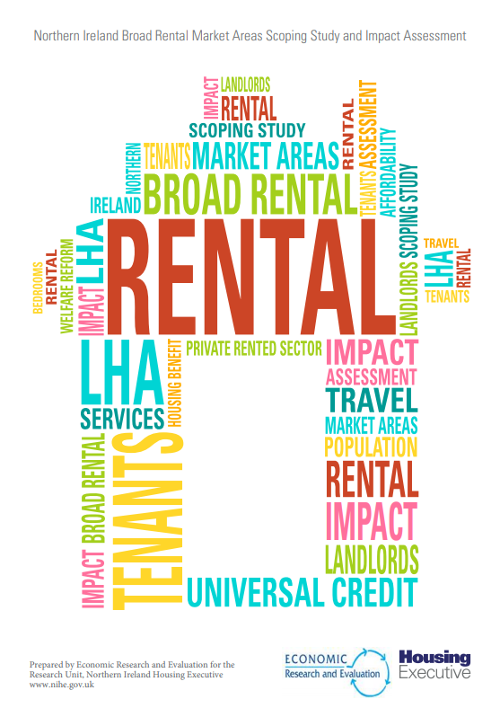
Local housing allowance
Notes:
Even with a substantial increase in social housing supply, it will not be available for everyone on the waiting list. There is clearly a gap in the housing market for more rented housing options that are affordable for lower to middle income working households.
There is interplay between LHA rates and intermediate options if they are priced by LHA, which may affect viability from the outset. LHA affordability outlined by Housing Rights.
Presentation from Karly Greene at NIHE on analysis to inform BRMAs. Outline background to research – CIH recommendation from LHA report. Need to be mindful of potential impacts on urban areas.

Slide 9
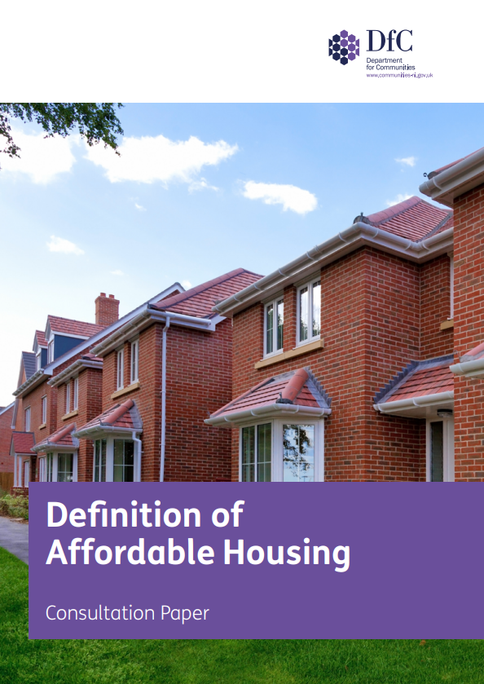
Affordable housing definition
Notes:
We believe the current definition for planning purposes needs to be amended, to facilitate more intermediate housing. However, the current proposal to collapse social and intermediate housing together in an overarching definition of affordable housing risks lines being blurred, and the distinction between social and intermediate housing – which meet very different kinds of need – being lost.
It’s about how it’s implemented by councils. Can’t be at expense of social housing.
We are concerned that defining shared equity homes – for example homes purchased through Help to Buy – as affordable housing could weaken the ability of councils to facilitate more genuinely affordable options.
Tom and Steve here today to talk options

Slide 10
Mixed-tenure and tenure blindness
Example – percentage contribution of plots
Housing association builds / purchases property on plot(s)
Tenure blindness
Levy on landowners?
Notes:
Mixed-tenure… how do we do this in practice?

Slide 11
Mixed-tenure and tenure blindness
Example – Hertsmere Borough
Regional thresholds apply for affordable housing
Qualifying sites allocate in the region of 25% of all dwellings or land
Difference between cost of development and price paid by HA is contribution from the developer
Notes:
Mixed-tenure… how do we do this in practice?

Slide 12
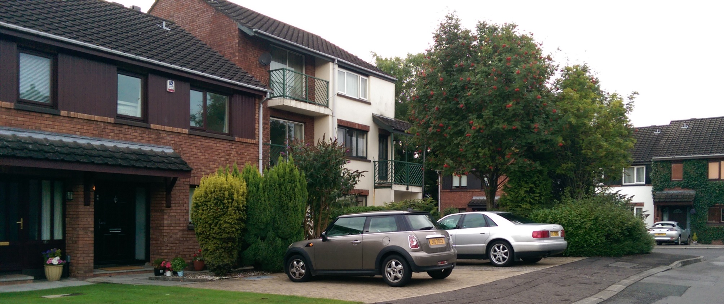
Mixed-tenure and tenure blindness
“[Affordable housing] units should be dispersed across the development. … The design and external appearance of the affordable housing element should, as far as possible, be similar (if not identical) to the remainder of the development and be well integrated into the overall layout to create a tenure blind development.”
Notes:
Mixed-tenure… how do we do this in practice?
Point about subsidised housing. Can’t have affordable, subsidised housing without subsidy

Slide 13
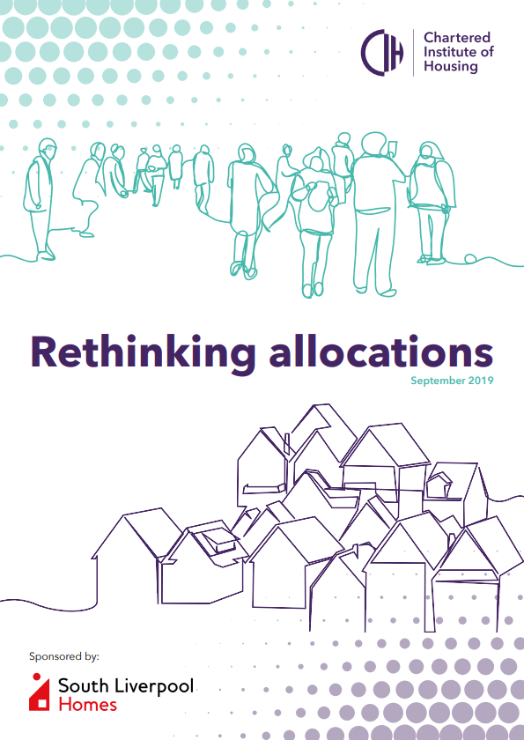
Allocations
England context
Rules and processes on access to social housing could be failing people in greatest need
Faced with not enough genuinely affordable homes, councils and housing associations are forced to ration – the way they allocate these homes can exclude some very vulnerable people
Notes:
Second working group…
Pre-tenancy affordability assessments debate. Define debate. Welfare reform context. NI is holding up its side of the bargain on the capital side, but successive UK governments have failed to offer people enough support through the social security system, housing practitioners are working in this context.
Rethinking allocations – need to put people before process when allocating social housing
Ideally wouldn’t be having the debate. BUT could be a false dichotomy where assessments do not fail people in greatest need.

Slide 14
Pre-tenancy affordability assessments
Hull City Council practice
Assessments flag applicants’ affordability as green, amber or red
Applicants flagged as red are signposted for further assistance – offers cannot be withdrawn without head of service approval
Notes:
Hull City Council – example of support framework. Important: staff carry out home visits to conduct the assessment, it is not self-fulfilled
The assessments flag applicants’ affordability (the measure of which is quite low), as either;
• Green – the tenancy is affordable and there are no concerns
• Amber – there are areas the applicant may need support with to ensure the tenancy is, or will remain, affordable
• Red - based on the applicant’s current financial circumstances, the tenancy is not affordable
Hull have put in place safeguards to ensure that applicants who are flagged as red are signposted for further assistance and offers cannot be withdrawn in these circumstances unless approved by their head of service.

Slide 15
Pre-tenancy affordability assessments
Hull City Council practice
Where a statutory duty is owed or in urgent situations, applicants flagged as red are rehoused, and referred to tenancy sustainment team with tenants’ agreement
To date, no offers have been withdrawn
Notes:
Where a statutory housing duty is owed or in urgent situations, they will rehouse people whose assessment outcome is ‘red’ and refer, where people agree, to their tenancy sustainment team to ensure they have the best opportunity for their tenancy to succeed.
To date, they have not withdrawn any offers of accommodation based on the outcome of an affordability assessment.
They have found, in most circumstances, there is something that can be done to improve the applicant’s financial position, or the applicant themselves will decide to look at other housing options once they understand the full costs associated with the prospective tenancy.
Only two applicants in past year have come out red and through work they were converted to amber

Slide 16
Choice-based lettings
Notes:
Report
Explain CBL. If people are choosing a property they want, they’re less likely to refuse it once it’s allocated. So it can bring down void and re-let times while giving prospective tenants more of a say in where they live. Work to ensure vulnerable households are not excluded.
CBL developed from initiatives in the 90s by CIH and a group of local authorities and housing associations in England. One of the messages that comes from that early work is the importance of the way in which councils and housing associations worked together to develop a system that met local needs. It was ground up.
The lessons from this is a ‘one size fits all’ system certainly shouldn’t be forced on housing providers. It has to be voluntary, or providers have to have a major stake in the system design for their areas. In NI providers should be given the option.
The link between CBL and affordability – provider, bedroom tax

Slide 17
Choice-based lettings
Notes:
60 second video

Slide 18
Next steps
Finalise recommendations with support of working groups
Opportunity for CIH members to influence
Which recommendations would you take forward?

Slide 19
Thanks for listening
@JustinCar1 | justin.cartwright@cih.org

