Slide 1


Making Housing Matter
5 July 2016, Skainos Centre

Slide 2






UK Partners

Slide 3
Inspiring Impact promotes Impact Practice:
Not another measurement tool:
A strategic planning process that helps you think through all the things you should be doing to demonstrate your impact.
Plan
Clarify what impact you want to have and develop an ‘impact plan’ to enable you capture this
Do
Identify and apply appropriate measures & tools that best suit your evidence needs
Review
Learn from & communicate findings -> improve future programmes/ practice
Assess
Analyse data you gather and draw honest conclusions about impact (or otherwise)

Slide 4
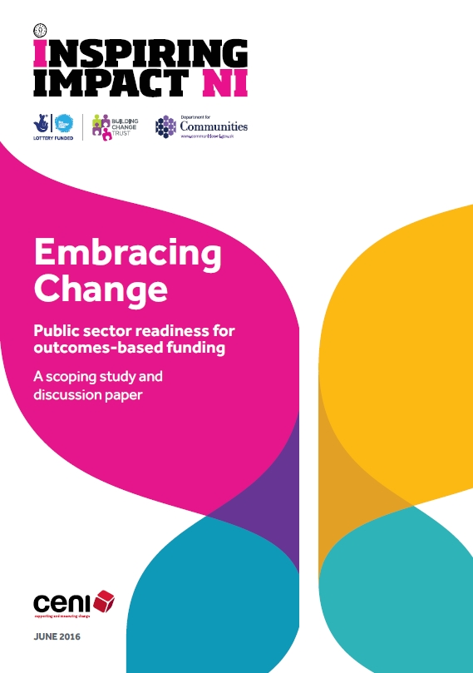

Slide 5
Recommendations
Support people to understand concept & language.
Develop their skills to deliver
Examine systems that account for programmes / expenditure
Adapt to fit to outcomes approaches
Apply demonstration projects
Share learning
Adapt

Slide 6
Jargon Buster
Activities
The actions, tasks and work a project or organisation carries out to create its outputs and outcomes, and achieve its aims.
Eg. One-to-one reading courses for people with low literacy levels
Outputs
Products, services or facilities that result from an organisation’s or project’s activities.
Eg. No. of one-to-one reading courses run / No. of people in attendance.
Outcomes
The changes, benefits, learning or other effects that result from what the project or organisation makes, offers or provides.
Eg. Individuals with poor literacy are able to read better.

Slide 7
Hard outcomes
Outcomes that are clear and obvious, or which involve an external change in people’s behaviour or circumstances.
Eg. A user of our reading classes becomes literate.
Soft outcomes
Outcomes that are less easy to observe or measure, or which involve some form of change inside people, such as a change in attitude or a change in the way they see themselves.
Eg. People with poor literacy improve their self-confidence as they learn to read.

Slide 8
Indicator
Well-defined information which shows whether something is progressing (EG literacy levels).
A client completing the reading course is an indicator that a service was delivered, but not of whether the client has reached the literacy level desired (the outcome).
Confusion between indicators & the outcome
Outcome: People achieve a level of literacy that allows them to function independently.
Indicator: Reading age indicates the level of literacy; a reading age of 16 indicates that they are literate enough to lead independent lives.

Slide 9
PfG Outcomes approach
Adopting an Outcomes Based Accountability (OBA™) model
Outcome = state of wellbeing for entire population
Eg. All children are healthy & educated
Below that (service level) – Performance Measures
Eg services delivered by partners to achieve this: hospitals & schools but also VCSE organisations

Slide 10
PfG Outcomes approach
1. Population Level –
Outcomes – high level / cross-departmental etc
Govt held accountable on these: Population Accountability
ie are more children healthy and educated per chosen indicators?
2. Performance Level
Not held responsible for delivering outcomes – its about your contribution and this is gathered through:
Performance Measures
Numbers & Percentages that add up to ‘turn the curve’

Slide 11
Concerns
Prioritising of quantitative over qualitative data
Everyone becomes creators of data for turning NI-wide curve
One measurement model doesn’t fit every situation
Outcomes should not be only about numbers & quantities
Outcomes for people, specific groups & communities
Outcomes on improving processes & practices
Outcomes that improve equality & quality of service
Soft outcomes essential for hard outcomes to happen

