Slide 1
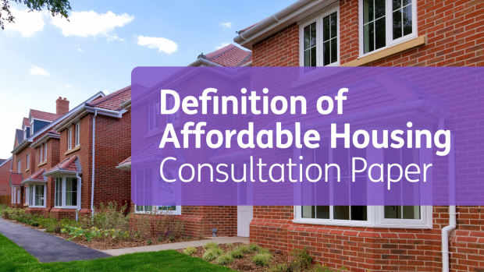
DEFINITION OF AFFORDABLE HOUSING NEXT STEPS FROM THE CONSULTATION David Polley Director Housing Supply Policy and Delivery

Slide 2
DfC - OUR COMMON PURPOSE
SUPPORTING
PEOPLE
BUILDING COMMUNITIES
SHAPING PLACES

Slide 4
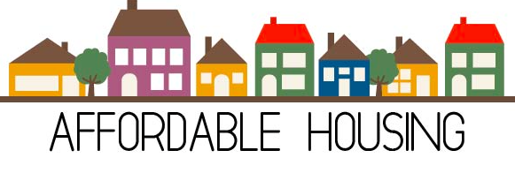
Definition – Proposed
“Affordable housing is housing provided for sale or rent outside of the general market, for those whose needs are not met by the market.
Affordable housing which is funded by Government must remain affordable or, alternatively, there must be provision for the public subsidy to be repaid or recycled in the provision of new affordable housing.”

Slide 5
AFFORDING HOUSING
House Prices
Income
Rents
Social Housing
Private Rented Sector
Housing Benefit/LHA

Slide 6
Interventions
Affordable (Mid Market) Rent
Shared Ownership
Role and Regulation of the PRS
Housing Development Grant

Slide 7
AFFORDABLE HOUSING
Families
Communities
People
Range of products
Meet needs
Carbon Neutral
Affordability
Financing
Partnership Delivery
Responsive
Flexible
Ageing Population

